Slide 1
MAKING SENSE OF PURPOSE, SUSTAINABILITY, ESG AND GOVERNANCE:
An essential shared map for transformative leadership
Dr Victoria Hurth
review all the tools at: www.victoriahurth.com

Slide 2
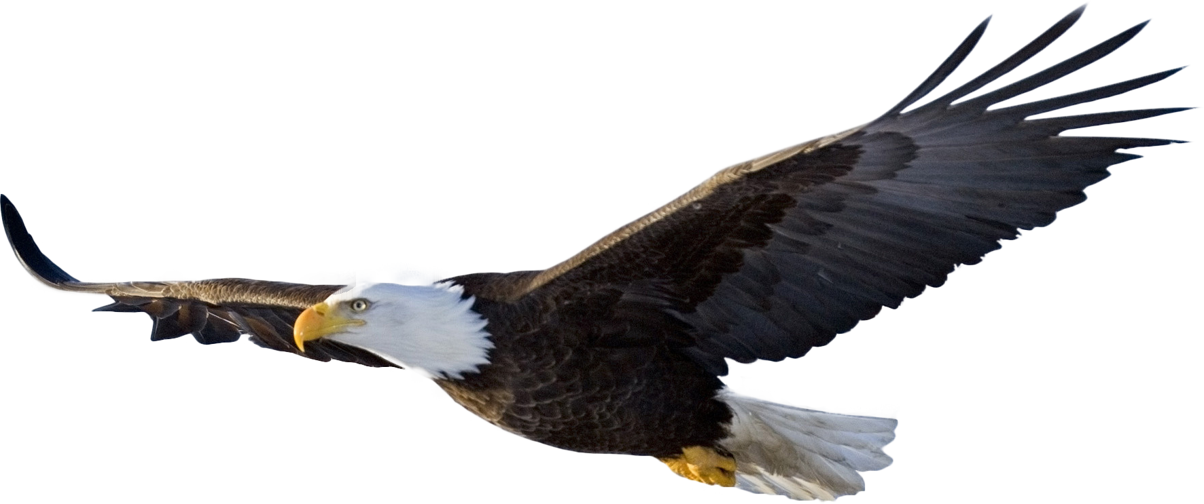


Slide 3
key takeaways:
Unsustainability is one massive governance failure at all levels - based around a false assumption that financial income is a good proxy for wellbeing outcomes and that financial capital is the main resource to protect and enhance
We will not achieve sustainability without fixing this failed governance. ESG is an imperfect ‘do no harm’ agenda but not enough – we need hyper-innovation.
BOTTOM LINE: Either we transform governance for a ‘Wellbeing Economy’ and Purpose-Driven Organizations, driven by Meaningful Work and Lives or we will lose benefits of the market economy

Slide 4
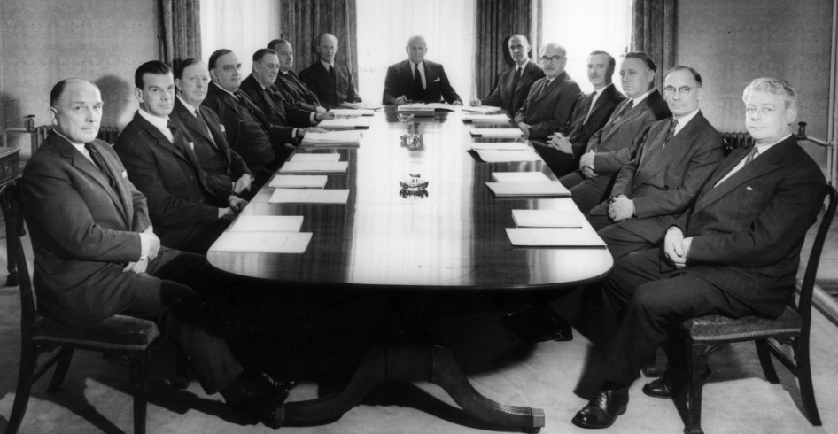
our mistakes. our choice.:
the existing
UNSUSTAINABLE
market economy
the emerging
SUSTAINABLE
market economy
OR
objective = financial goals =
long-term wellbeing for all
objective =
long-term wellbeing for all people and planet
THE NON-MARKET ALTERNATIVE
MACRO:
A GDP Economy
MACRO:
A Wellbeing Economy
Command-and-Control Economy
MESO:
Profit-Driven Organizations
MESO:
Purpose-Driven Organizations
?
MICRO:
Financially-driven
work and lives
MICRO:
Meaningful
work and lives

Slide 5
economy = wellbeing = sustainability
economy: “allocating the resources available to society in a way that maximizes social wellbeing” (Goodland and Ledec, 1987)
wellbeing: “positive state of being where current and future needs are met, such that there is the capacity and opportunity to flourish” (BS 8950:2020, 3.7, adapted)
sustainable development: “development that meets the needs (wellbeing) of the present without compromising the ability of future generations to meet their own needs” (WCED 1987)
THE SHARED OBJECTIVE: LONG-TERM WELLBEING FOR ALL (SUSTAINABILITY)

Slide 6

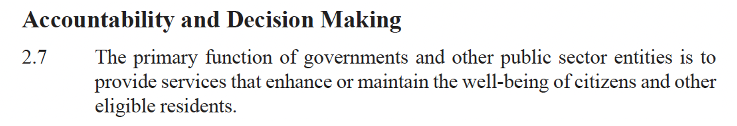
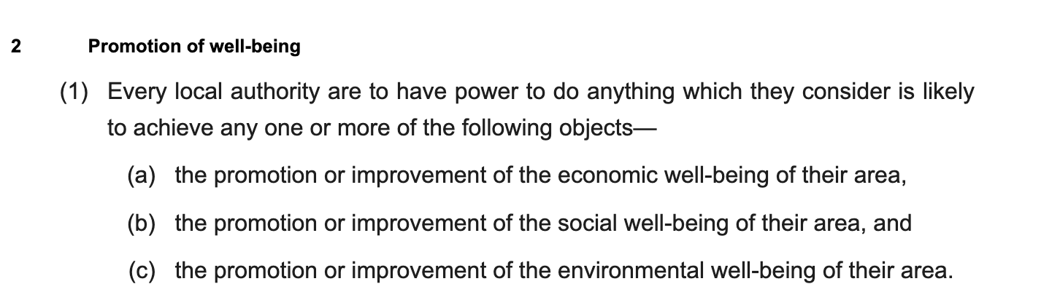
sustainability = the object of those that govern companies
UK Local Government Act 2000 – purpose of Local Authorities (Corporations):

Slide 7
so…the economy should have been delivering long-term wellbeing for all (sustainability)
yet…..

Slide 8
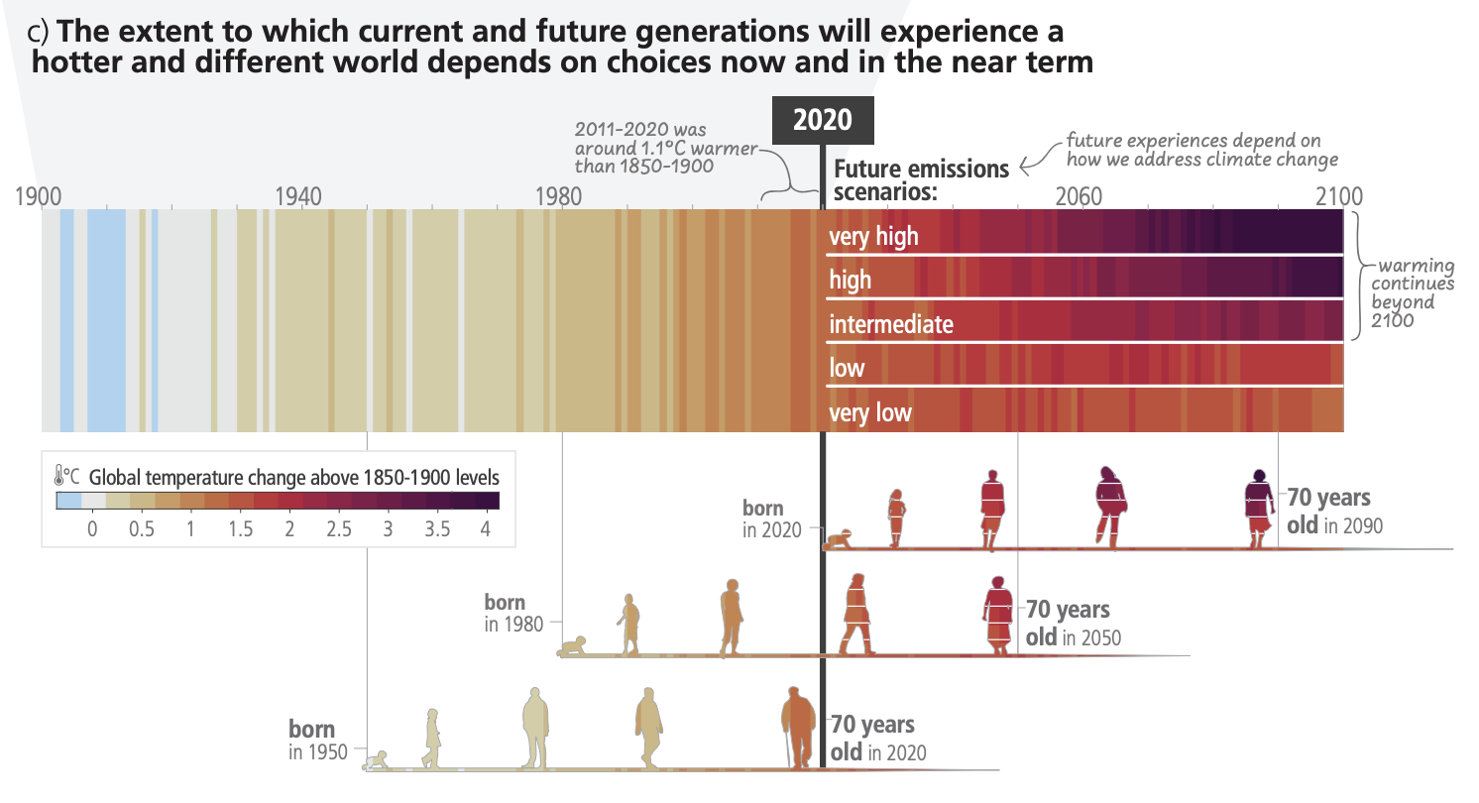
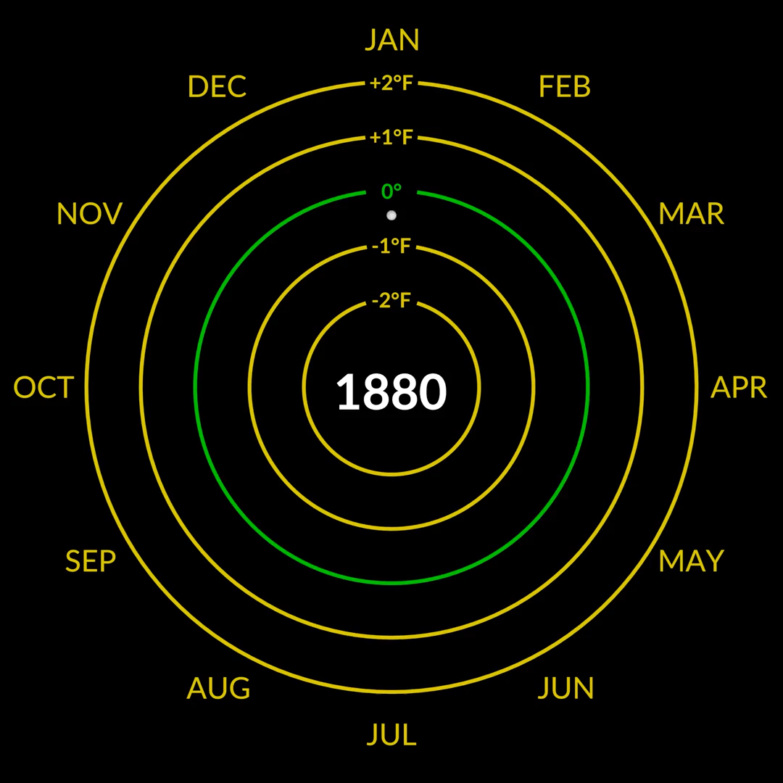
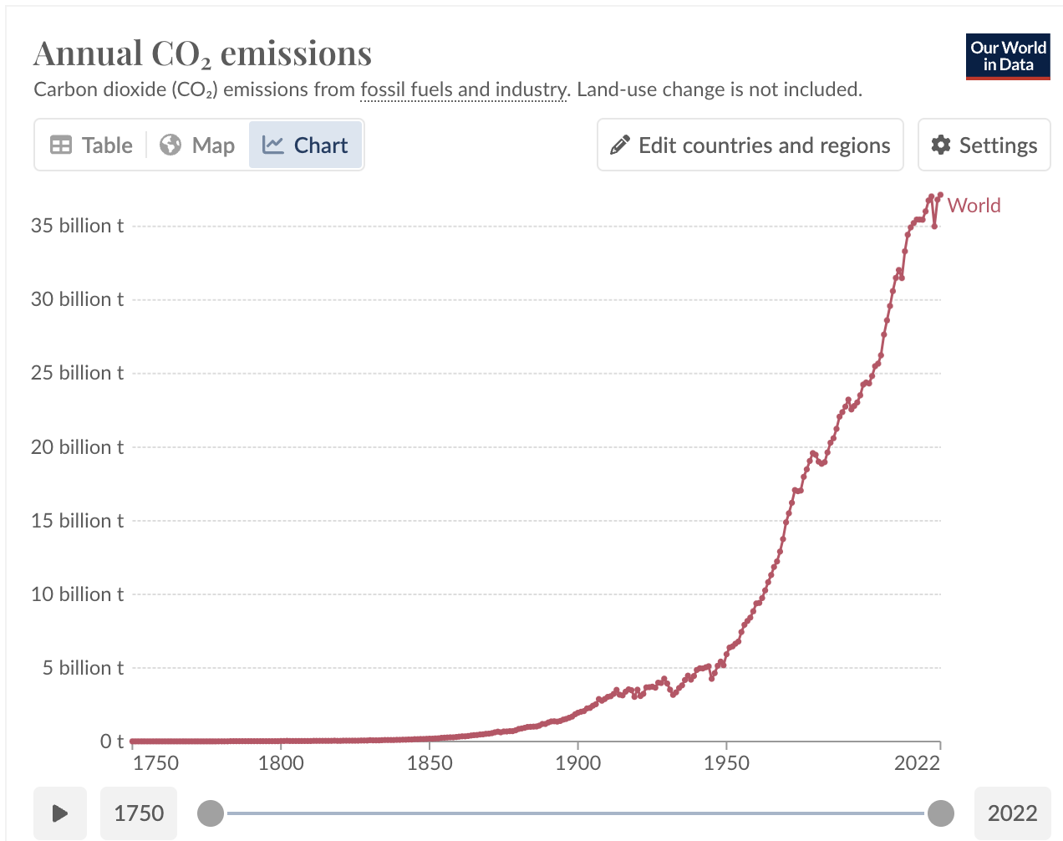
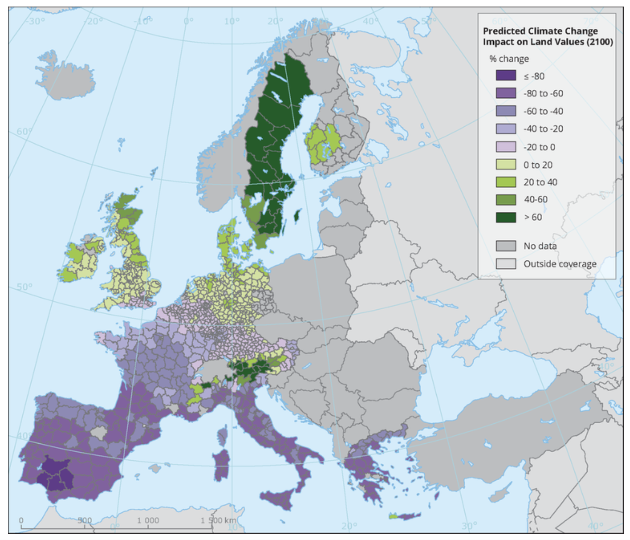

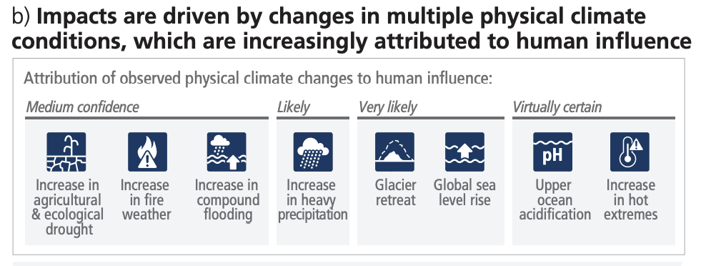
climate collapse
Predicted Climate Change impact on land values (2100)
“In the five years since the Paris Agreement…Fossil fuel financing was, more prevalent” than before
Persefoni, 2023
“Italy has the largest aggregate loss of farmland value, losing around 100 billion euro (−60%).”
https://www.eea.europa.eu/data-and-maps/figures/predicted-climate-change-impact-on
https://content.persefoni.com/hubfs/PSFI-WhitePaper-FinancedEmissions.pdf
https://climate.nasa.gov/climate_resources/300/video-climate-spiral-1880-2022/

Slide 9
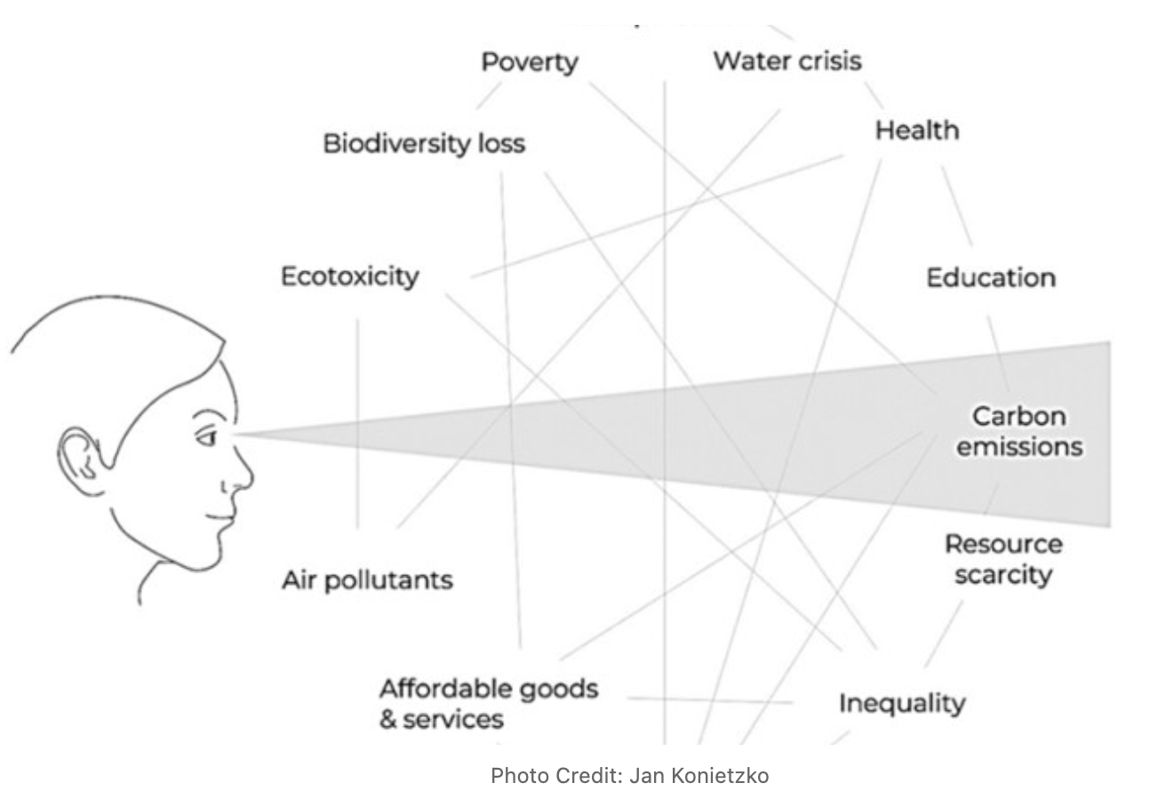
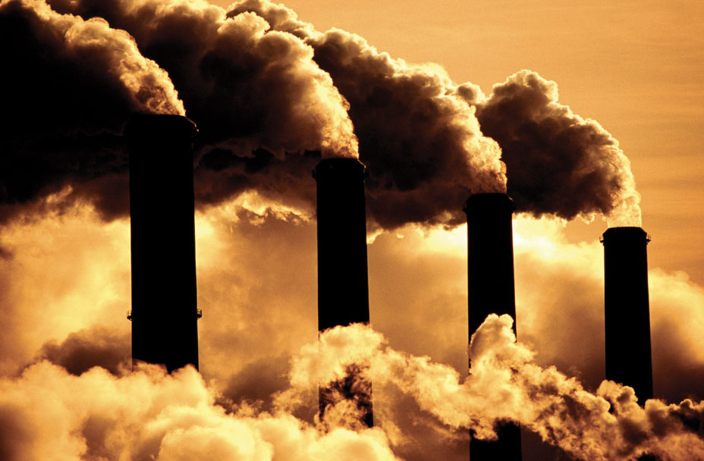
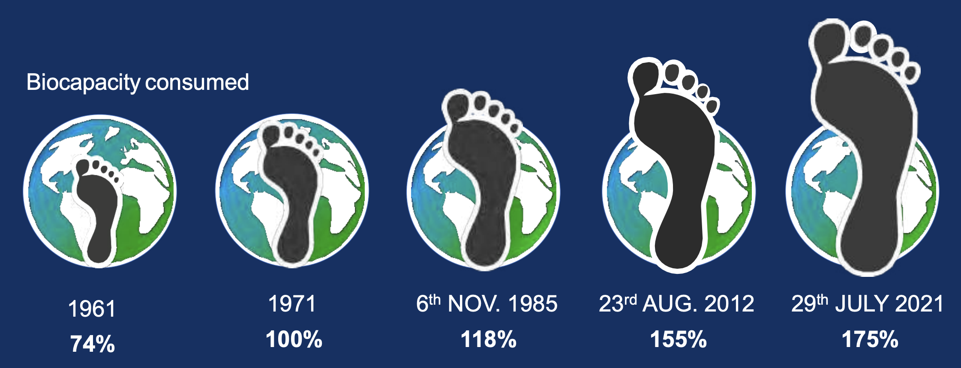
we need solve multiple issues at once – not just climate
ENERGY IS AT THE HEART OF UNSUSTAINABILITY
THE FUEL WE BURN
HOW WE USE THE ENERGY
SOME SOLUTIONS HELP BOTH SIDES. SOME MAKE THE OTHER SIDE WORSE

Slide 10
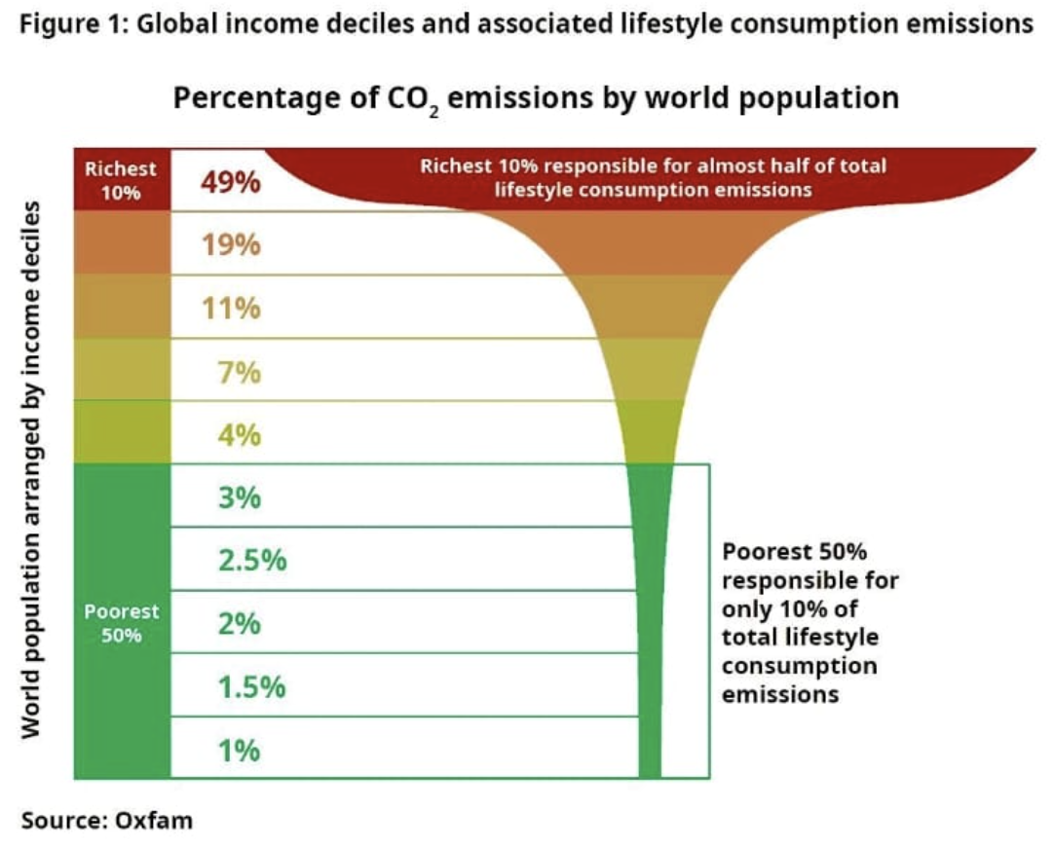
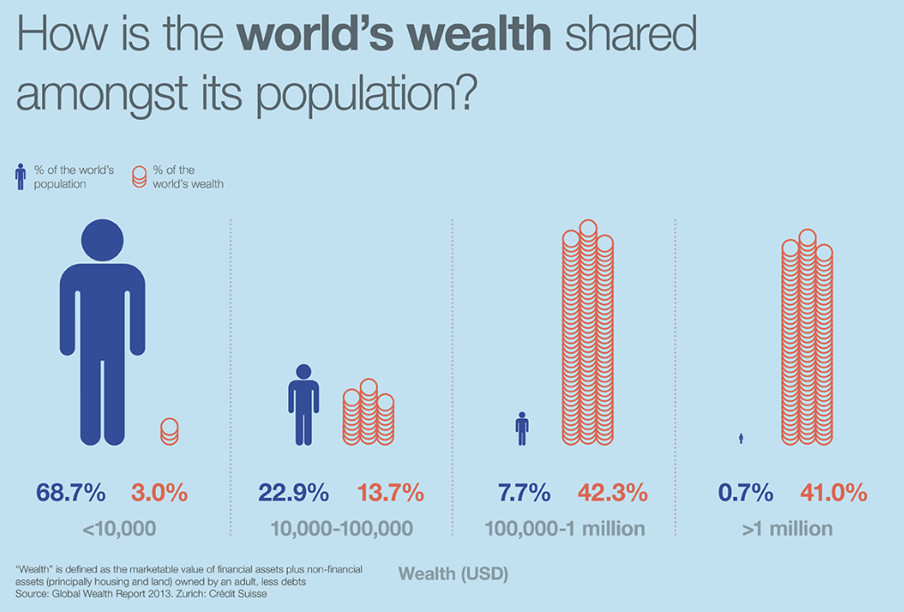
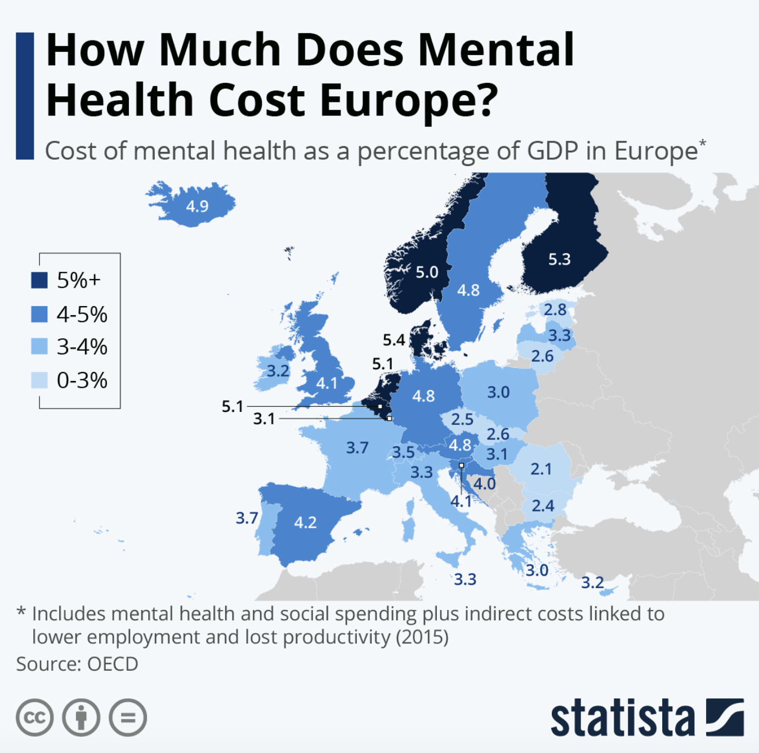
social crisis
http://cdn.statcdn.com/Infographic/images/normal/25040.jpeg

Slide 11
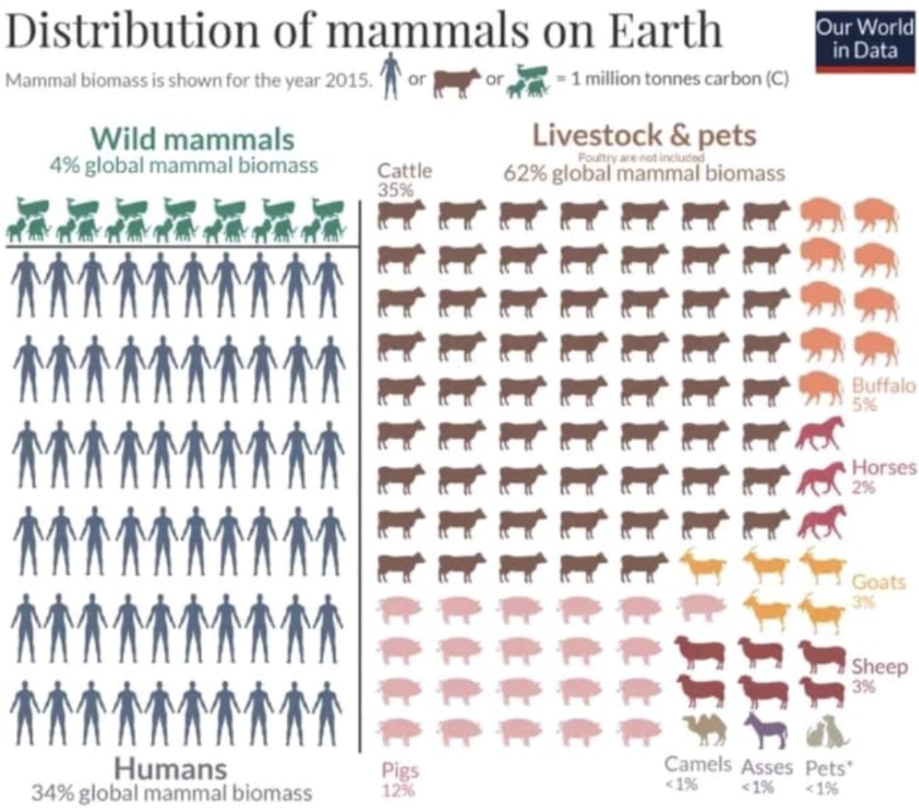
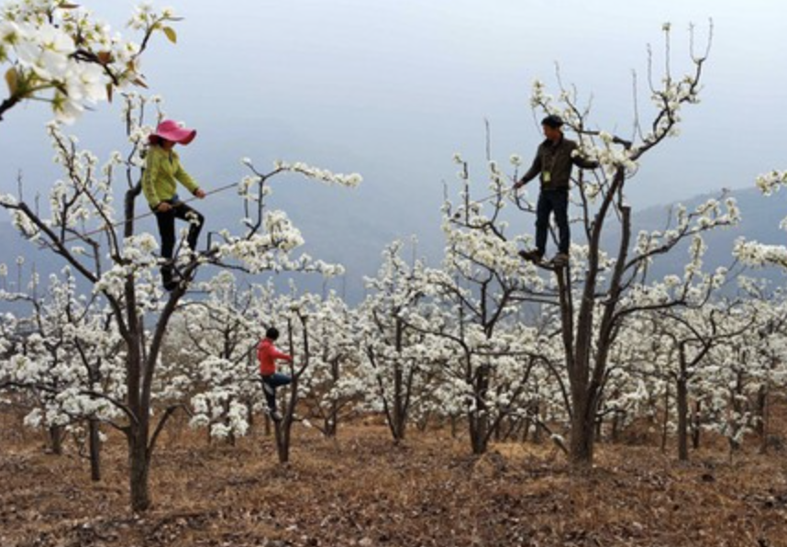
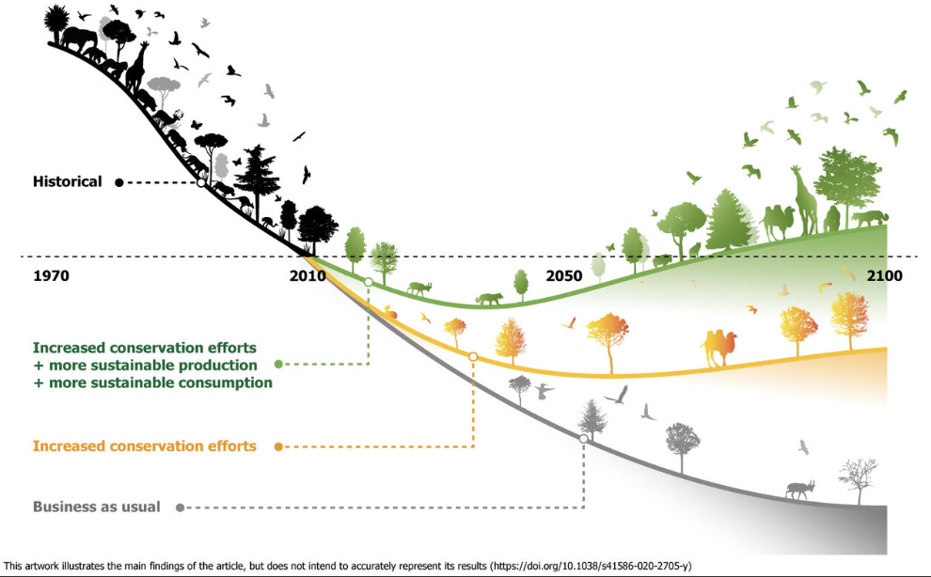
ecological collapse
Humans and their animals as % of animal mass on earth:
10,000 years ago: 0.1% Now: 96%

Slide 12
if the objective of the economy is long-term wellbeing for all (sustainability)….
WHERE DID WE GO SO WRONG AND HOW DO WE FIX IT…FAST?

Slide 13
decision-making = culture = governance
organisations make organised decisions: “person or group of people that has its own functions with responsibilities, authorities and relationships to achieve its objectives” (ISO 37301:2021. Modified)
culture is the result of routine decisions:
worldviews (assumptions/beliefs about the world)
developed over time into ways of thinking, feeling and acting (cultural software) that optimise the success of decision-making regarding problems commonly faced in context.
cultural software is manifested in, and reinforced by, material reality (cultural hardware) - structures, processes, artefacts etc. (Hurth, Unleashing Culture, 2023)
governance structures routine decisions: “human-based system by which an organization is directed, overseen and held accountable for achieving its defined purpose” (ISO37000:2021)

Slide 14


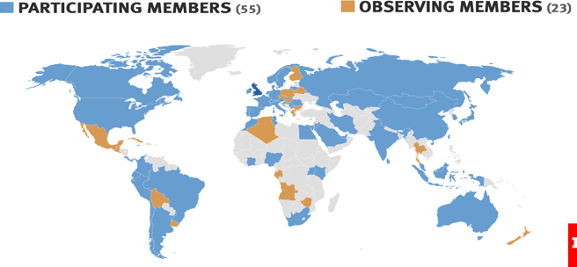

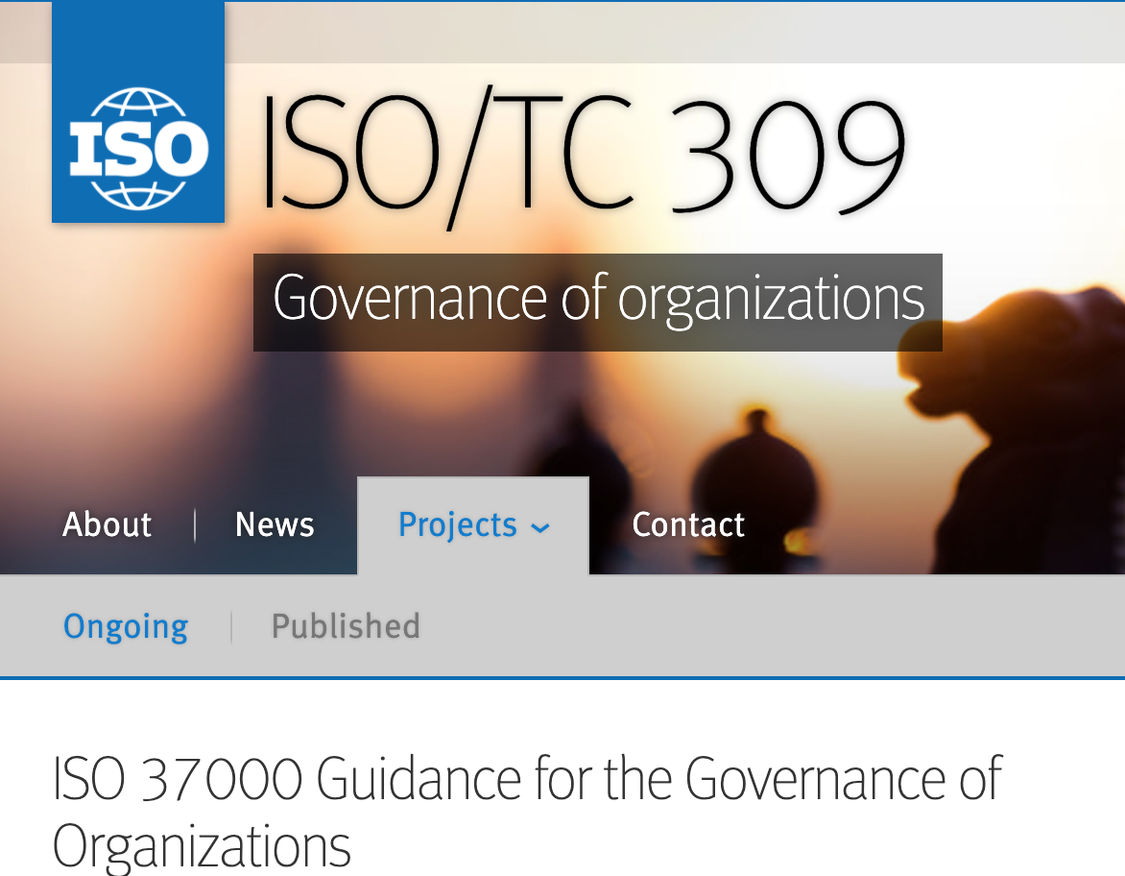
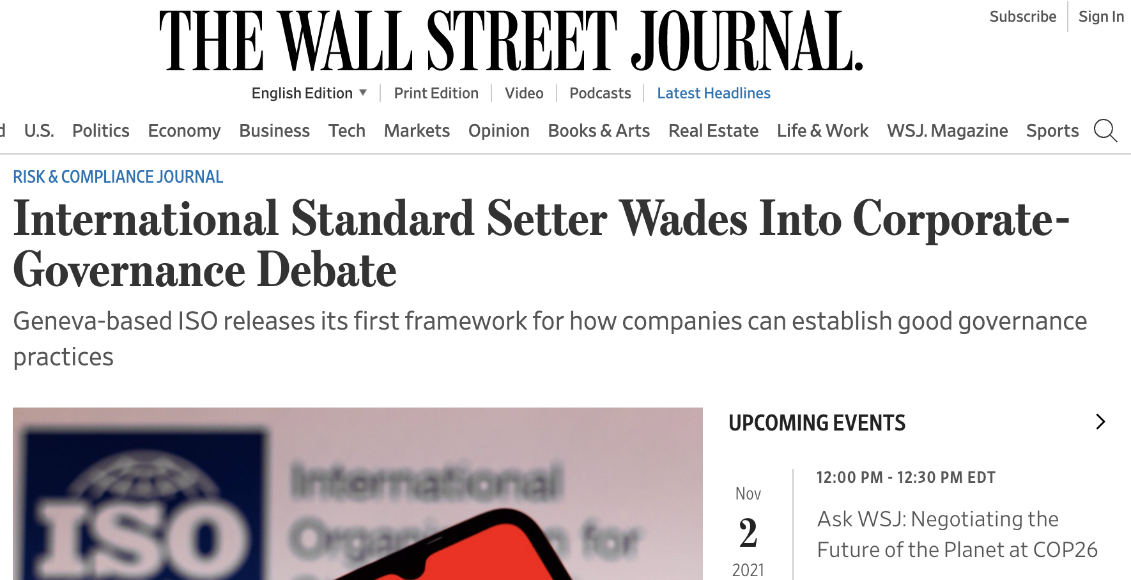
ISO 37000: setting the standard for governance
ISO 37000 key facts:
Scoping: 2016-2017
Development: 2017-2021
Countries involved: 77
Liaisons involved: 24
Comments resolved: 1,500 unique comments resolved by WG1
Approval: 100% approval and all 164 ISO member countries had the opportunity to vote.
https://committee.iso.org/ISO_37000_Governance_published
https://www.wsj.com/articles/international-standard-setter-wades-into-corporate-governance-debate-11632322569

Slide 15
decision-making = culture = governance
DEFINITION:
governance of organizations
human-based system by which an organization is
directed,
overseen and
held accountable
for achieving its defined purpose
(ISO37000:2021)
what is being optimised/ innovated for based on assumptions about value and the world (worldviews)
optimising goal
how the goal is achieved within the chosen and non-chosen parameters
strategy
=
investment
=
action
=
impact
parameters
parameters
constraints that you have on decisions, imposed and based on assumptions about value and the world (worldviews)
parameters
Notes:
What is an example of a goal? Purpose, strategic objective. WHAT you are optimising for

Slide 16
HOW AND WHY
BUSINESS-AS-USUAL GOVERNANCE
IS LOCKING IN DECISIONS THAT ENSURE UNSUSTAINABILITY

Slide 17

LOGIC 1: Business-as-Usual/CSR. Driving unsustainability
OFF LIMITS
ULTIMATE GOAL
long-term wellbeing of all people and planet (sustainability)
optimising goal
FINANCIAL CAPITAL
as the core objective
LOGIC 1:
SHORT-TERM
SELF INTEREST
strategy
(business case)
BUSINESS-AS-USUAL
FINANCIAL CAPITAL
as the core parameter
parameters
natural, human & social capital
NOT COSTED
stakeholders
environmental and social systems
FOUNDATIONAL PARAMETERS

Slide 18

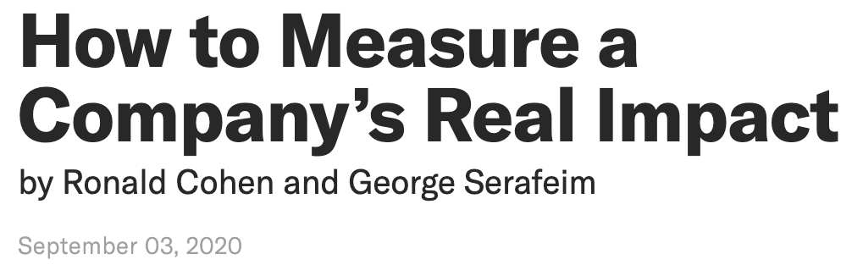
‘asset stripping’ is the norm:
&
profit
Of 1,694 companies which had positive EBITDA in 2018, if the cost of environmental damage was counted”
-> 15% would see their profit more than wiped out
-> 32% would see their EBITDA reduced by 25% or more
https://hbr.org/2020/09/how-to-measure-a-companys-real-impact

Slide 19
LOGIC 2 – Enlightened Self-Interest/
Long-Term Profit Maximisation

Slide 20
LOGIC 2: Business-as-Usual/ Enlightened Self-interest: ‘do no harm’
OFF LIMITS
ULTIMATE GOAL
long-term wellbeing of all people and planet (sustainability)
optimising goal
FINANCIAL CAPITAL
as the core objective
LOGIC 1:
SHORT-TERM
SELF INTEREST
strategy
(business case)
FINANCIAL CAPITAL
as the core parameter
parameters
BUSINESS-AS-USUAL
natural, human & social capital
stakeholders
LOGIC 2:
LONG-TERM SELF-INTEREST
environmental and social systems
parameters
FOUNDATIONAL PARAMETERS

Slide 21
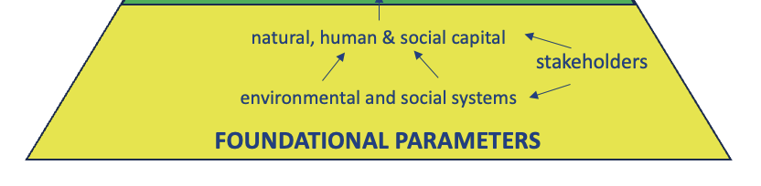

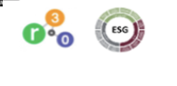
Logic 2: the basis of ESG business case
‘asset stripping’ is the issue that ESG is trying to address
operationalising purpose
ESG

Slide 22
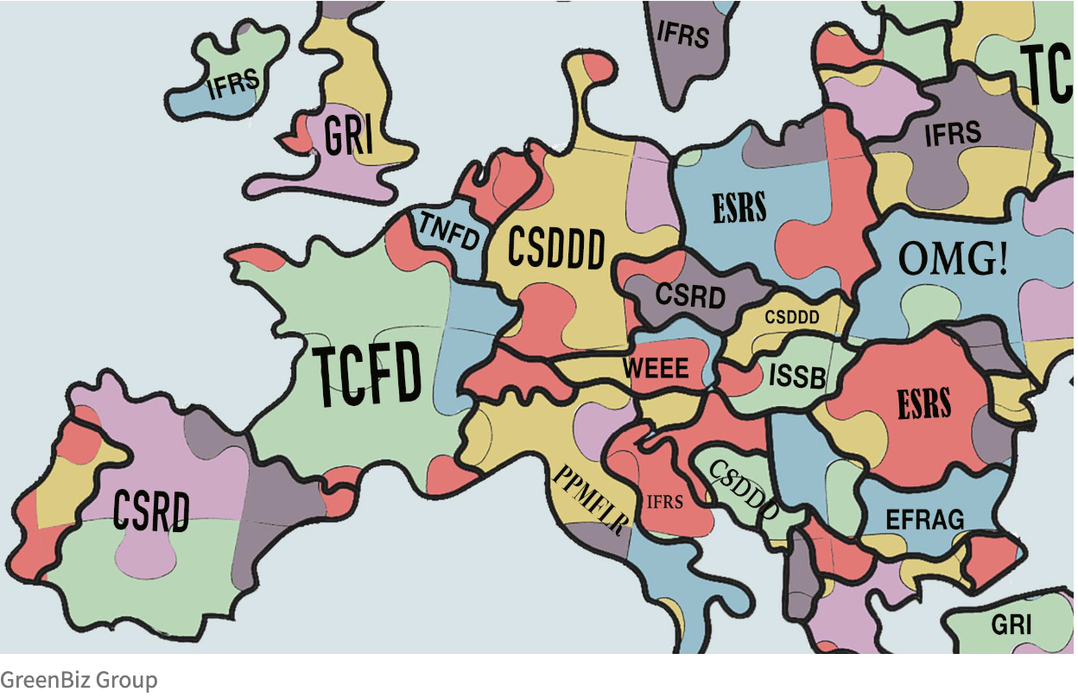
the messy and constrained ESG context

Slide 23

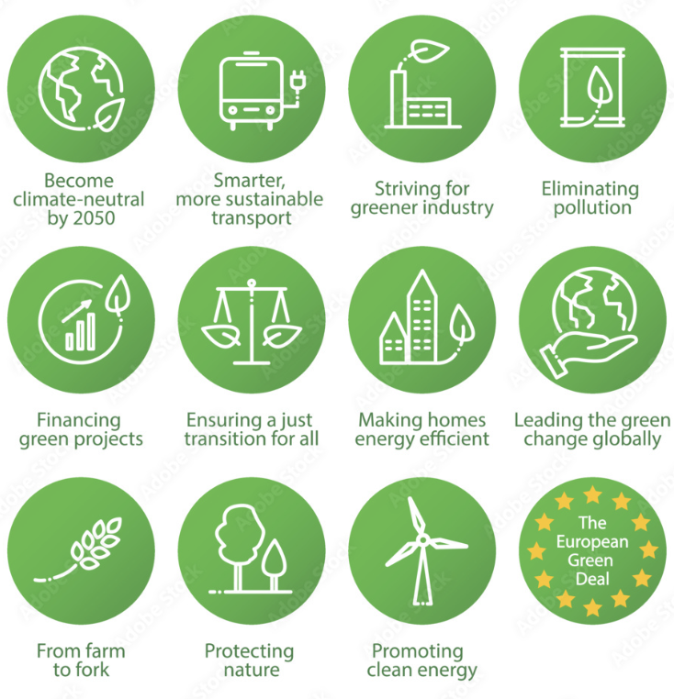
intentions of the EU Green Deal
“Why is the Commission adopting European Sustainability Reporting Standards (ESRS)?
…to make companies ‘disclose information on what they see as the risks and opportunities arising from social and environmental issues, and on the impact of their activities on people and the environment.”
This helps investors, civil society organisations, consumers and other stakeholders to evaluate the sustainability performance of companies, as part of the European green deal.” July 2023
https://ec.europa.eu/commission/presscorner/detail/en/qanda_23_4043

Slide 24
from ‘asset stripping’ to ‘do no harm’:
Disclose direct, indirect risks to financial profits + harm to society
Set targets for change + based on science about harm
Measure and transparently report progress against these targets
Report how you govern to ensure change happens
Assure all your claims are justified and make your data open
Climate
Biodiversity
Justice and human rights
Water
Pollution
+
The ESG End Game:
prove you are not asset stripping society if you want to exist.

Slide 25
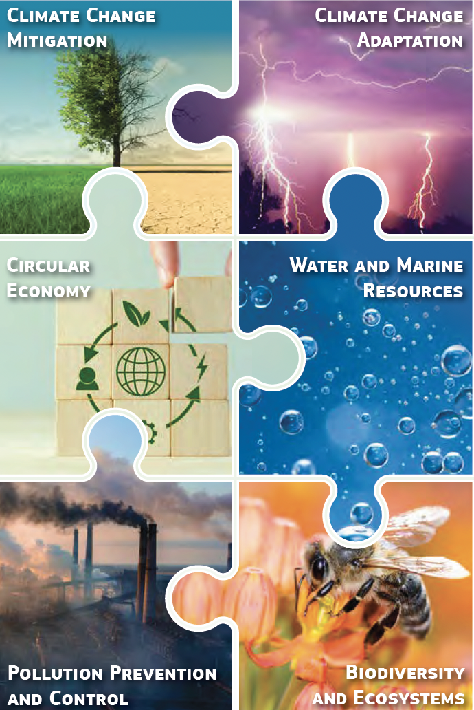
the ESG end game – you can see it coming….if you look
Taxonomy topics (social taxonomy coming but on hold) :
Taxonomy: What is a sustainable investment?
* A ‘sustainable investment’ = “ it is an investment in an economic activity that contributes to an environmental or social objective
the investment does not significantly harm any social or environmental objectives and
the investee companies follow good governance practices.”

Slide 26
LOGIC 3: BEYOND ‘DO NO HARM’ TO PURPOSE

Slide 27
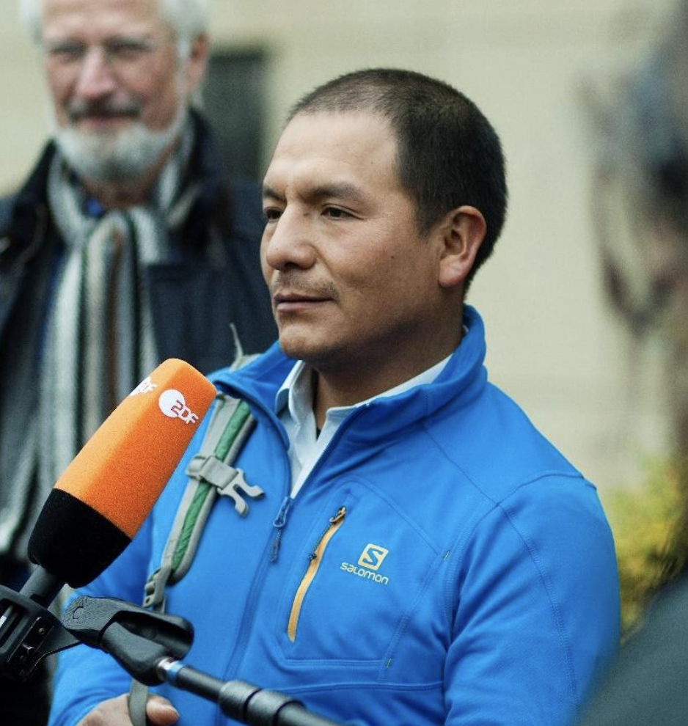

ESG - beyond the law
Even people who act accordingly to the law must be held responsible for damage they cause
The judges said.
SAUL LUCIANO LLIUYA,
PERUVIAN FARMER
VS
https://www.theguardian.com/environment/2017/nov/30/german-court-to-hear-peruvian-farmers-climate-case-against-rwe

Slide 28
how long until we are reminded of these realities
A Fiduciary?
“A fiduciary is a person or organization that acts on behalf of another person or persons, putting their clients' interests ahead of their own, with a duty to preserve good faith and trust. Being a fiduciary thus requires being bound both legally and ethically to act in the other's best interests.”
The Doctrine Of Utmost Good Faith
“The doctrine of utmost good faith, also known by its Latin name uberrimae fidei, is a minimum standard, legally obliging all parties entering a contract to act honestly and not mislead or withhold critical information from one another. (compatible with Shariah law: Abubakar et al. 2018). “
Materiality (accounting)
Materiality is the threshold above which missing or incorrect information is considered to have an impact on the decision making of users
https://www.researchgate.net/publication/329471186_Doctrine_of_good_faith_in_contracts_A_comparison_between_conventional_and_islamic_laws
https://www.investopedia.com/

Slide 29
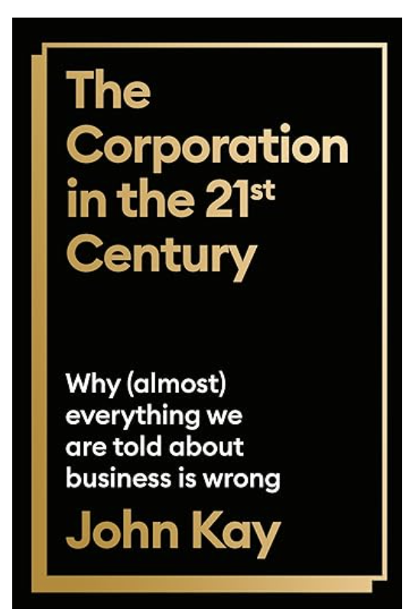
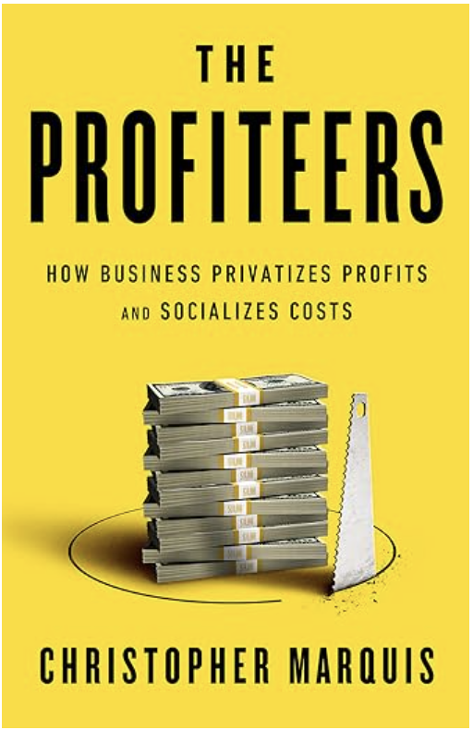
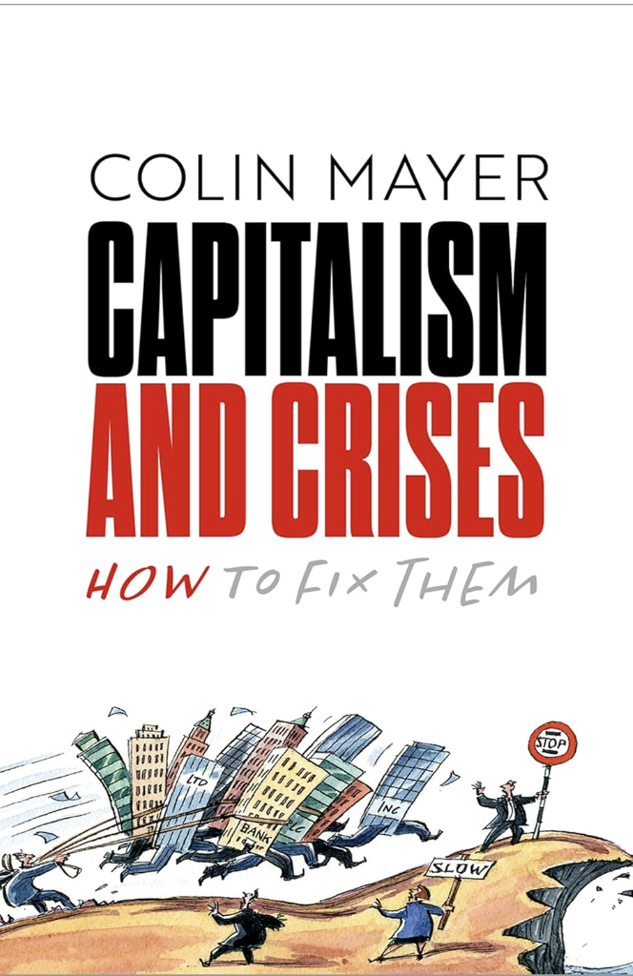

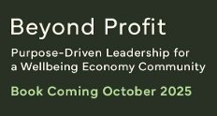
mometum to change the self-interest motive is building:
Dr Victoria Hurth
Ben Renshaw
Dr Lorenzo Fioramonti

Slide 30
LOGIC 3: Purpose: drive long-term wellbeing for all + do no harm to it
optimising goal
LOGIC 3:
LONG-TERM OTHER INTEREST
ULTIMATE GOAL
long-term wellbeing of all people and planet (sustainability)
PURPOSE
strategy
(business case)
FINANCIAL CAPITAL
as the core objective
LOGIC 1:
SHORT-TERM
SELF INTEREST
parameters
FINANCIAL CAPITAL
as the core parameter
BUSINESS-AS-USUAL
natural, human & social capital
stakeholders
LOGIC 2:
LONG-TERM SELF-INTEREST
environmental and social systems
parameters
FOUNDATIONAL PARAMETERS

Slide 31
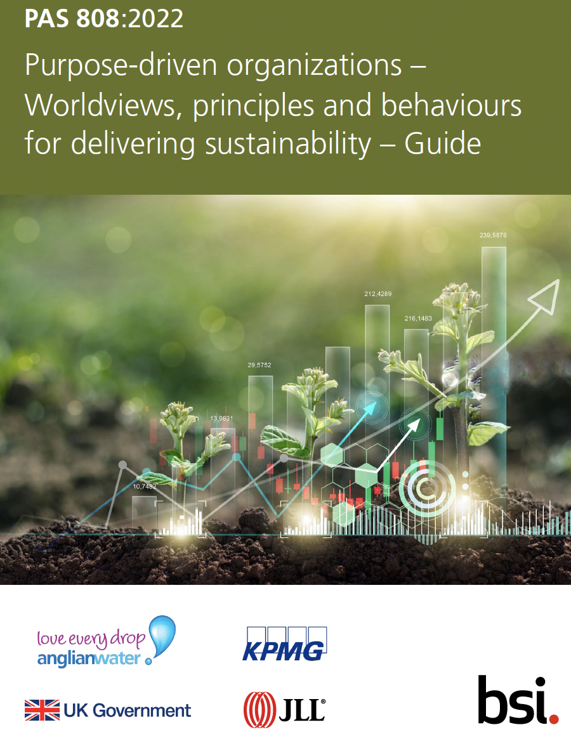

purpose gets serious: PAS 808:2022
(organizational) purpose
“an (organization’s) reason to exist that is an optimal strategic contribution to the long-term wellbeing of all people and planet”
BSi PAS 808: 2022
purpose - unleashes humanity back into the organisation and is the source of the sheer energy and creativity needed to break the inertia of bad governance system

Slide 32
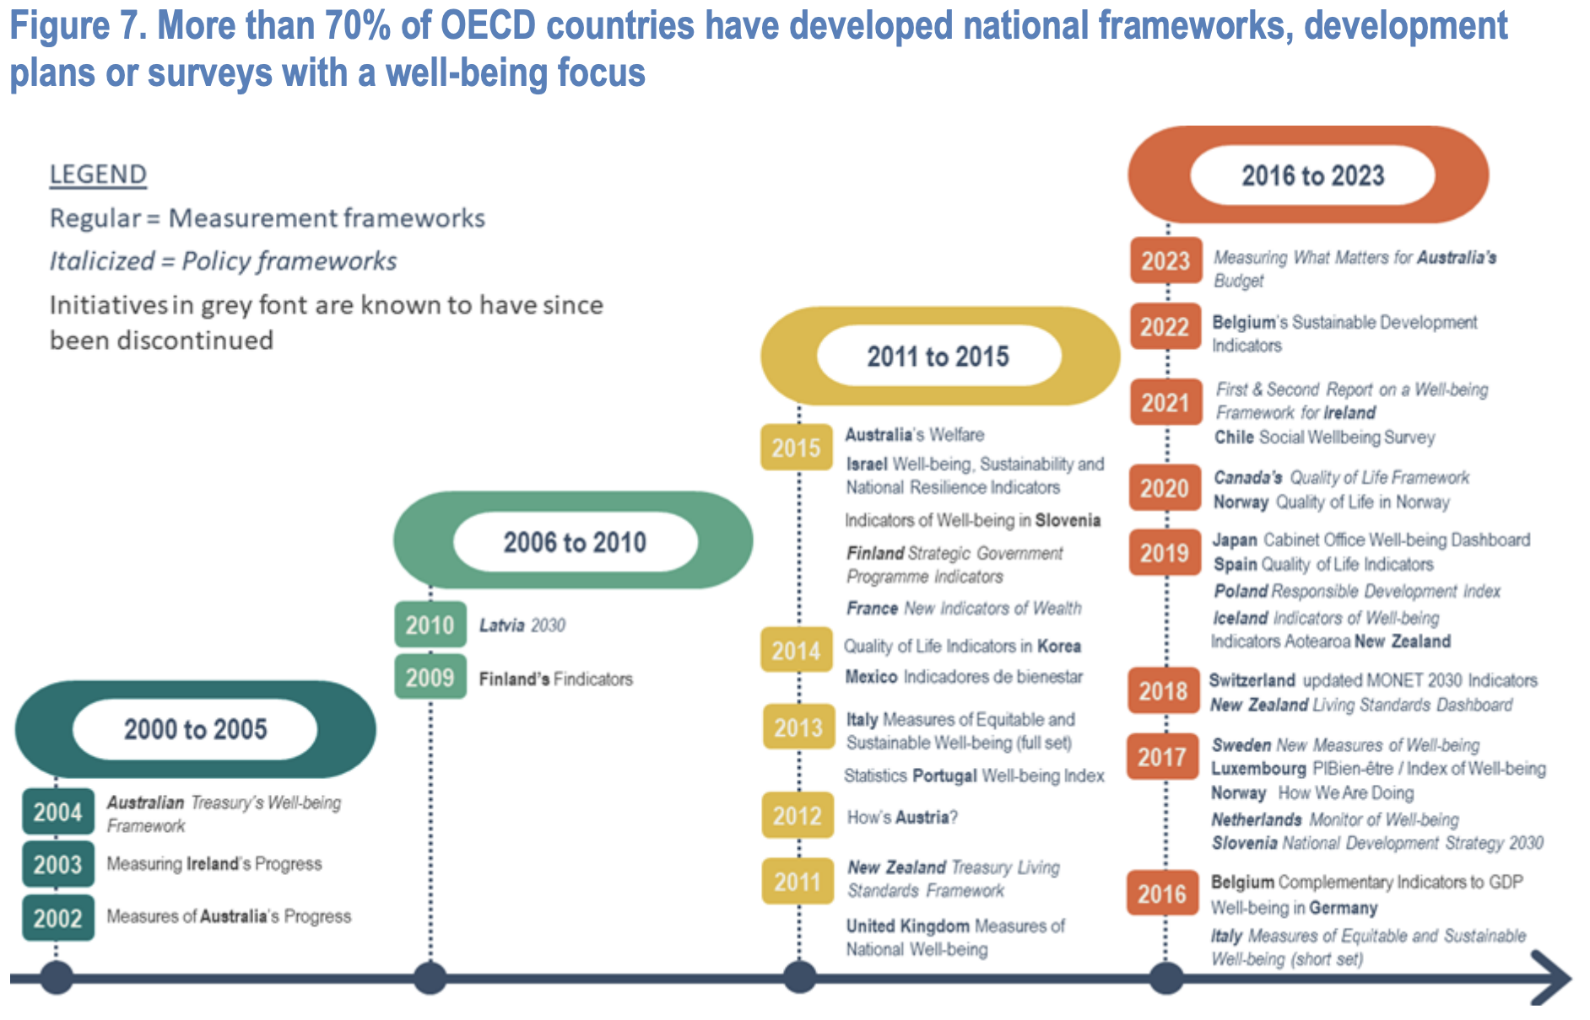


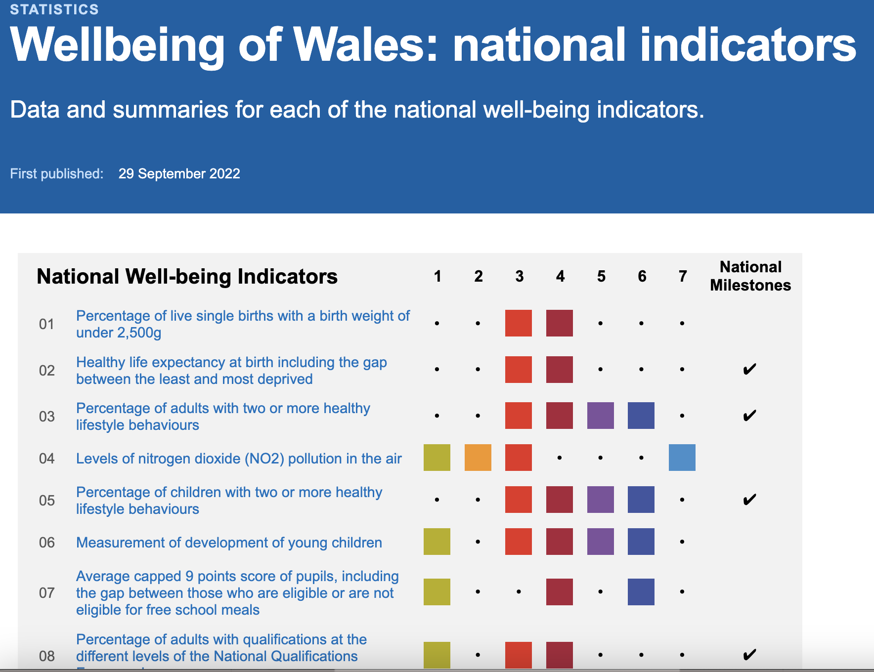
from theory to practice: government:
https://www.oecd.org/economy/G7_Beyond_GDP_Economic_policy_making_to_pursue_economic_welfare_2023.pdf

Slide 33









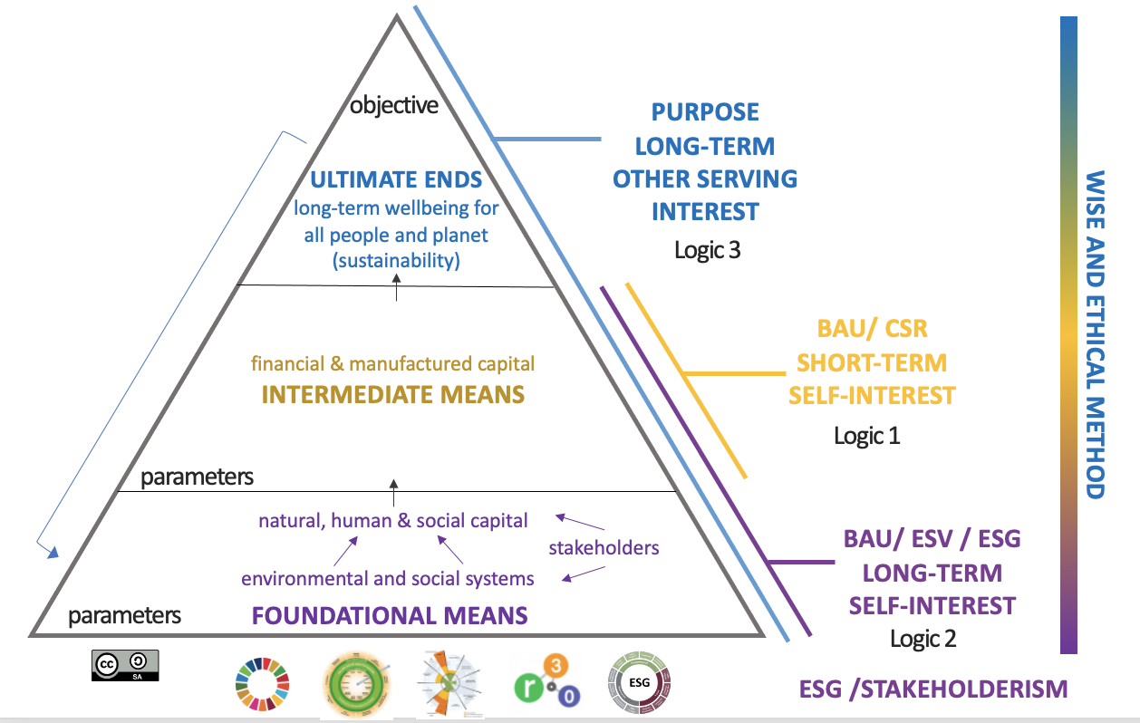

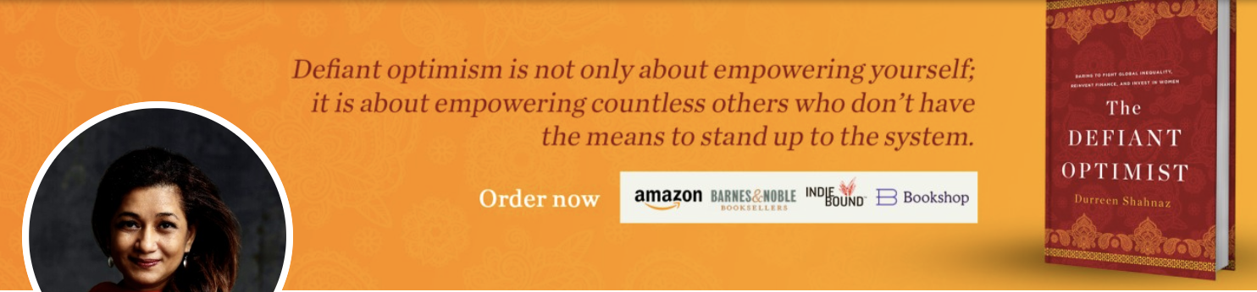
in practice (meso):

Slide 34


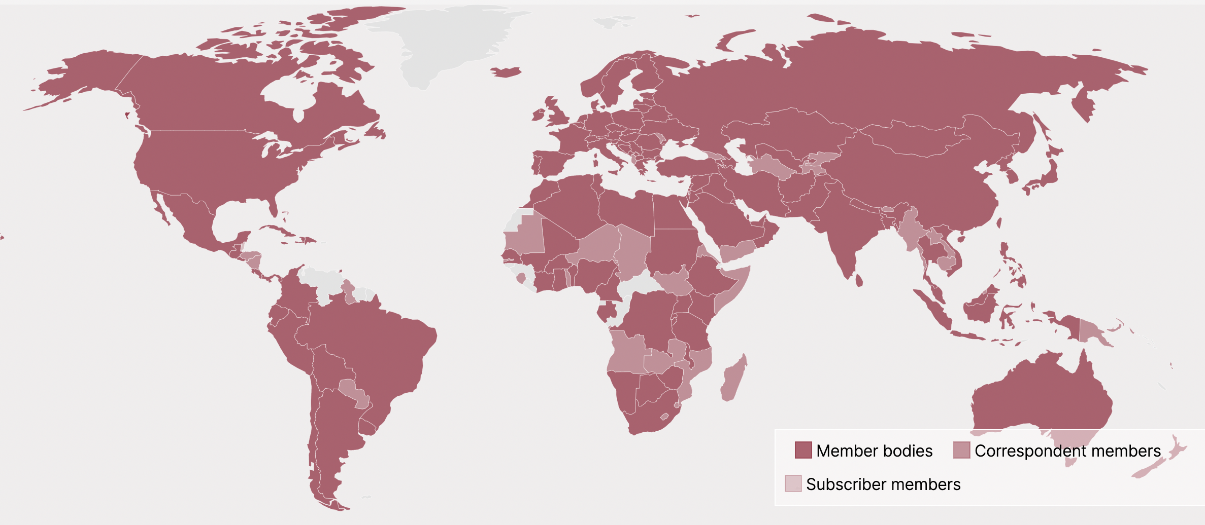










the call to action: next step ISO
co-created, co-owned precise destination
170 nations
https://www.iso.org/members.html
leading edge ways to get there

Slide 35
what can you do now?
Assess your organization and stakeholders against the 3 Logics and PAS808. What is your current reality, realistic ambition and plan for change?
Ensure any talk about ‘change’ is anchored to what needs to change about GOVERNANCE (see ISO37000 and PAS808). The rest is ‘talk’ and ‘nice ideas’ (or greenwashing). How far are your discussions anchored to governance now?
How can you support the your community to help move the market economy to a Wellbeing Economy - How can you get involved in developing and spreading the word about the ISO in Purpose?

Slide 36
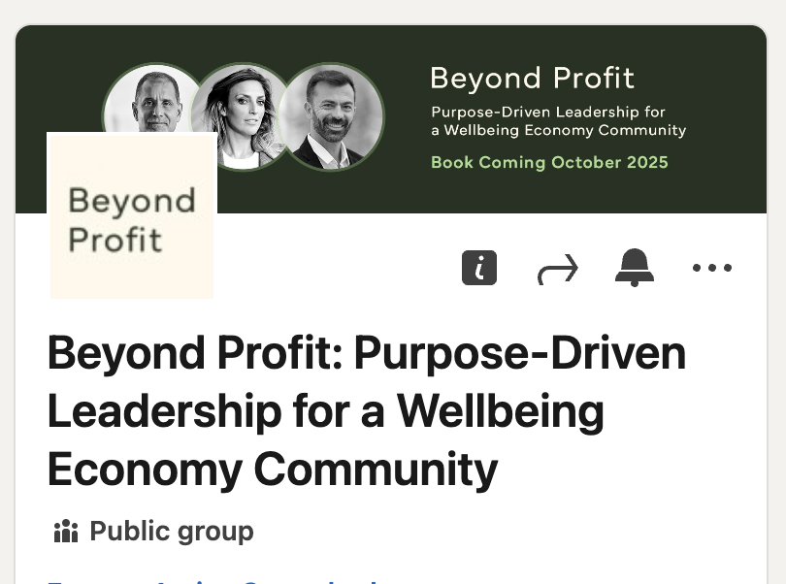
join our book community for updates
Join our book’s linkedin group to stay up to date:
https://www.linkedin.com/groups/13085230/

Slide 37
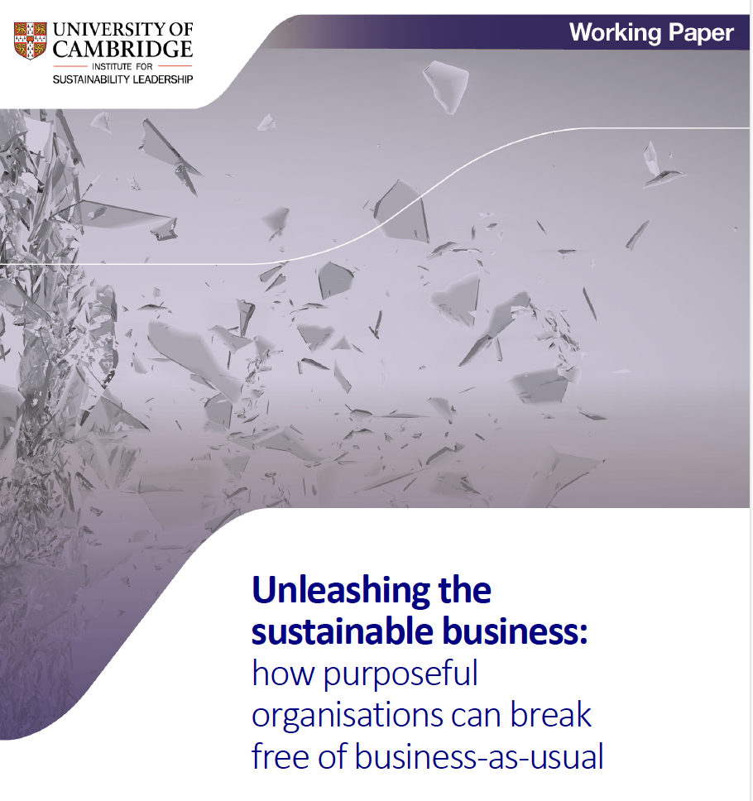
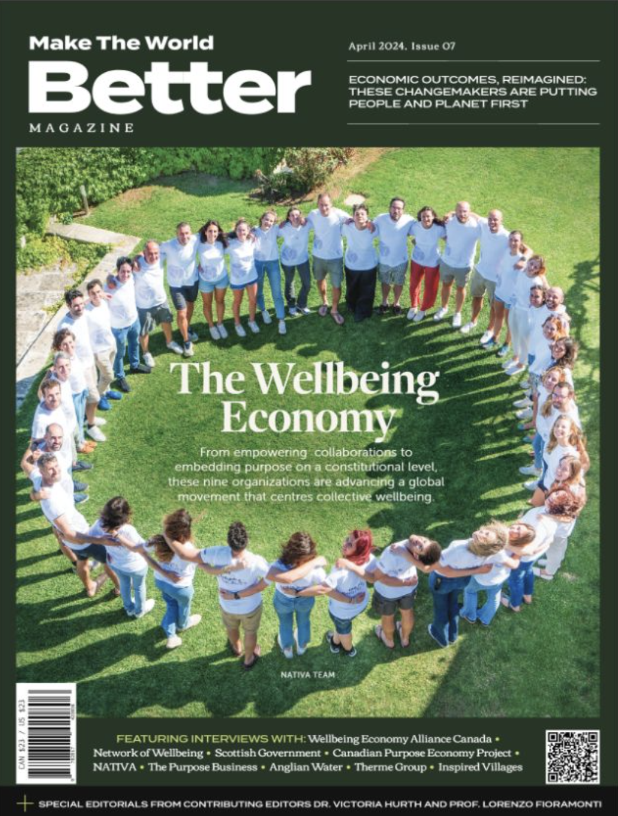
further reading:
https://www.cisl.cam.ac.uk/resources/unleashing-sustainable-business
https://www.bsigroup.com/en-GB/standards/pas-808/
https://www.sparxpg.com/make-the-world-better/issue7/
Find all resources on: www.victoriahurth.com

Slide 38

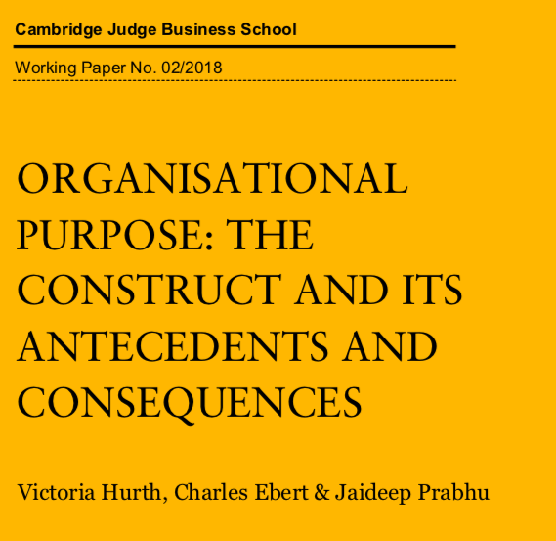

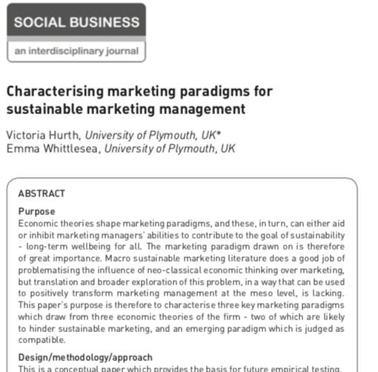

further reading:
https://www.managers.org.uk/~/media/Files/Reports/Guide-for-Leaders-White-Paper.pdf
https://www.jbs.cam.ac.uk/wp-content/uploads/2020/08/wp1802.pdf
https://www.waterstones.com/book/powered-by-purpose/sarah-rozenthuler/9781292308791
https://www.researchgate.net/publication/322099214_Characterising_marketing_paradigms_for_sustainable_marketing_management
https://www.waterstones.com/book/generation-impact/adam-richards/jeremy-nicholls/9781789739305
Find all resources on: www.victoriahurth.com

