Slide 1
Forward Faster
to the
Future We Want
Steve Kenzie, Executive Director
UN Global Compact Network UK
Notes:
I am Steve Kenzie, Executive Director of the UN Global Compact Network.
The UN Global Compact Network UK is the UK Country Network of the world’s largest corporate sustainability initiative.
Our mission is to create a world we want to live and do business in.
I want to talk to you about “good” business.
I’m not going to try and persuade you all to become social enterprises.
I’m talking about good business in the traditional business school sense,
where managers understand the risks and opportunities facing their organisations in the short, medium, and long term
And then, taking this into account, they create policies, procedures, business models, organisational cultures, and partnerships
to generate profits
I will try to make the case that the best way to achieve long-term profitability,
is to contribute to solving the world’s big problems.
Before we get into that,
I’m going to tell you about the UN Global Compact, and the UN Sustainable Development Goals
Because these are initiatives that can support good business (double entendre).
To get started, a quick video.

Slide 3
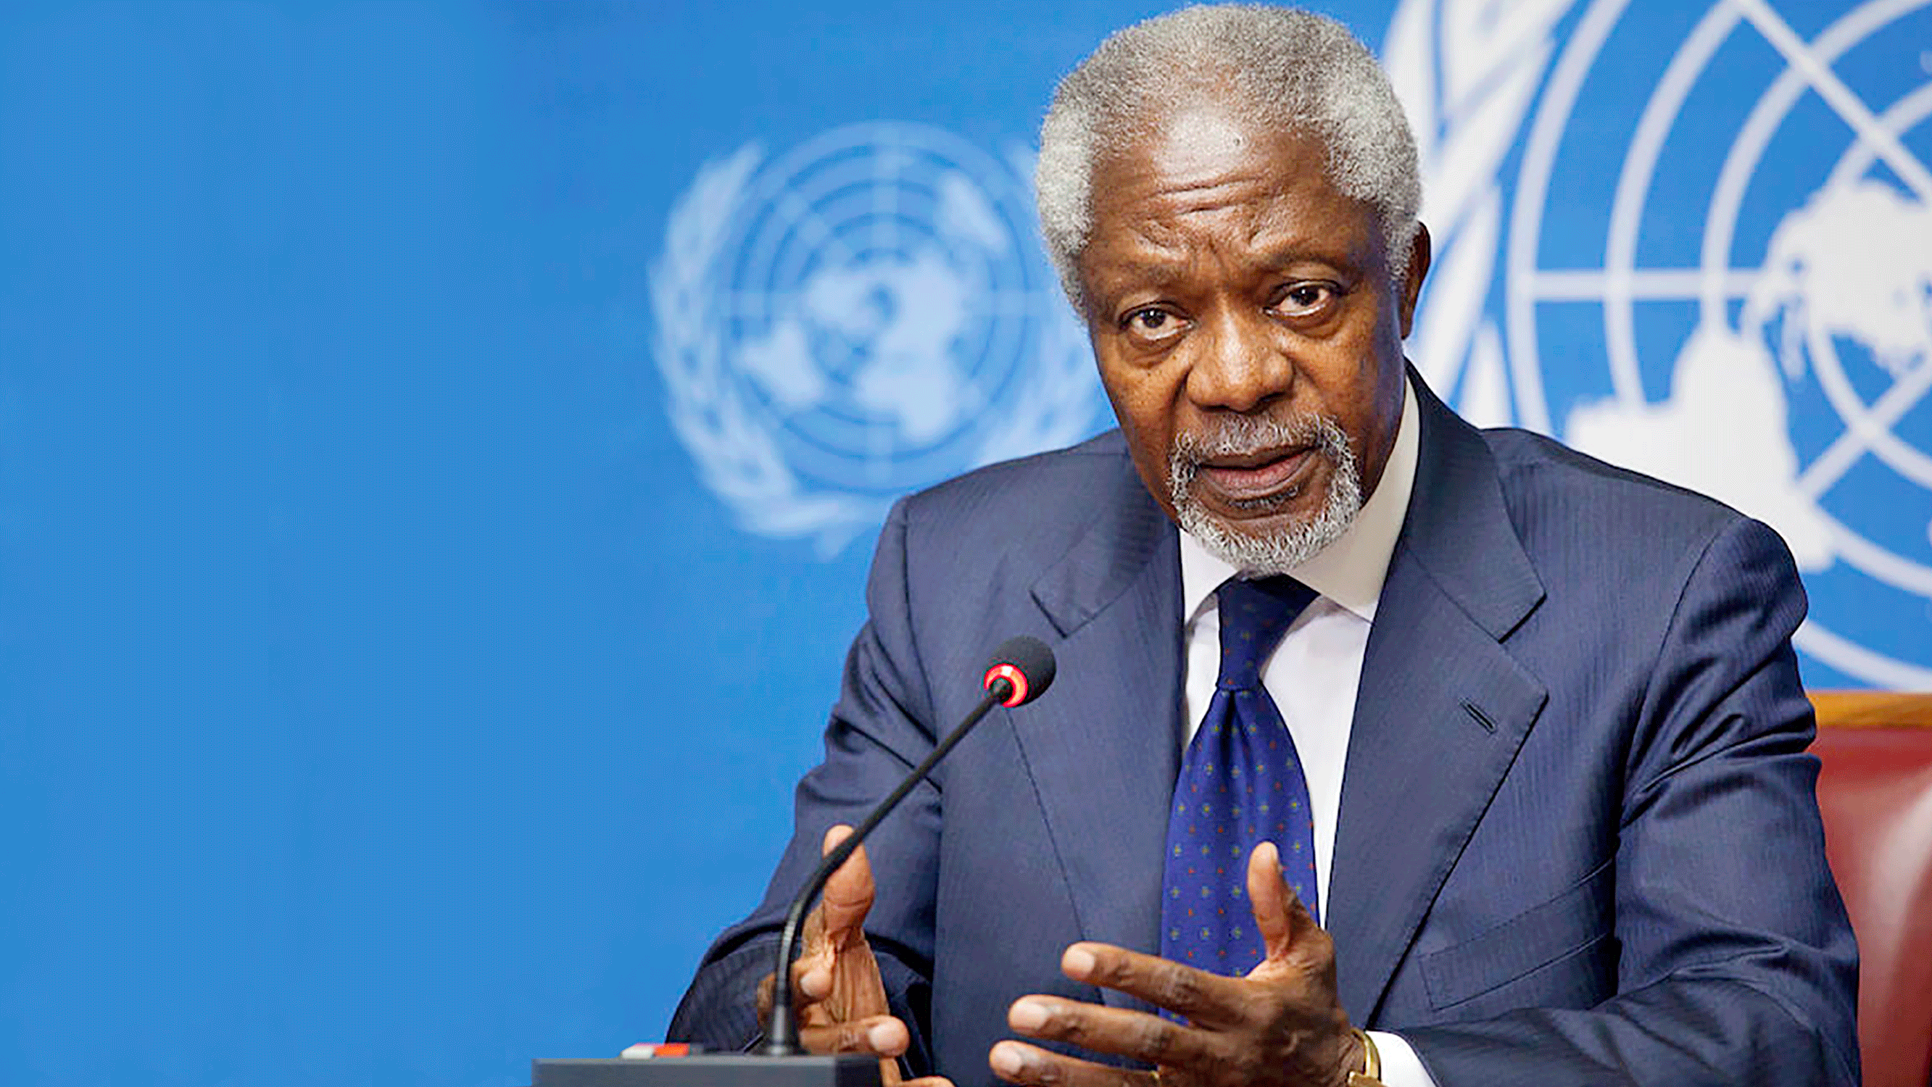
A HUMAN FACE TO THE GLOBAL MARKET
I propose that you, the business leaders… and we, the United Nations, initiate a global compact
of shared values and
principles …...
Kofi Annan, UN Secretary-General (1997–2006)
Notes:
The UN Global Compact was launched in 2000 by then Secretary-General Kofi Annan who reached out to a group of CEOs at Davos about coming together to initiate a Global Compact of shared values and principles to give a human face to the global market.

Slide 4
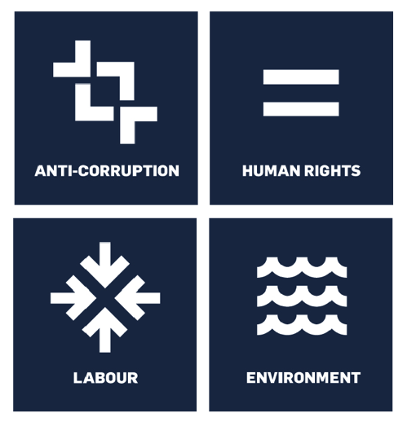
UN GLOBAL COMPACT: OVERVIEW
1037 UK Participants
2229 France Participants
23,000+ businesses committed to the Ten Principles of the UN Global Compact
167 countries with UN Global Compact participants
3,000+ non-business members
62 country networks
Notes:
As I mentioned in my introduction, the UN Global Compact is the world’s largest corporate sustainability initiative with over 26,000 global participants.
More than 23,000 businesses and 3,000 non-business organisations in 167 countries are part of 62 different country networks. In the UK, we currently have more than 1000 participating organisations, and the number is growing…

Slide 5
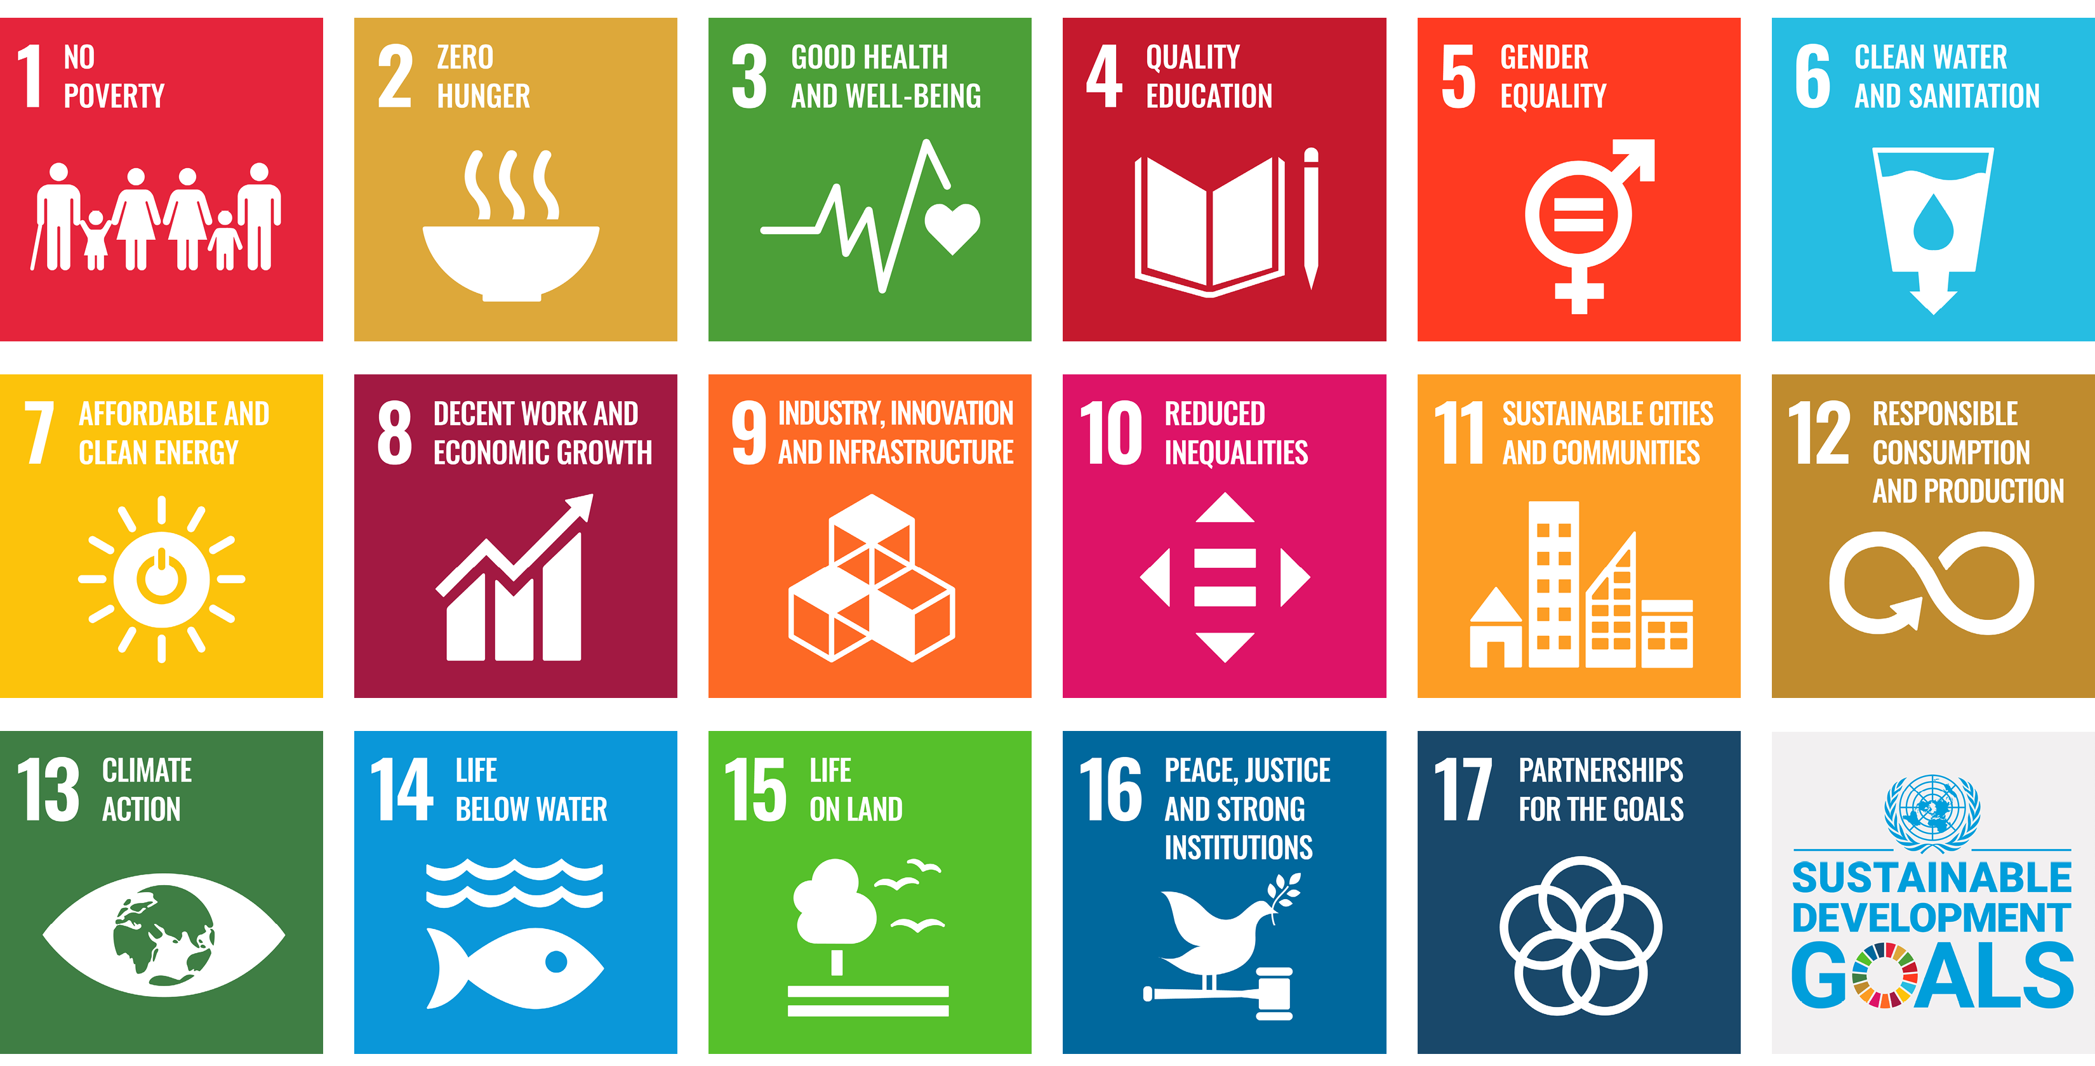
THE COMMITMENT
UN Global Compact Commitment:
Operationalise the Ten Principles
Report annually on progress
Support the wider UN development agenda
Notes:
The UN Global Compact is a call to companies to align their strategies and operations with 10 universal principles, rooted in international declarations and conventions, in the areas of Human and Labour Rights, Environment, and Anti-corruption. The principles represent the minimum responsibilities that each business has to respect to operate by safeguarding people and the planet.
While the principles of the Global Compact are timeless, UN Global Compact companies are also called to contribute to the wider UN development agenda, which currently corresponds to the 2030 Agenda for Sustainable Development launched in September 2015.
This agenda, as you might know, is made up of 17 time-bound goals to end extreme poverty, fight inequality and injustice, and protect our planet. These are the so-called Sustainable Development Goals or Global Goals. The Ten Principles are a vehicle to advance this agenda.
Joining the UN Global Compact requires companies to prepare an official letter signed by their CEO committing to operationalise the Ten Principles, report annually on progress, and support the wider UN development agenda – i.e. the SDGs.

Slide 6
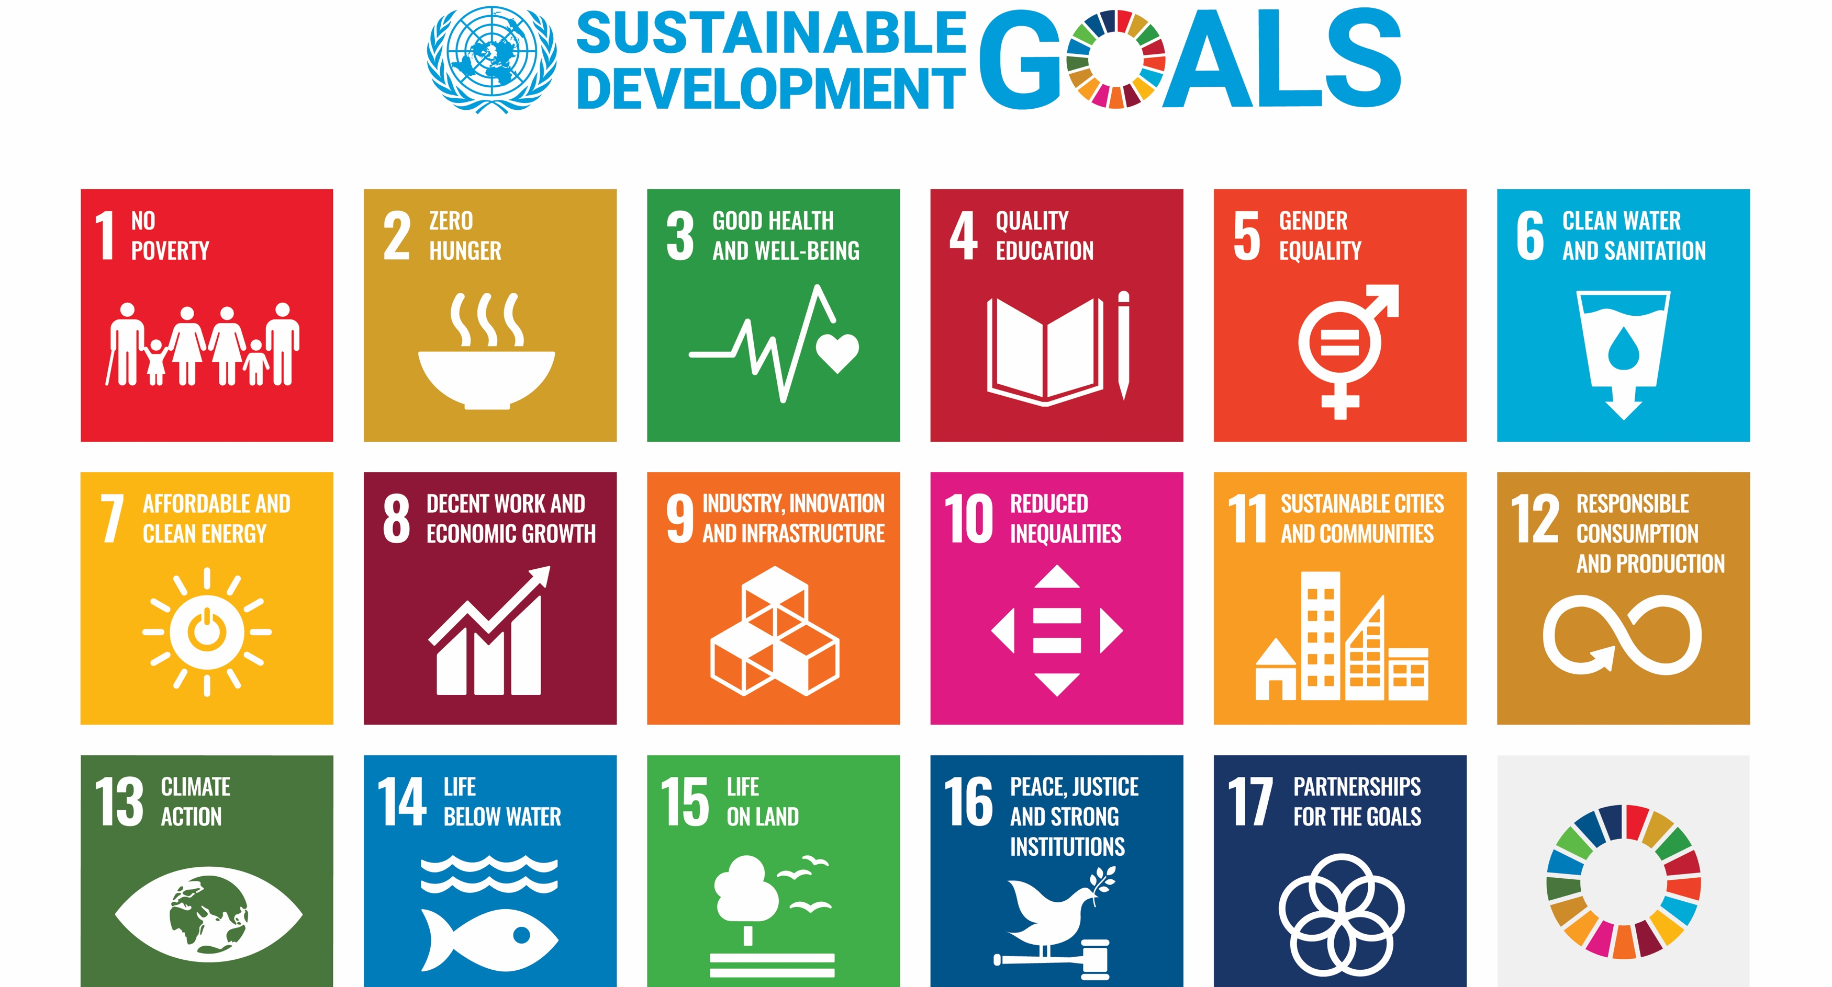
6
Notes:
I have ‘the Future We Want’ in the title of my presentation and just want to address that briefly.
That turn of phrase featured prominently at Rio +20, the UN Conference on Sustainable Development in 2012.
And it is the guiding principle of the UN Sustainable Development Goals, which were formally launched there.
Coming out of the conference, the UN set in motion a massive global consultation, the largest they’d ever undertaken, to try and define the future we want and codify it.
The SDGs are the result of that exercise.
While I do find that turn of phrase inspiring,
the reason I’m bringing it up now is just to flag how valuable the SDGs can be to business.
The people have spoken, this massive market research exercise provides a picture of where we want to be in 2030.
I think it is self-evident that good business management would be aligning their long-term plans with this agenda.

Slide 7
Notes:
Last year’s halfway point to 2030 triggered lots of stocktaking at the SDG Summit held during the UN General Assembly in September 2023.
The URLs are on the slide if you’re interested.
From 2015 to 2019, the world made some progress on the SDGs, although this was already vastly insufficient to achieve the goals.
Since the outbreak of the pandemic in 2020, the Ukraine War, and the cost of living crisis they precipitated, SDG progress has stalled globally.
Only 15% of the SDGs are on track to be delivered by 2030.

Slide 8
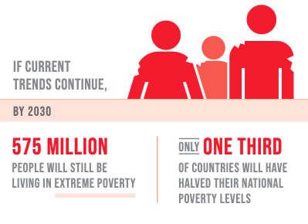
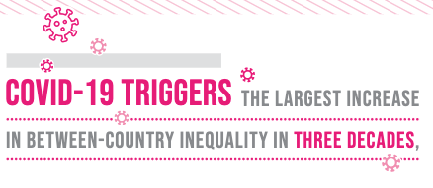
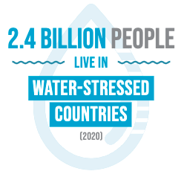
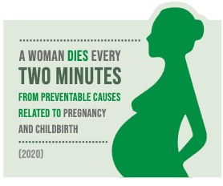
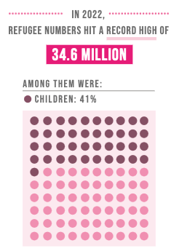
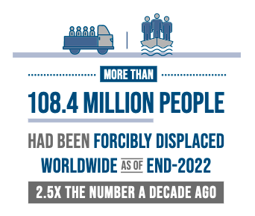
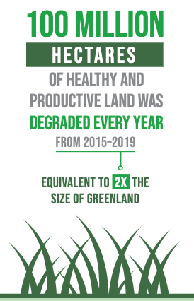
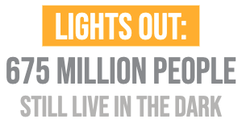
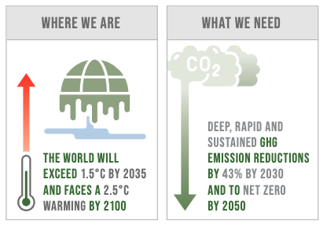
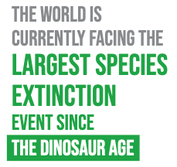
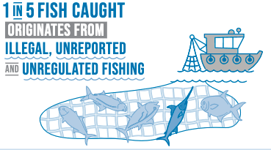
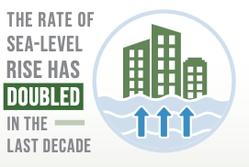
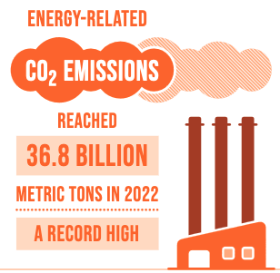
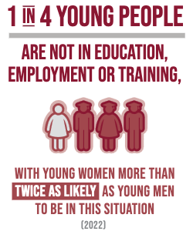
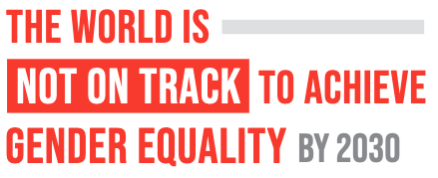
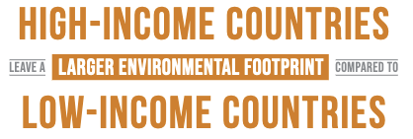
Notes:
Here are only a few examples of where progress on the SDGs is stalling or reversing. I’ll give you a minute to scan this slide and choose your poison.
I’m particularly struck by a woman dying every two minutes from preventable causes related to pregnancy and childbirth,
But there’s something here to depress everyone…

Slide 9
Notes:
In contrast, the 2023 SDG Stocktake produced by the UN Global Compact and Accenture paints a slightly more positive picture.
While the prospects for 2030 are still grim,
there is broad support for the vision that the Goals present.
And the report provides pathways for progress and constructive guidance for business on how to engage with this agenda.

Slide 10
Notes:
For example, the report has great ideas for how companies can measure their SDG impact and understand how the SDGs link to their current work on ESG.

Slide 11
10 key pathways forward:
1. Recommit to the basics
2. Provide a living wage
3. Promote gender equality
4. Innovate responsibly
5. Accelerate climate action
6. Improve water resilience
7. Protect and restore nature
8. Invest in circularity
9. Commit to sustainable corporate finance
10. Strengthen sustainability leadership
Notes:
At this point, I want to note that it was national governments that made this commitment in the full knowledge that achieving the Goals would require contributions from all members of society: individuals, local governments, academia, civil society organisations, and businesses.
We need everyone to understand how they are impacting the Goals both positively and negatively,
and then keep going and make real changes from business as usual
to do more of the good stuff and less of the bad stuff.
Recommit to the basics by adopting responsible human rights-based business policies and strategies and conducting business in a principled manner, free of corruption
Provide a living wage in collaboration with contractors, supply chain partners, and other key stakeholders, to work toward achieving living wages
Promote gender equality by ensuring gender balance across all levels of management, providing equal pay for work of equal value, and advocating for gender equality beyond direct operations
Innovate responsibly by infusing purpose and responsibility in all innovation activities and anticipating unintended consequences
Accelerate climate action by setting science-based net-zero emissions reduction targets in line with a 1.5°C pathway and contribute to a just transition by addressing social impacts of climate change mitigation and adaptation measures
Improve water stewardship by achieving net-positive water impact in water-stressed basins
Protect and restore nature by aligning with the Taskforce on Nature-related Financial Disclosures
Invest in circularity by sourcing sustainable material inputs and sending zero waste to landfills and incinerators
Commit to sustainable corporate finance by achieving 100% alignment with the CFO principles on integrated SDG investments and finance
Strengthen sustainability leadership by aligning executive remuneration to SDG-aligned goals, creating a board position to advocate for all stakeholders’ long-term interests, and engaging in responsible advocacy

Slide 12
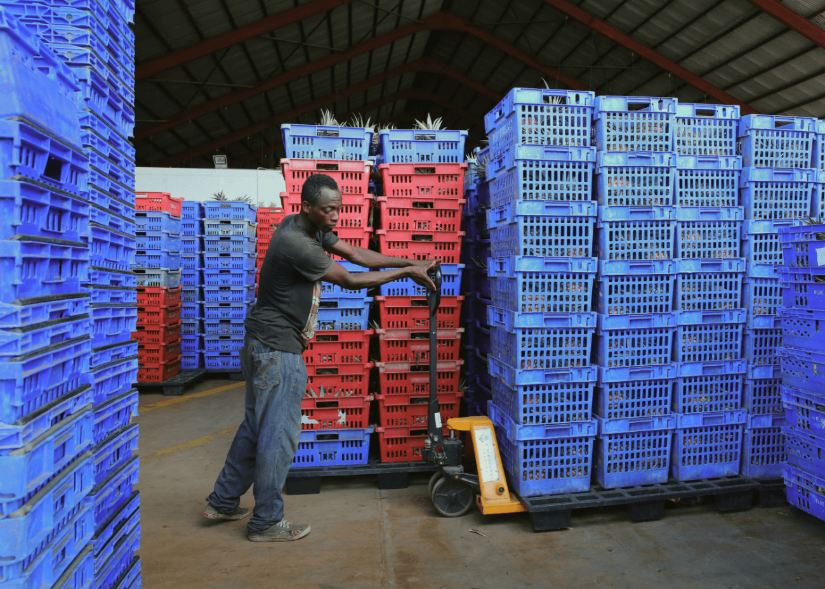
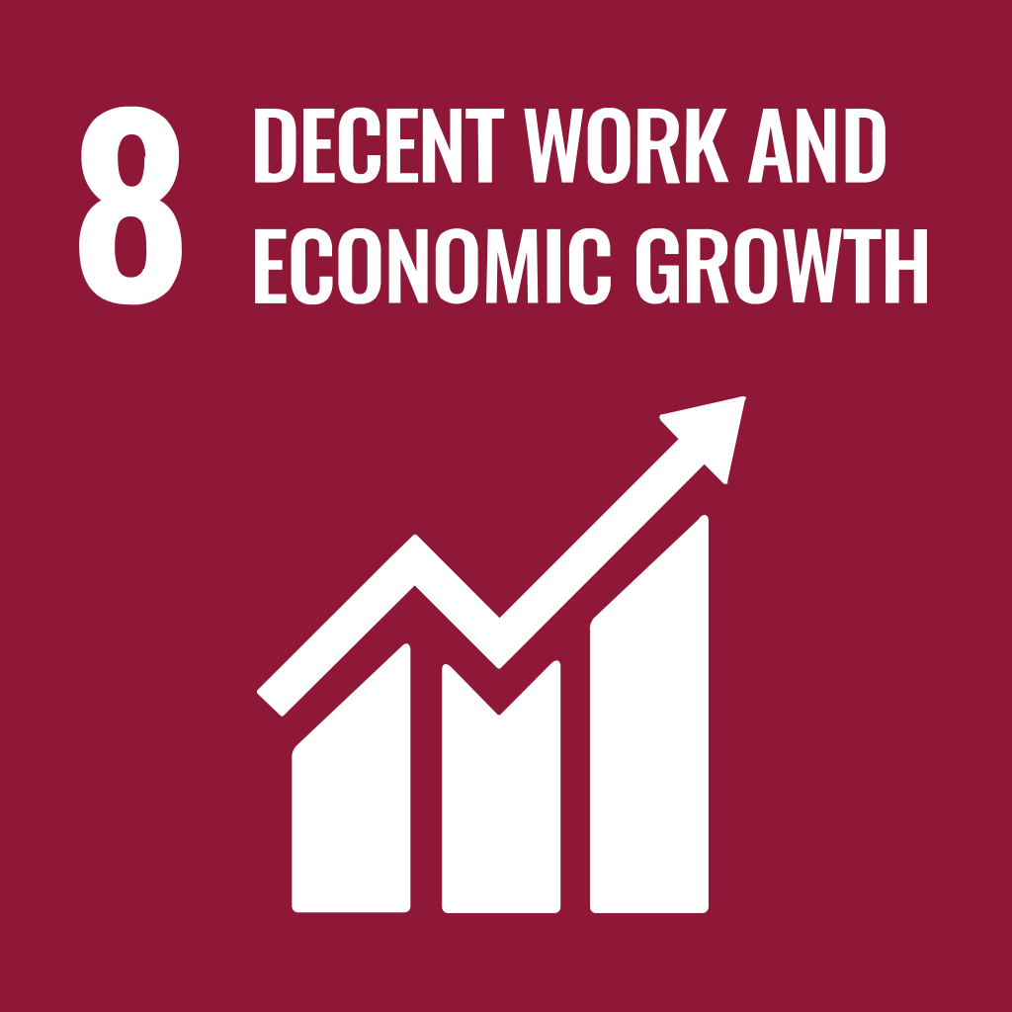
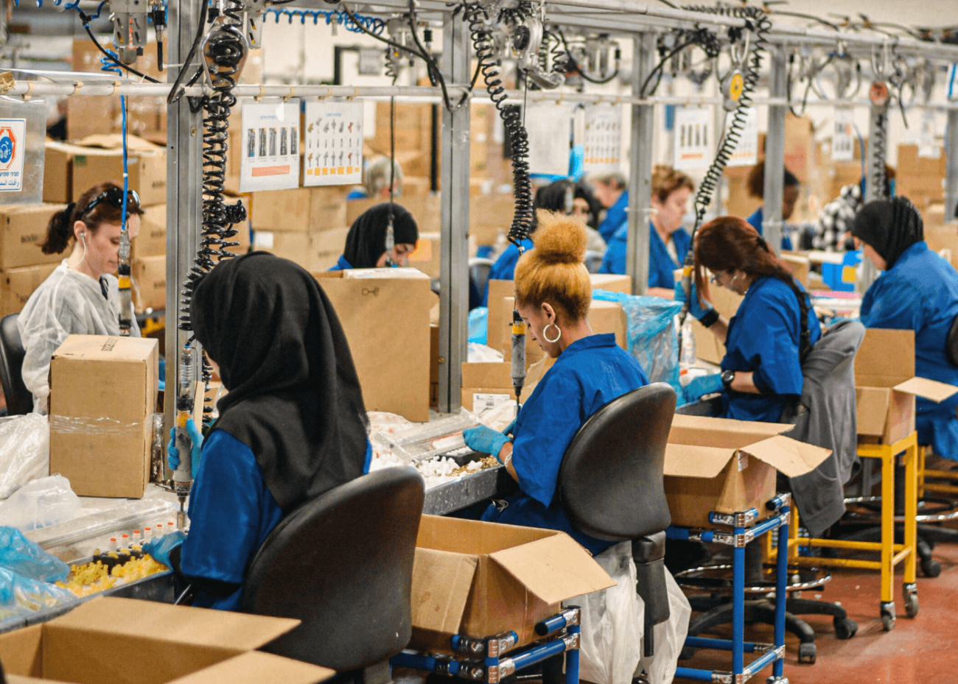
Provide a Living Wage
Over a billion working people worldwide –1/3 of all workers – are estimated to earn less than they need to afford a decent standard of living.
By paying living wages, you can improve productivity and gain important advantages:
Reduce staff turnover and absenteeism, increase retention and motivation, attract new talent and increase staff productivity
Improve supply chain relationships, performance, resilience and transparency
Demonstrate a commitment to respecting and promoting the human rights of workers
Become the employer of choice in your market
Notes:
Provide a living wage in collaboration with contractors, supply chain partners, and other key stakeholders, to work toward achieving living wages.
Ensuring a living wage across your workforce reduces inequalities and builds more resilient supply chains.
By paying living wages, you can improve productivity and gain important advantages:
Reduce staff turnover and absenteeism, increase retention and motivation, attract new talent and increase staff productivity
Improve supply chain relationships, performance, resilience and transparency
Create a pathway to tackle poverty and reduce inequalities
Demonstrate a commitment to respecting and promoting the human rights of workers

Slide 13
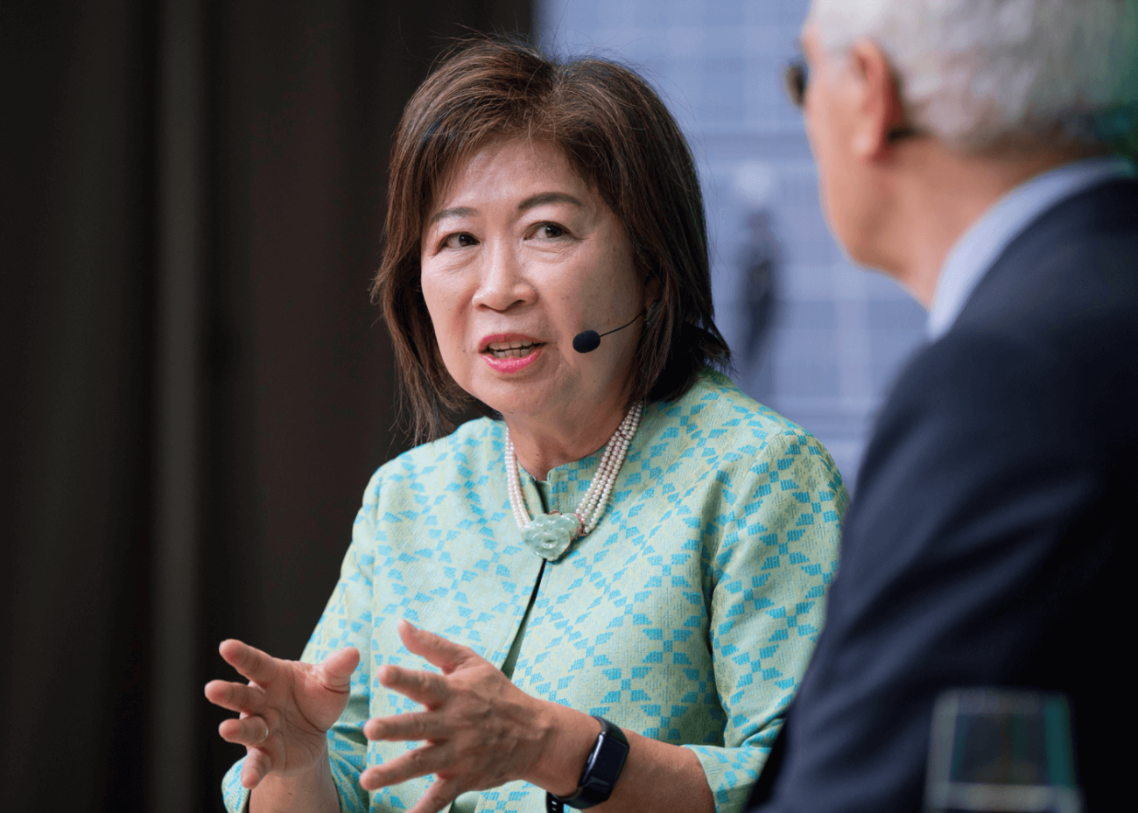
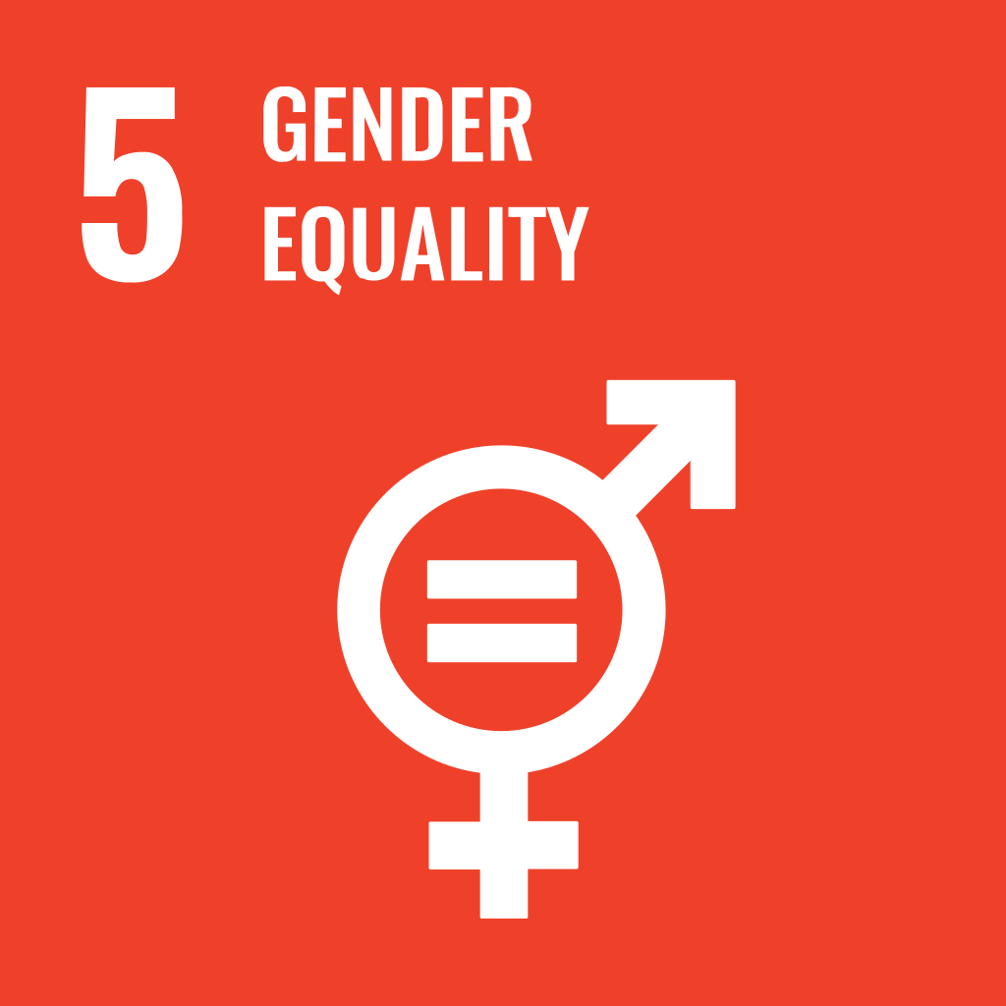
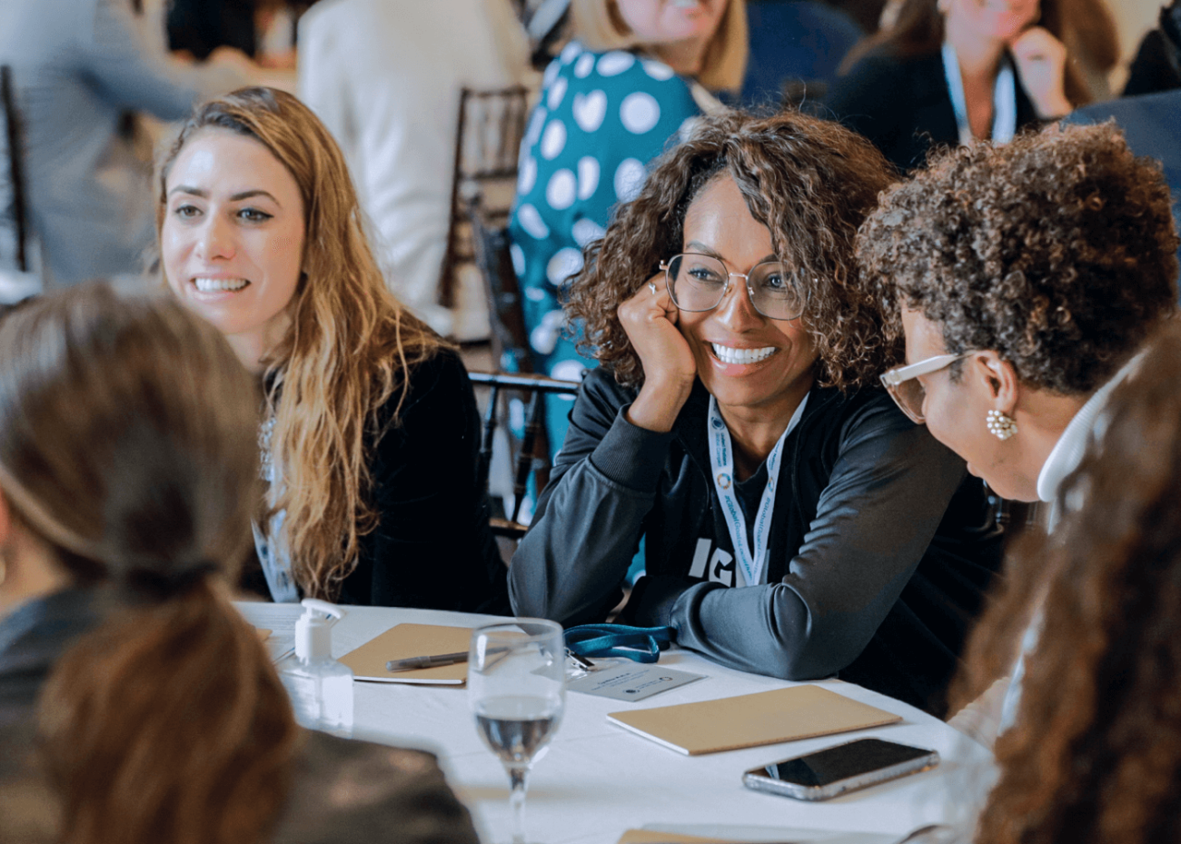
Promote Gender Equality
At our current rate, it will take over 169 years to achieve gender equality in terms of women’s economic empowerment and participation.
By taking action on gender equality, you can improve performance and gain an important advantage:
When boardrooms are gender balanced, enterprises are 20 per cent more likely to have improved business outcomes
Gender equality in the workplace can help unlock more than $12 trillion in new market value linked to the SDGs
Notes:
Promote gender equality by ensuring gender balance across all levels of management, providing equal pay for work of equal value, and advocating for gender equality beyond direct operations.
When women are empowered and included, economies grow, communities thrive, and businesses flourish.
By taking action on gender equality you can improve performance and gain an important advantage:
When women serve as leaders and employees of companies, businesses benefit and performance improves
On average across countries, long-run GDP per capita would be almost 20 per cent higher if gender employment gaps were closed
When boardrooms are gender balanced, enterprises are 20 per cent more likely to have improved business outcomes
Gender equality in the workplace can help unlock more than $12 trillion in new market value linked to the SDGs

Slide 14
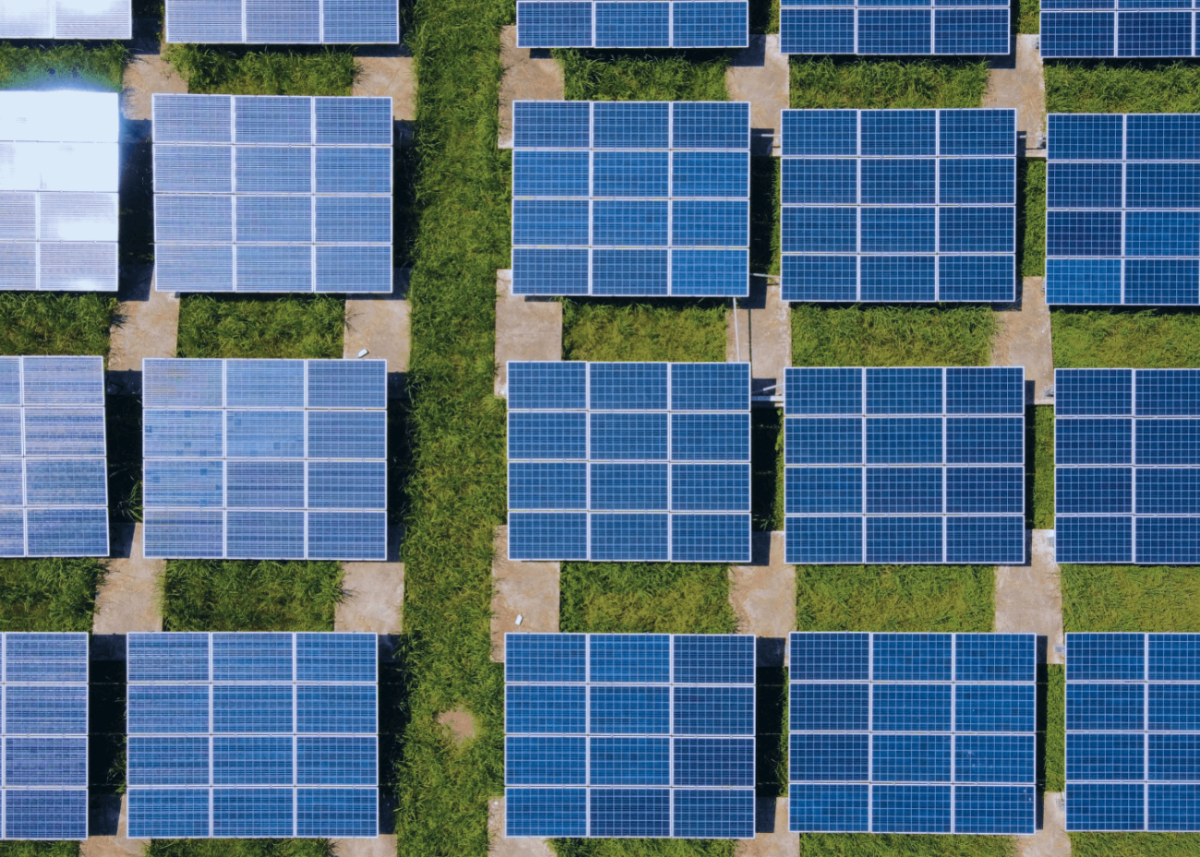
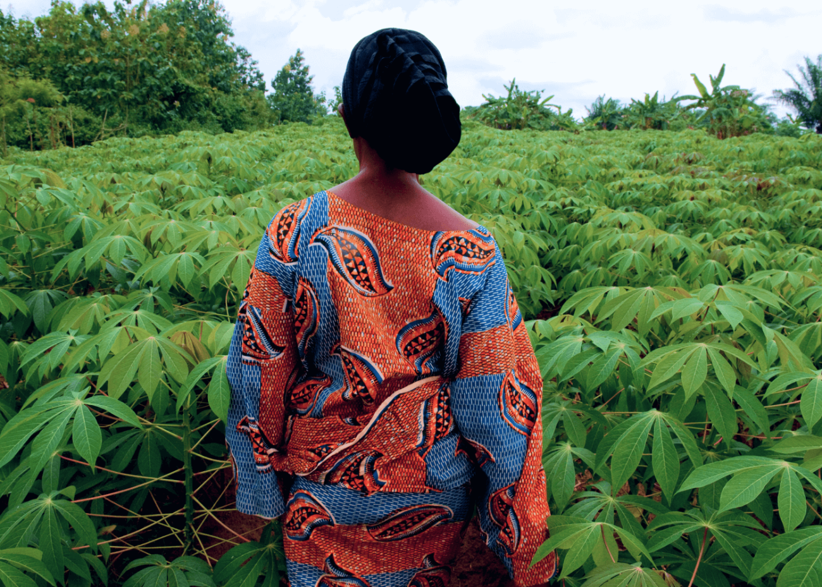
Accelerate Climate Action
In order to limit global warming to 1.5°C above pre-industrial levels, we need to cut emissions in half by 2030.
Taking climate action will help future-proof your business.
Improve efficiency and cut operating costs by reducing energy usage and emissions
Strengthen your reputation with customers, suppliers, investors and regulators whilst reducing your exposure to climate risks
Stay one step ahead of policy changes and climate regulations
Notes:
Accelerate climate action by setting science-based net-zero emissions reduction targets in line with a 1.5°C pathway and contribute to a just transition by addressing social impacts of climate change mitigation and adaptation measures.
How will taking ambitious action in this area benefit your company?
Improve efficiency and cut operating costs by reducing energy usage and emissions
Strengthen your reputation with customers, suppliers, investors and regulators whilst reducing your exposure to climate risks
Stay one step ahead of policy changes and climate regulations
Ensure you leave no one behind in the transition to an environmentally sustainable economy

Slide 15
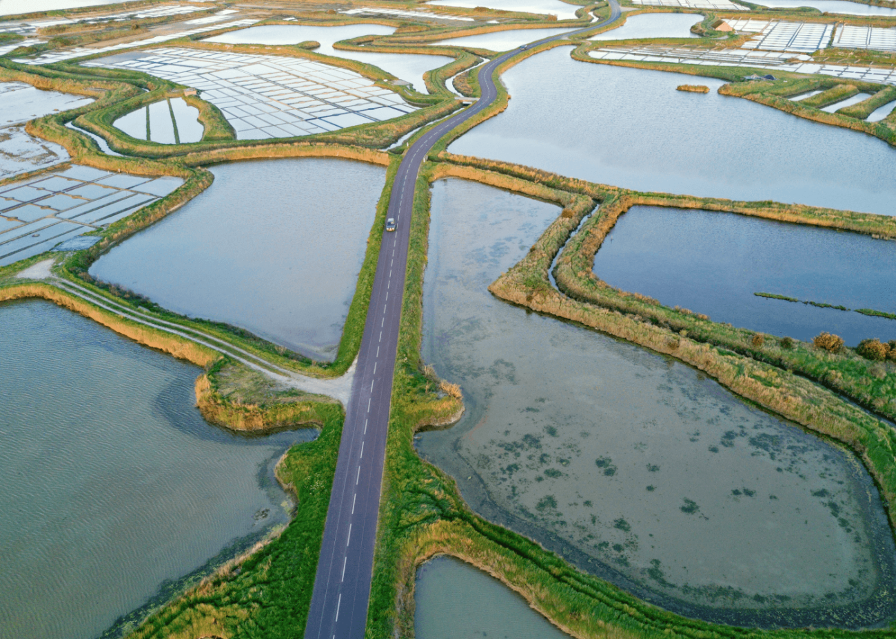
Improve Water Resilience
Right now, more than 2 billion people lack safe drinking water. It is estimated there will be a 40% gap between available water and demand for water by 2030.
Building water resilience at your organisation can improve business performance and accelerate growth.
Notes:
Improve water stewardship by achieving net-positive water impact in water-stressed basins.
Taking ambitious action in this area will help you:
Reduce potential business risks caused by water challenges (operational and supply chain)
Enhance your reputation in the communities you operate and with your investors
Profoundly impact our ability to fulfil the UN human right to water and sanitation (HRWS) and broader Sustainable Development Goals
Support ecosystems that capture, filter and store water resources, while supporting biodiversity and helping to reduce the impacts of climate change

Slide 16
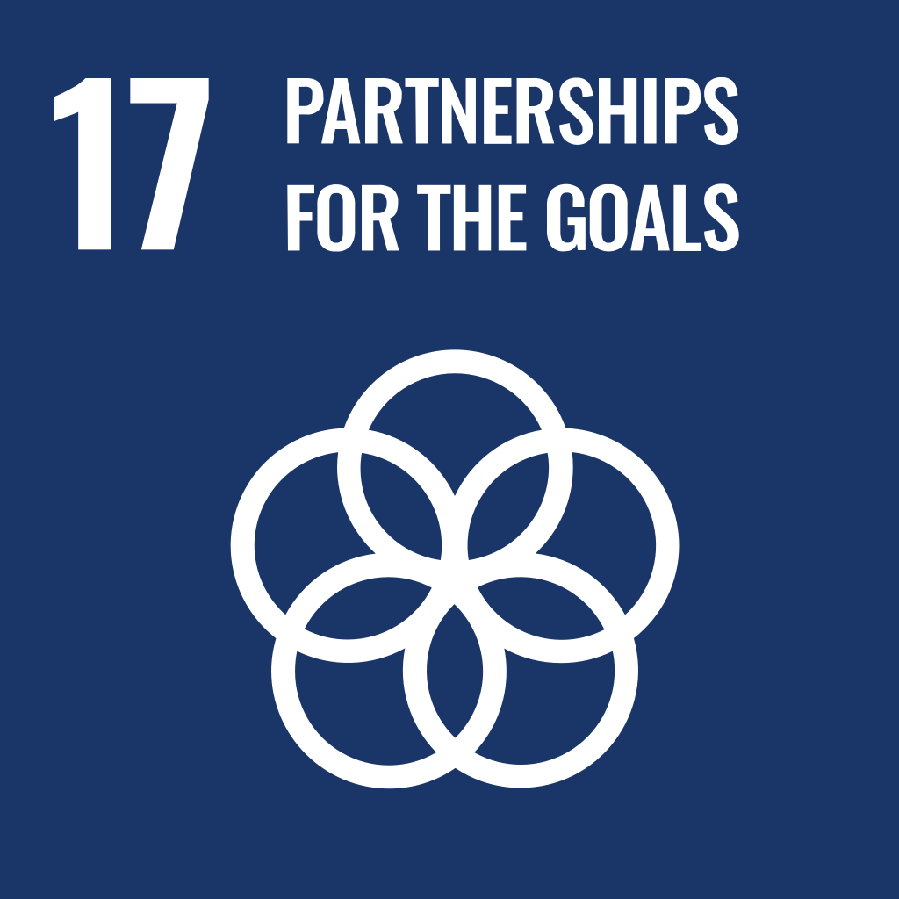
Commit to Sustainable Corporate Finance
The world will need to spend between $3 trillion and $5 trillion annually to meet the Sustainable Development Goals by 2030.
Aligning financial strategies with the SDGs unlocks new revenue possibilities.
Attract investors and open up new avenues for capital investment
Protect long-term financial performance and avoid potential legal and reputational issues
Mitigate risks associated ESG factors
Stay one step ahead of policy changes and climate regulations
Notes:
Commit to sustainable corporate finance by achieving 100% alignment with the CFO principles on integrated SDG investments and finance.
By taking action in this area, you can increase performance and unlock new possibilities:
Attract investors and open up new avenues for capital investment
Protect long-term financial performance and avoid potential legal and reputational issues
Identify and mitigate risks associated with environmental, social, and governance factors
Attract top talent who prioritize purpose-driven work and seek employers committed to sustainability
Expand into new markets and attract environmentally and socially conscious customers

Slide 17
https://forwardfaster.unglobalcompact.org/
Notes:
Pledges are being made. Speeches are being given. But there’s not enough progress happening to meet the 2030 Agenda.
We must be more ambitious.
It’s time to put words into action.
The UN Global Compact has launched Forward Faster to guide companies on where they can make the biggest, fastest impact for 2030.
We want to accelerate progress in five areas that can have a significant multiplier effect:
Living Wage
Gender Equality
Climate Action
Water Resilience, and
Sustainable Finance
There are strong business cases for action in all these areas. We’re not asking for charity.
You can learn more about Forward Faster here: https://forwardfaster.unglobalcompact.org/

Slide 18
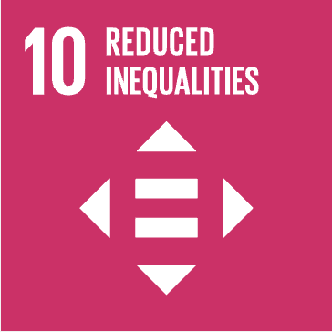
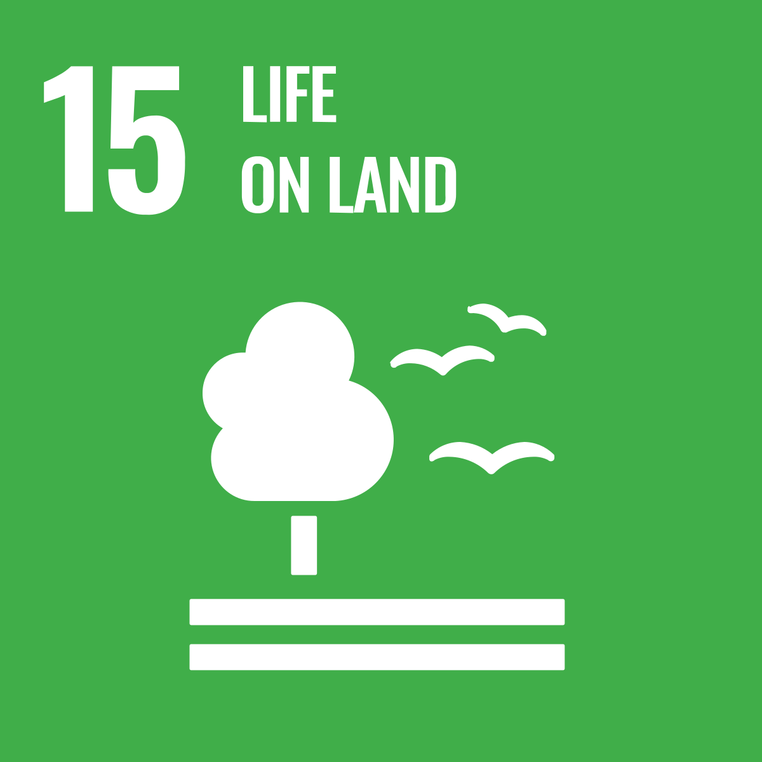
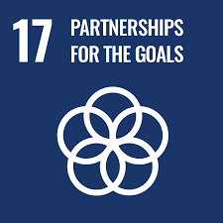
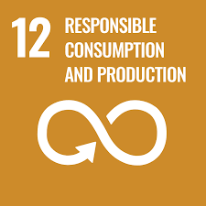
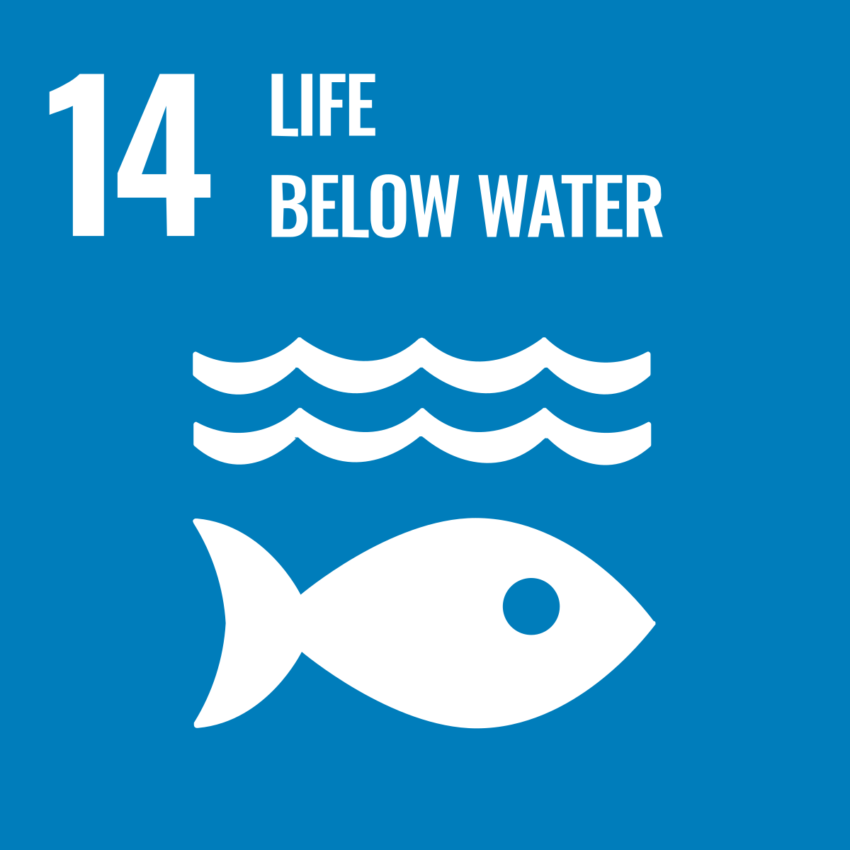
SDG Ambition Benchmarks
Topic | FF | Global SDG Ambition Benchmarks | SDG Impact
 |  |  | Primary | Additional
Gender equality and diversity |  | Gender balance across all levels of management |  | 1, 4, 8, 10, 11
 |  | Equal pay for work of equal value |  | 1, 5, 8, 10
 |  | Improve Diversity, Equity and Inclusion in the workplace |  | 5, 8, 10
Climate Action |  | Science-based emission reduction |  | 3, 9, 12, 14, 15
 |  | Land degradation neutrality |  | 3, 6, 9, 12, 13
Labour Rights |  | 100% of employees across the organization earn a living wage |  | 1, 2, 3, 4, 5, 10, 13
 |  | Zero severe and fatal work-related accidents, injuries and diseases |  | 1, 3, 10
Water resilience |  | Net-positive water impact in water-stressed basins |  | 11, 12, 13,14, 17
Finance, Investment & Governance |  | 100% alignment with the CFO Principles on Integrated SDG Investments and Finance |  | Cross-cutting
 |  | Zero incidences of bribery |  | Cross-cutting
Circularity & Sustainable Value Chain |  | Zero waste to landfill and incineration |  | 6, 9, 11, 13, 14, 15
 |  | Zero discharge of hazardous pollutants and chemicals |  | 3, 6, 9, 11, 13, 15, 17
 |  | 100% sustainable material inputs that are renewable, recyclable or reusable |  | 6, 9, 11, 13, 14, 15, 17
 |  | 100% resource recovery, with all materials and products recovered and recycled or reused at end of use |  | 6, 9, 11, 12, 13, 15, 17
Notes:
The UN Global Compact offers a range of resources and programming
to support companies seeking to bring more rigour to their ESG work by aligning with and internalising the SDGs.
Our SDG Ambition Benchmarks and Forward Faster Campaign provide practical support to companies that are ready to raise their ambition to match the SDGs.

Slide 19
SDG Playbook for SMEs
The UN Global Compact Network UK SDG Playbook for SMEs breaks down embedding the SDGs into core business functions into four simple steps:
STEP ONE: Map Impacts and Identify Priorities
STEP TWO: Setting and Achieving Ambitious Goals
STEP THREE: Communicate and Report
STEP FOUR: Partnerships for the Goals
Notes:
For smaller companies, the UN Global Compact Network UK has produced a playbook to help you gain business benefits from engaging with the Goals.
It is a step-by-step guide to help smaller companies unlock the competitive advantages associated with embracing the SDGs in four simple steps.

Slide 20
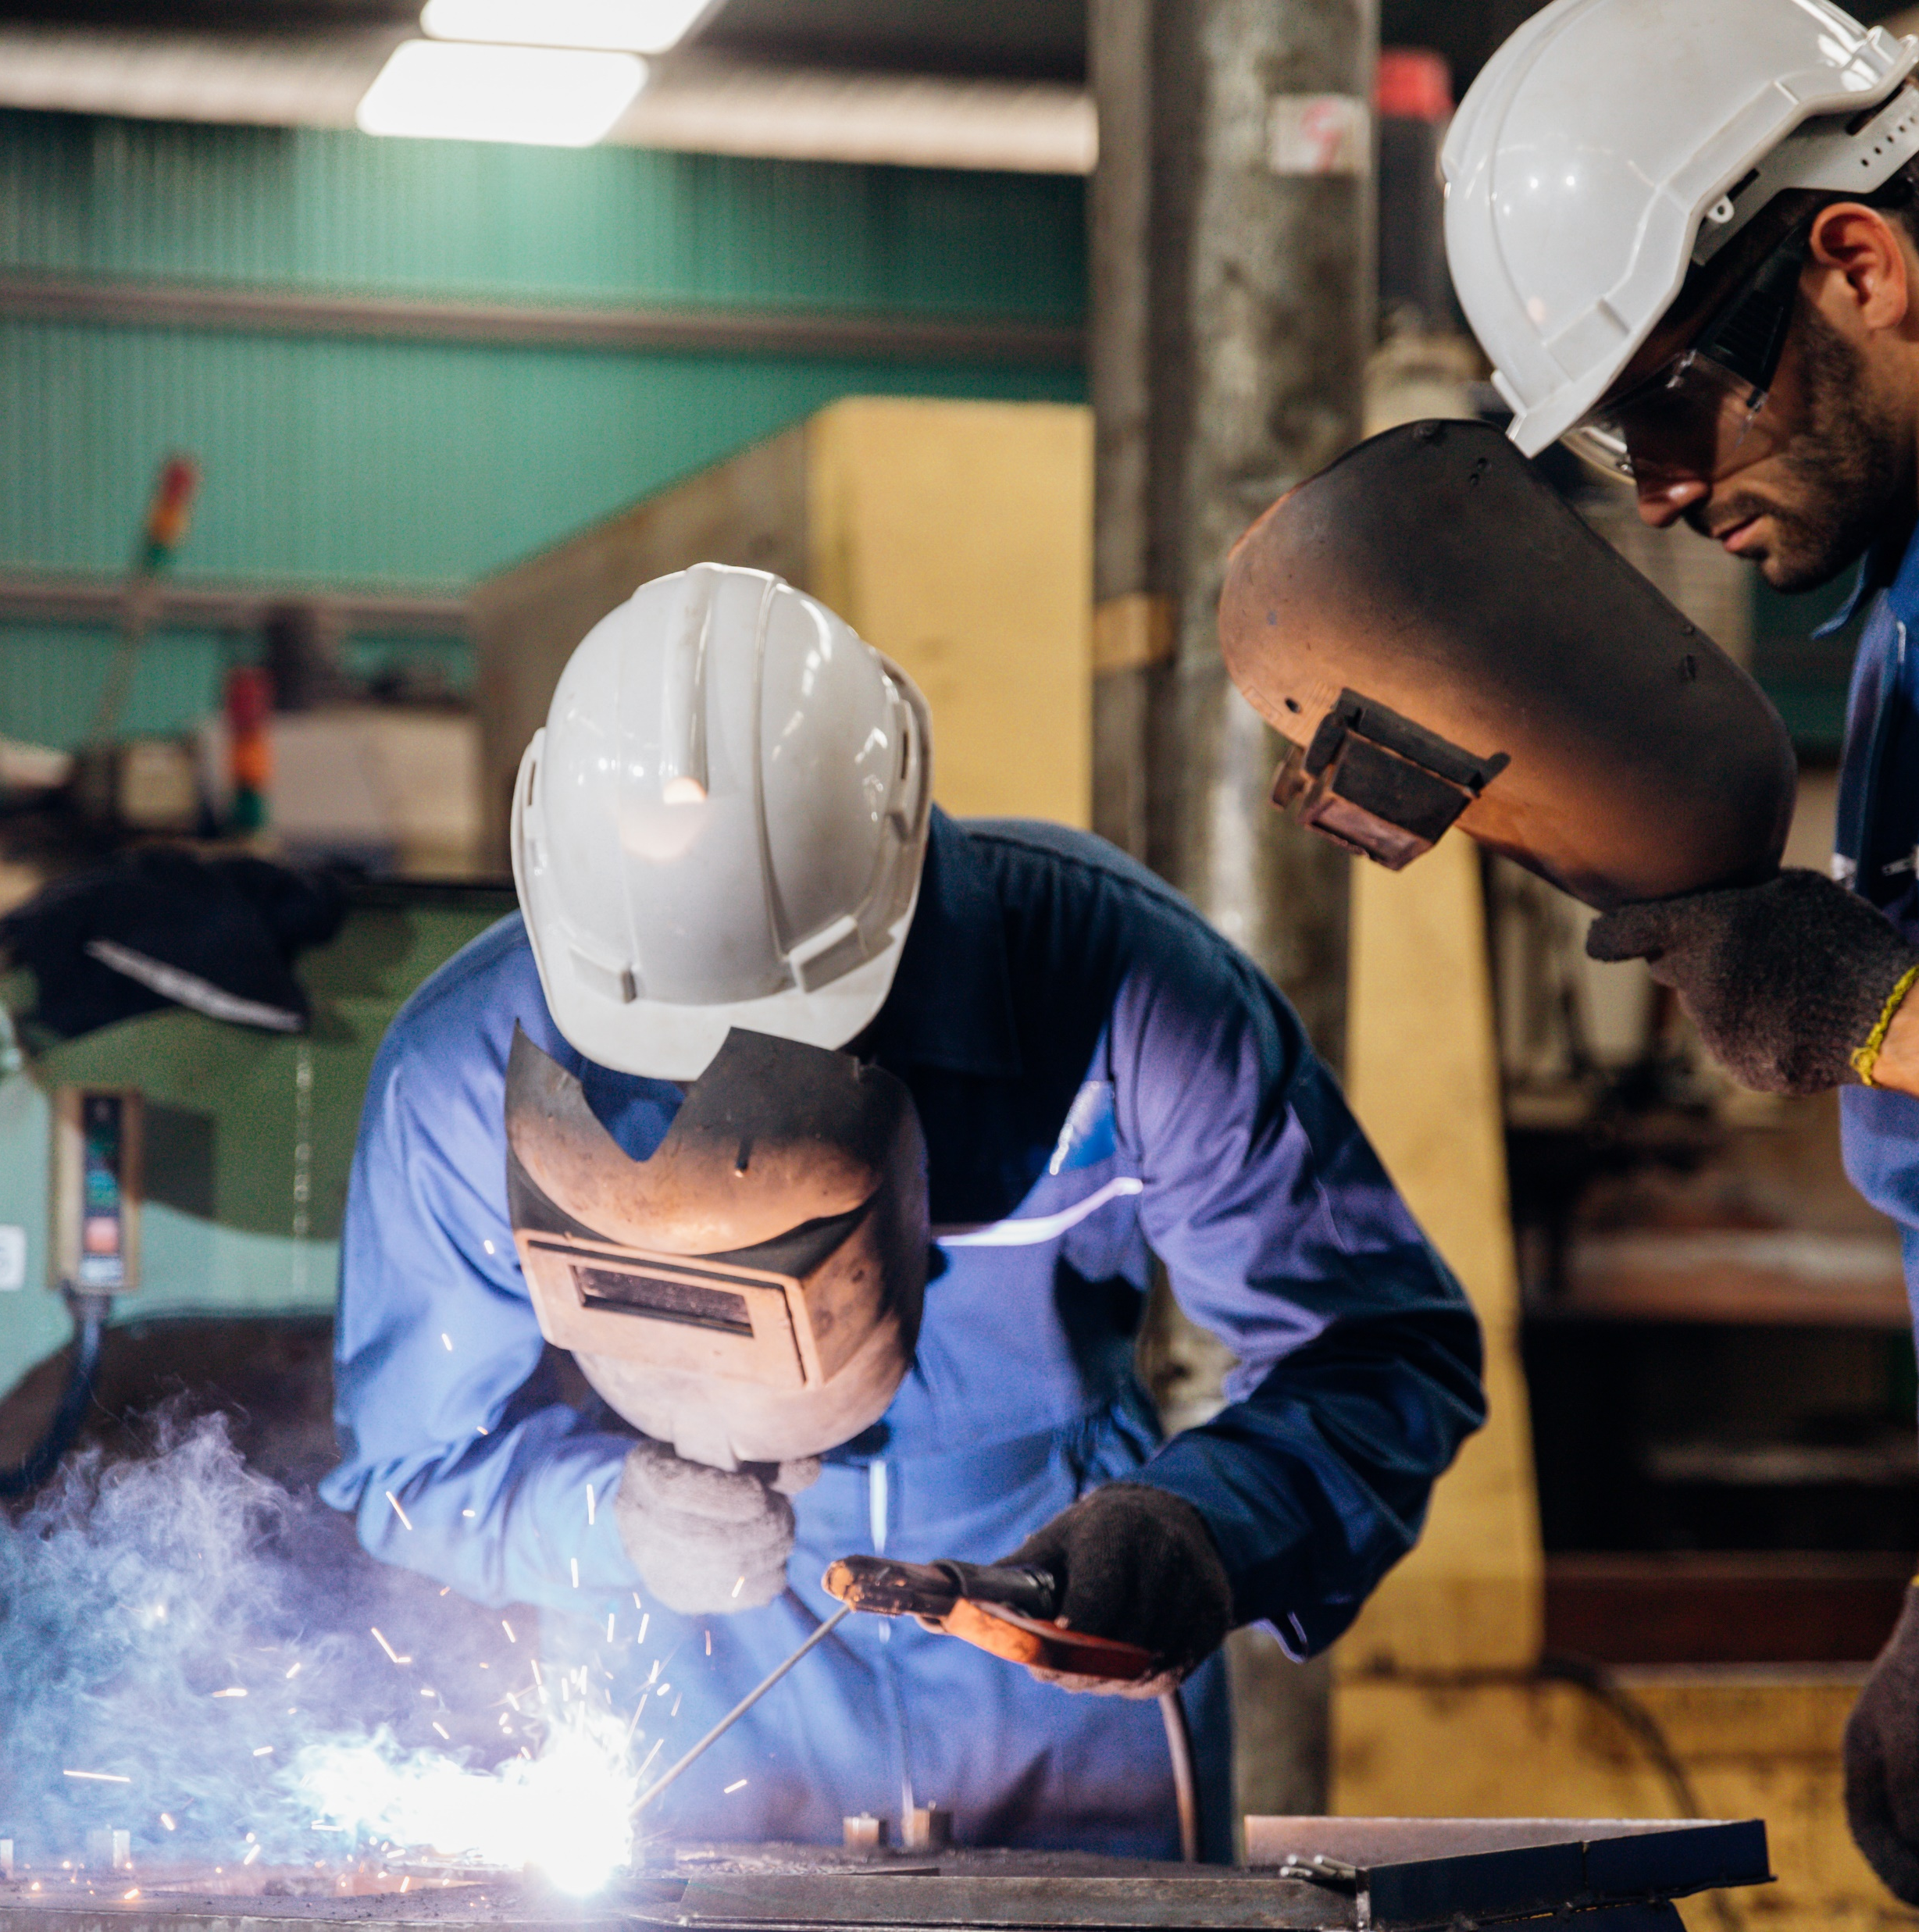
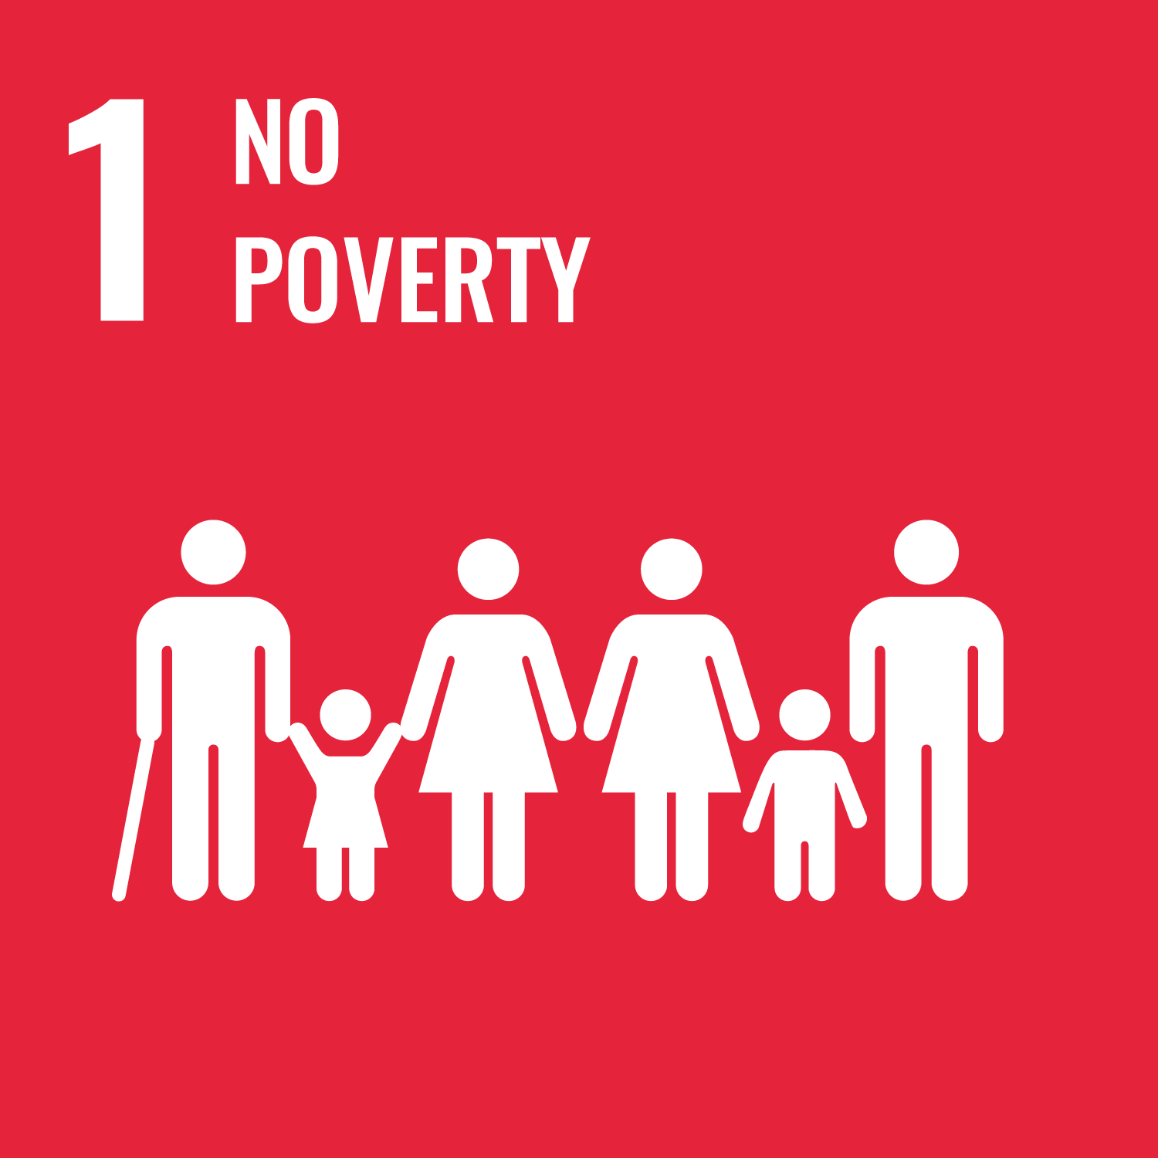
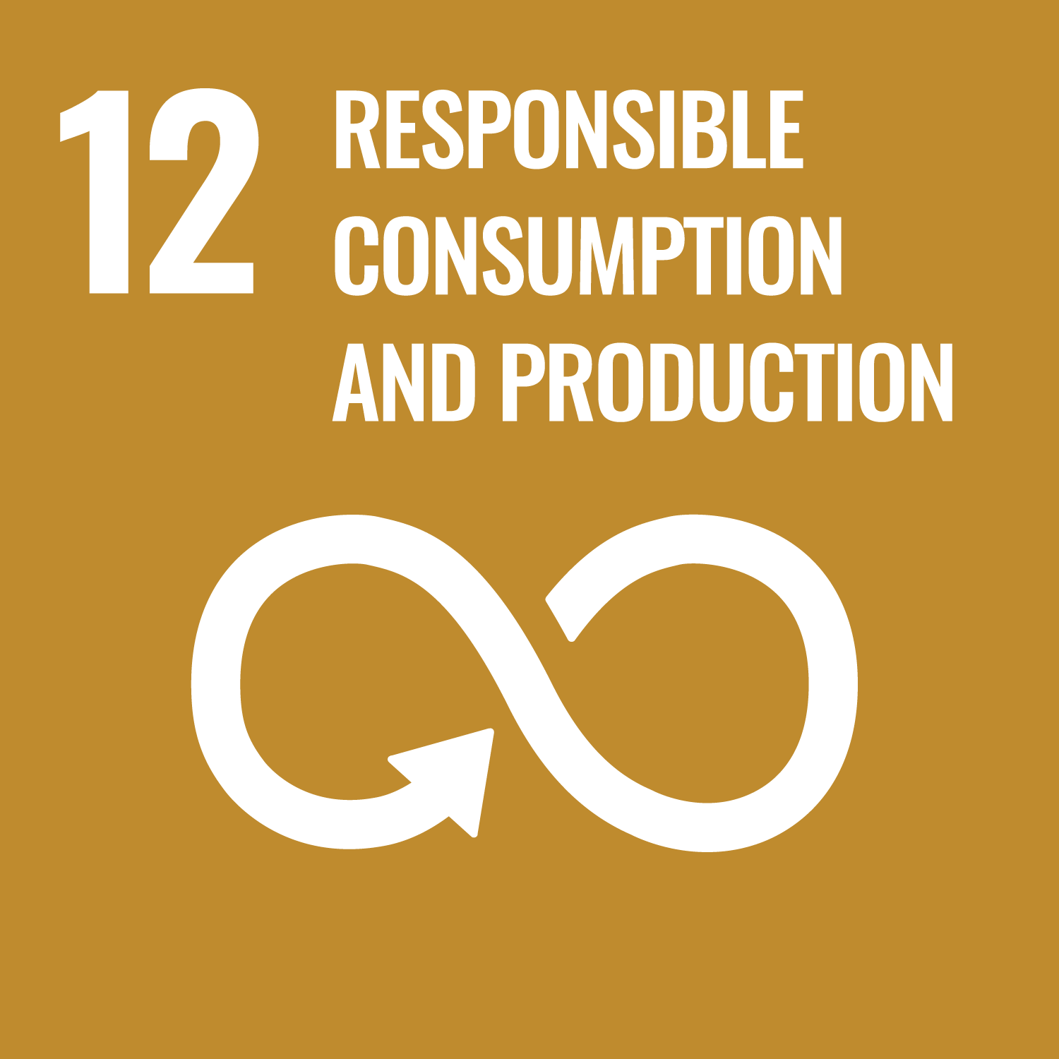
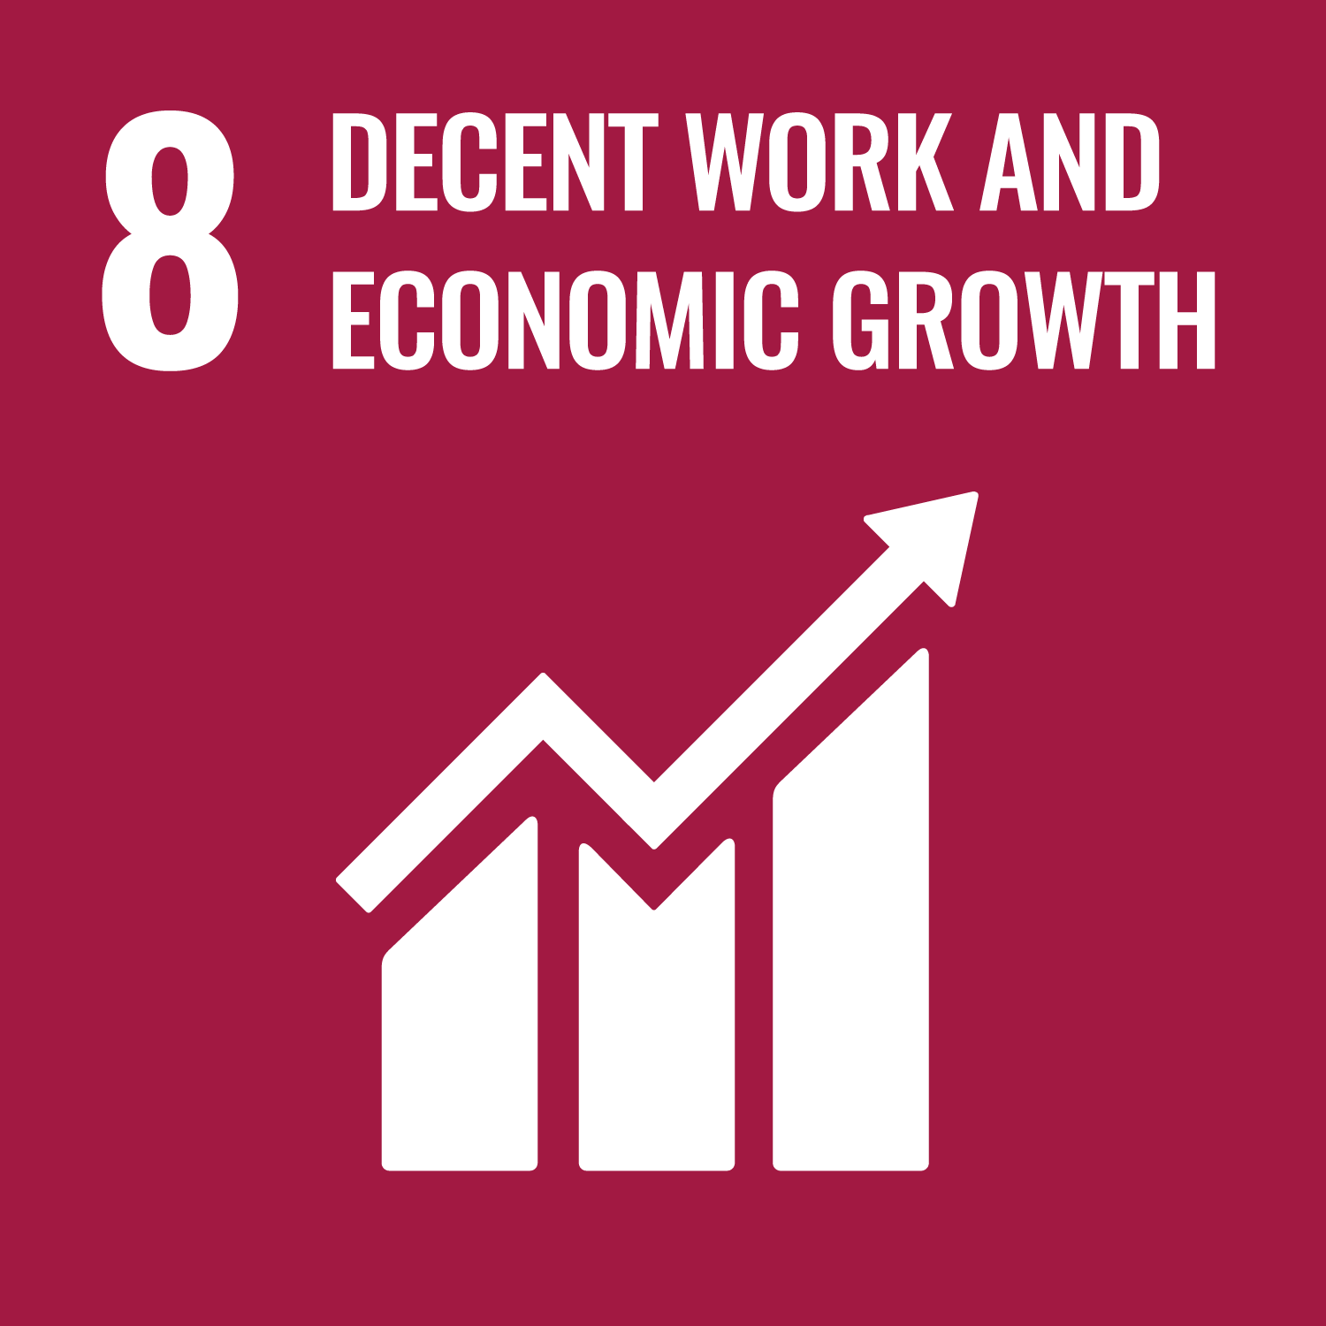
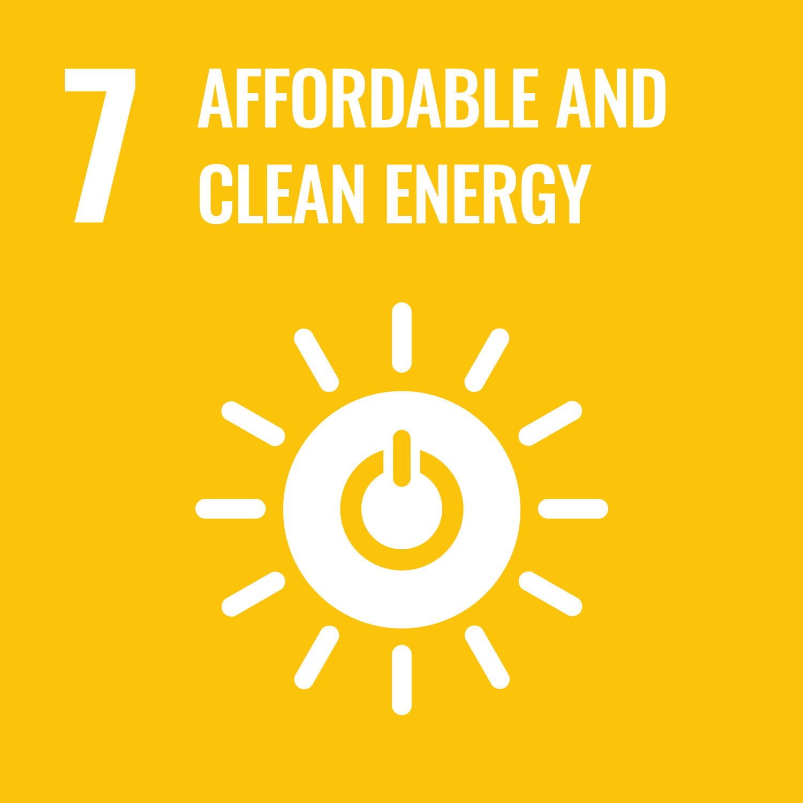
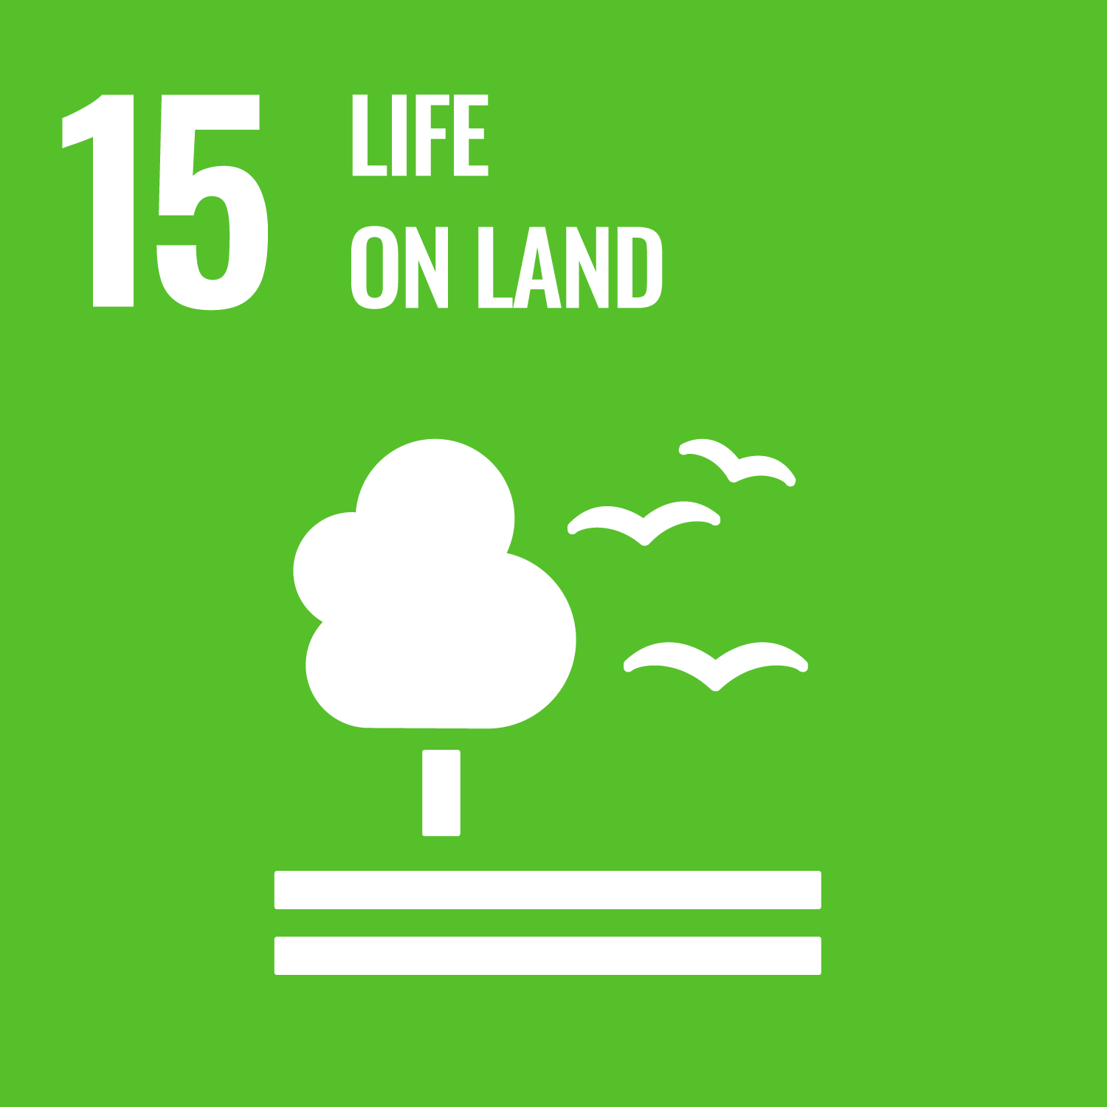
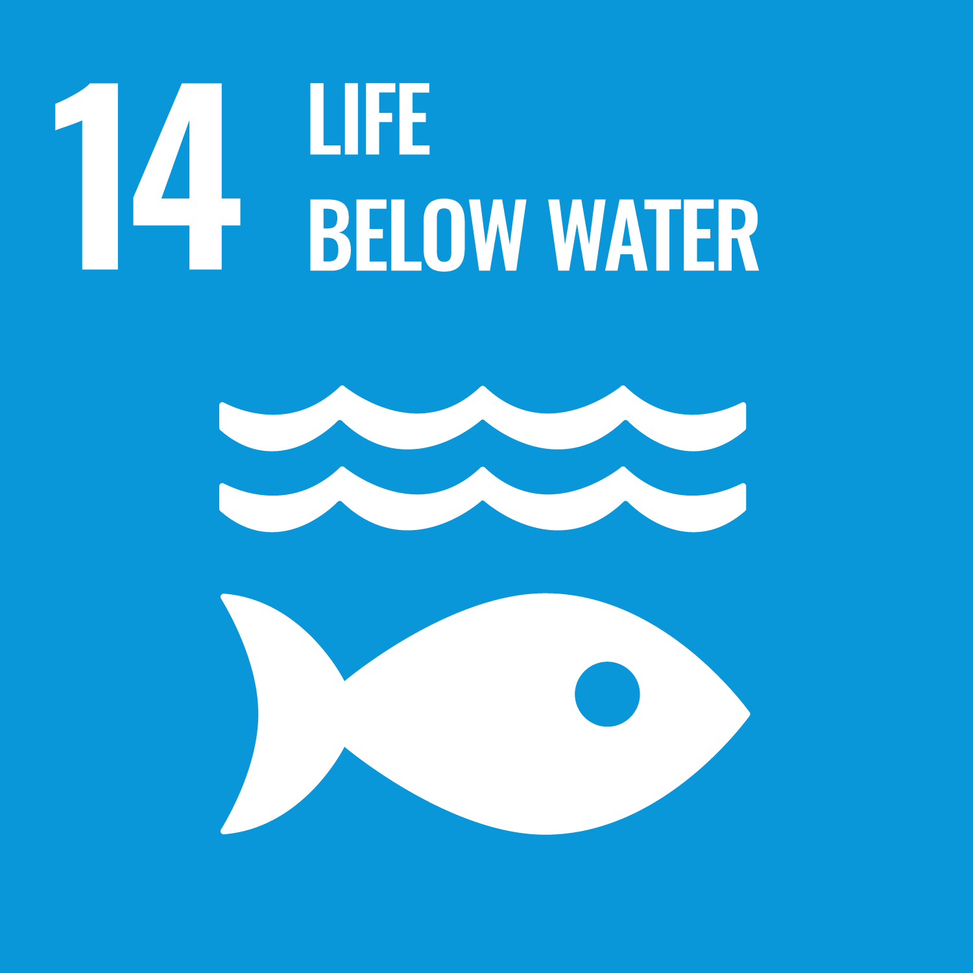
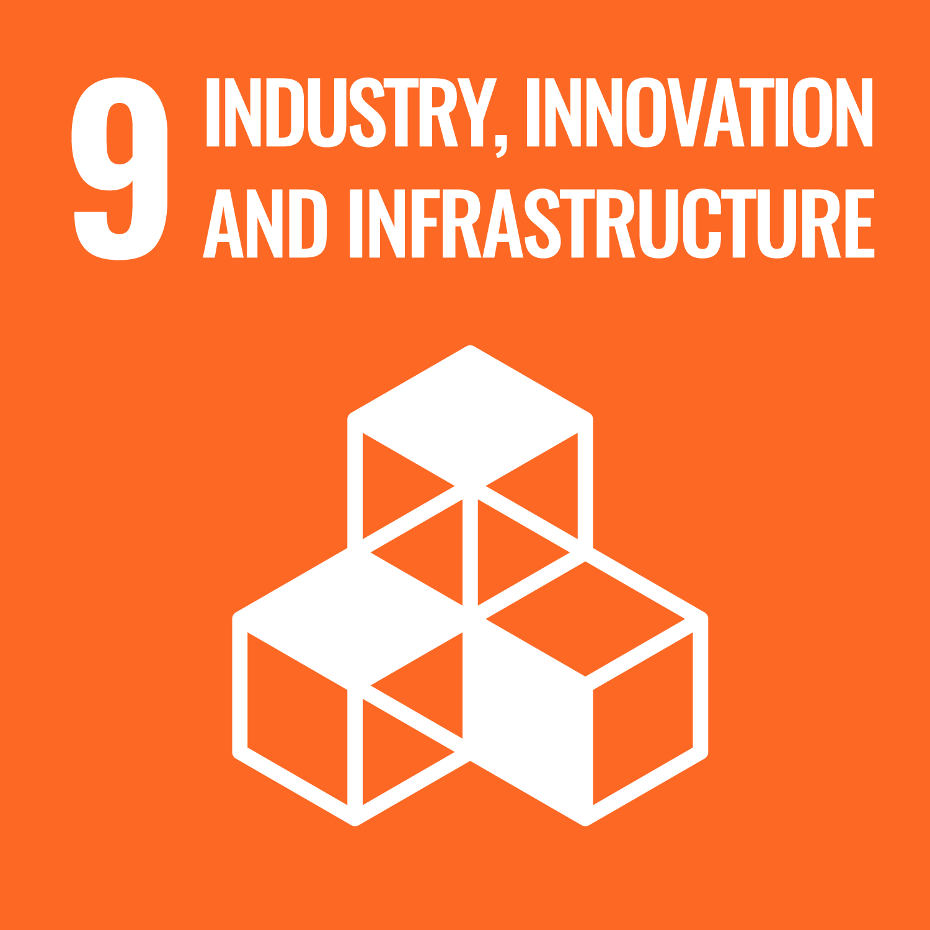
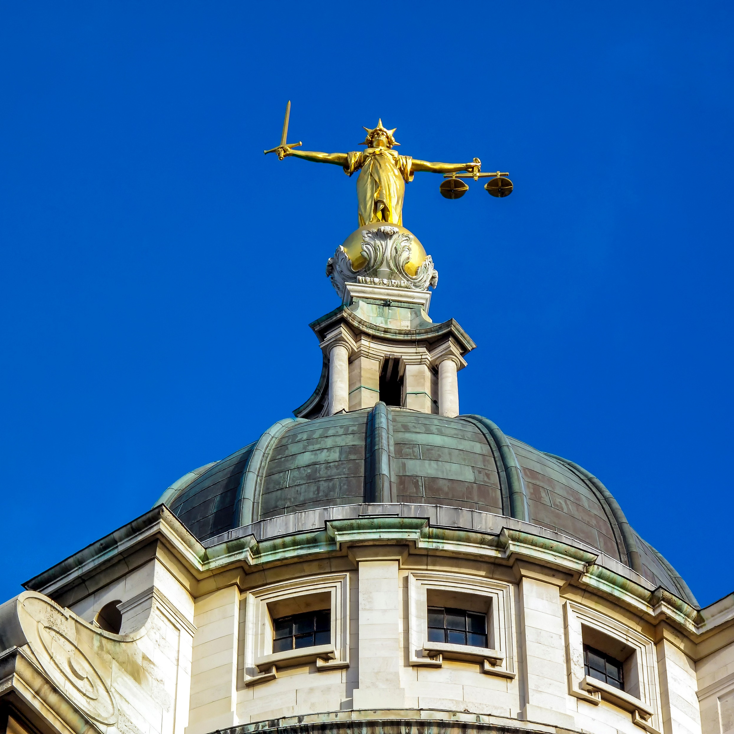
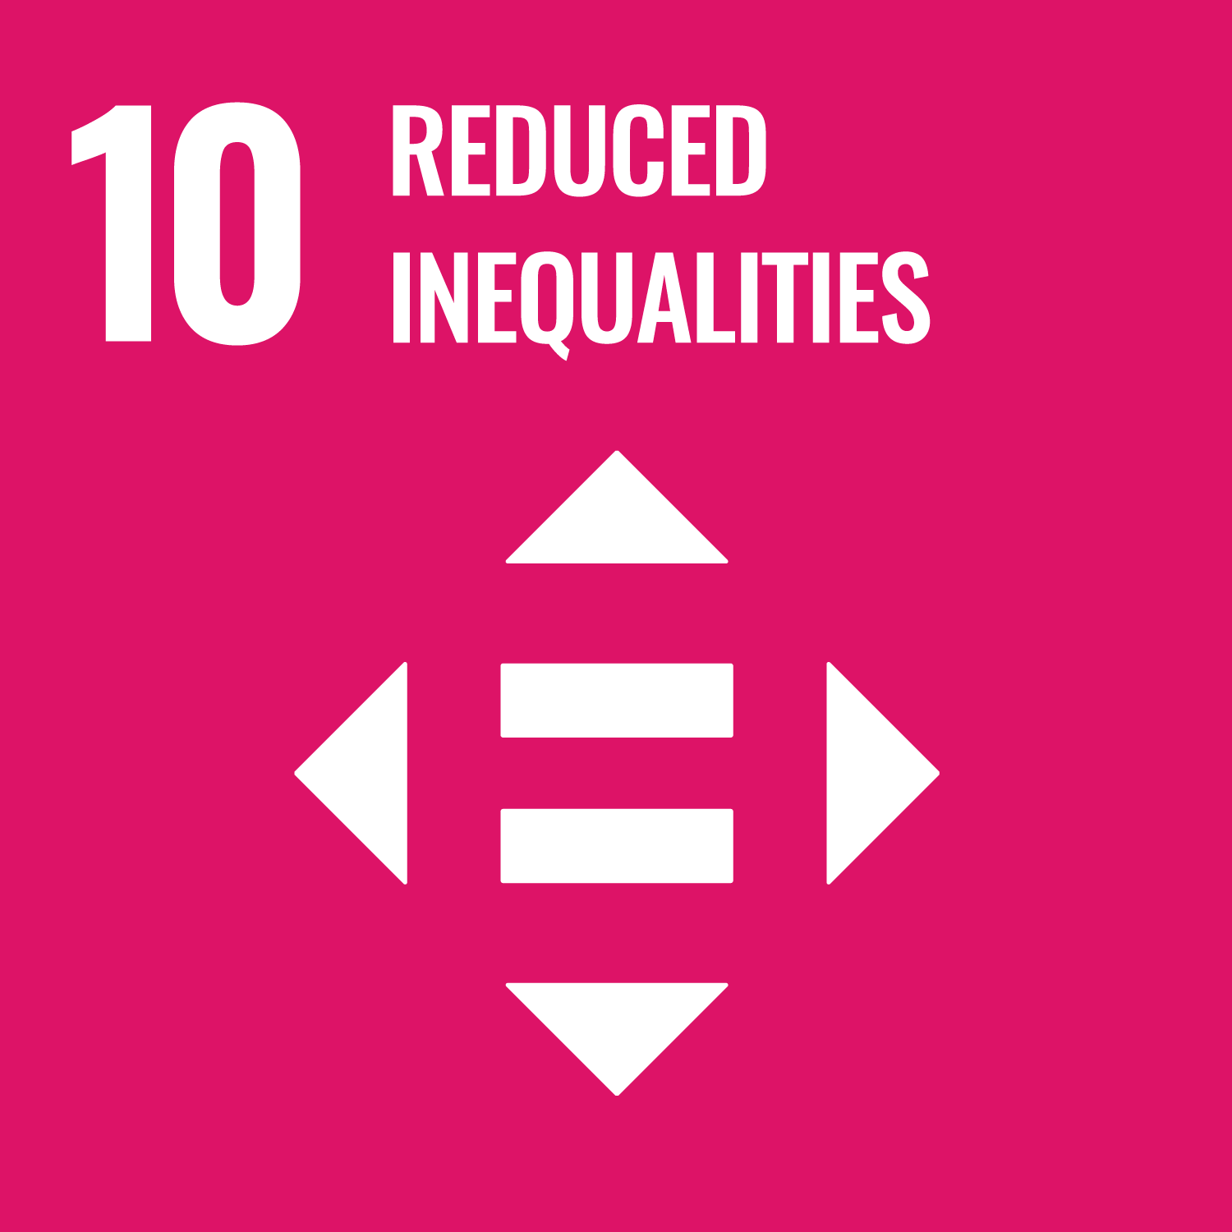
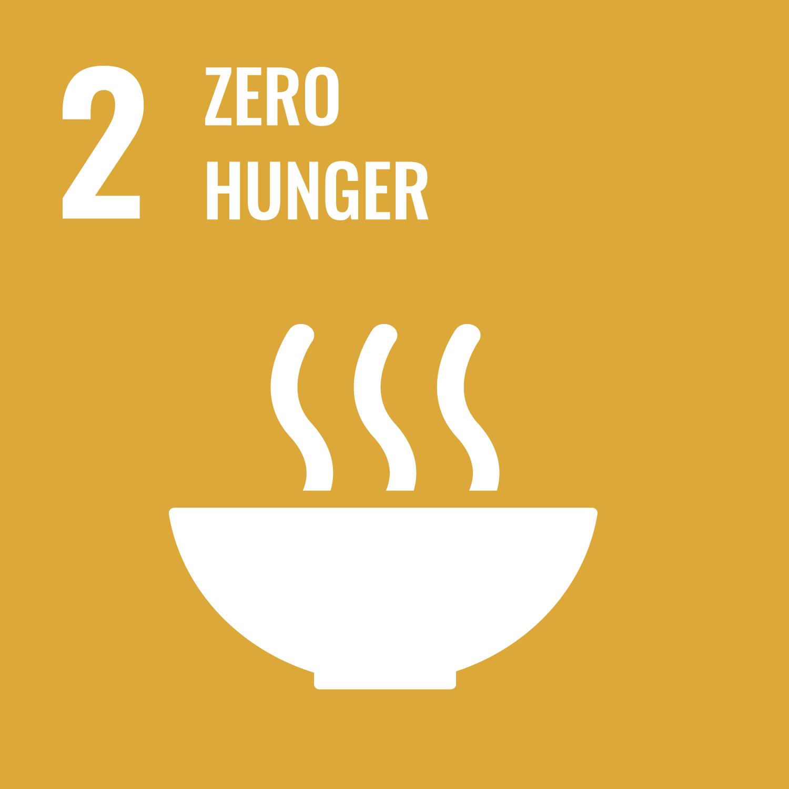
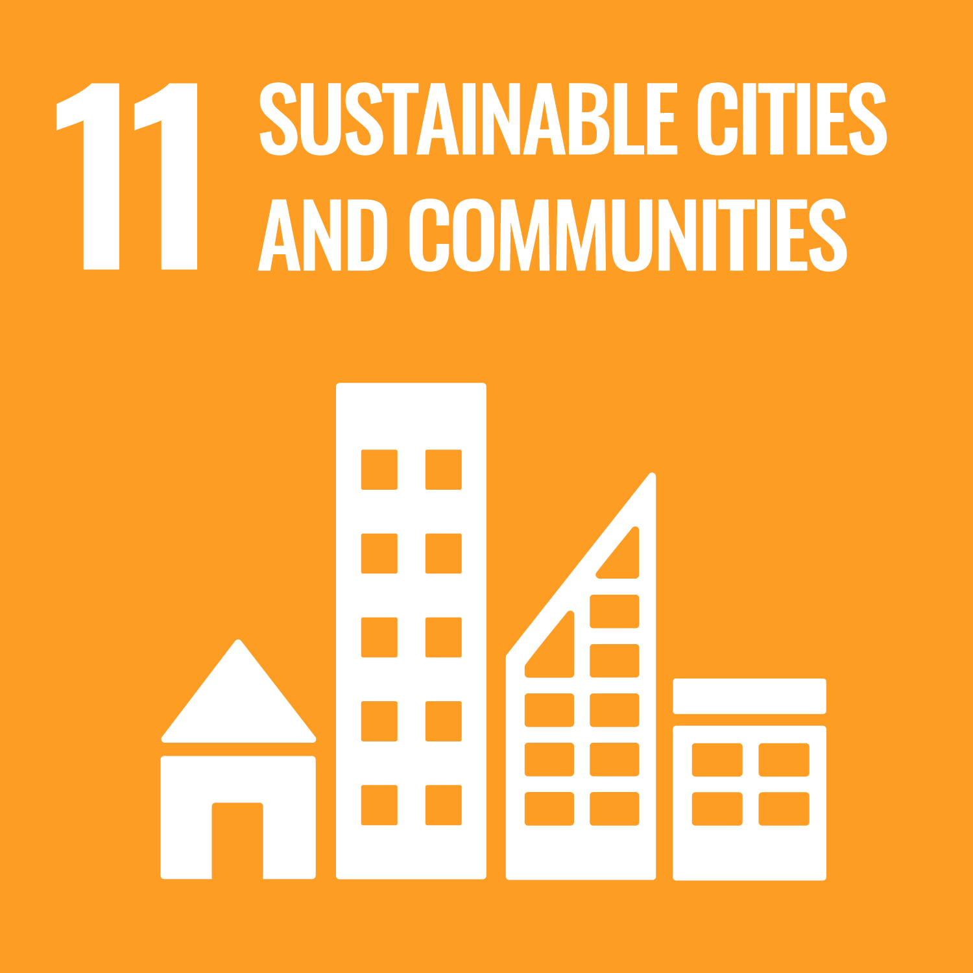
Engagement with the Goals has increased but we need more action, from more organisations, at a more strategic and ambitious level, to help us meet the SDGs and deliver the future we want.
Notes:
My penultimate slide,
I want to return to the idea of creating the future we want.
It’s not going to happen organically. We cannot afford to be passive and just go with the flow.
That’s how we get the future we deserve…
The future we want is where all people and the environment can thrive.
We want a just transition to a net zero economy that avoids the worst impacts of climate change and adapts to the changes we can’t avoid. Where no one and no place is left behind.
No poverty. Good health and well-being. Gender equality. Affordable, clean energy. Decent work. Sustainable cities. Peace.
The SDGs provide the vision and a practical globally recognised framework to deliver this future – and notably the all of your governments have already committed to it.
Many of you are already doing great work in this area.
I urge you to make that commitment more tangible and more visible.
Use the SDGs as a tool to mobilise enthusiasm and resources.
Use the SDGs as a framework for action rather than reinventing this agenda.
There is great power in being part of this global movement;
I encourage you to harness that power to increase your own impact and achieve your own sustainability goals.

Slide 21
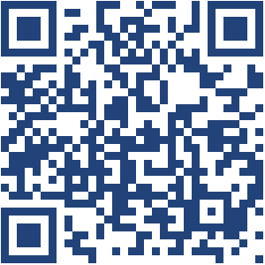
Thanks!
The UN Global Compact’s aim is to mobilise a global movement of sustainable companies and stakeholders to create the world we want.
The UK Network delivers an extensive programme of activity to support Global Compact signatories to operationalise the Global Compact's 10 principles that cover human rights, labour, environment and anti-corruption - and to promote the Sustainable Development Goals.
Steve Kenzie LinkedIn:
Follow UN Global Compact at:
LinkedIn: @united-nations-global-compact
@un-global-compact-network-uk

