Slide 1
“Transforming Organizational Models to Embrace Sustainability: A call for new leadership."
Dr Marc Kahn
Chief Strategy and Sustainability Officer, Investec Plc, London
Senior Associate, CISL, Cambridge University
2024

Slide 2
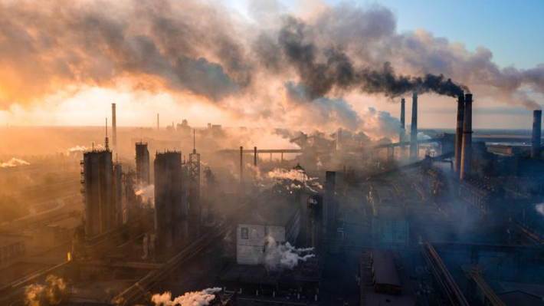
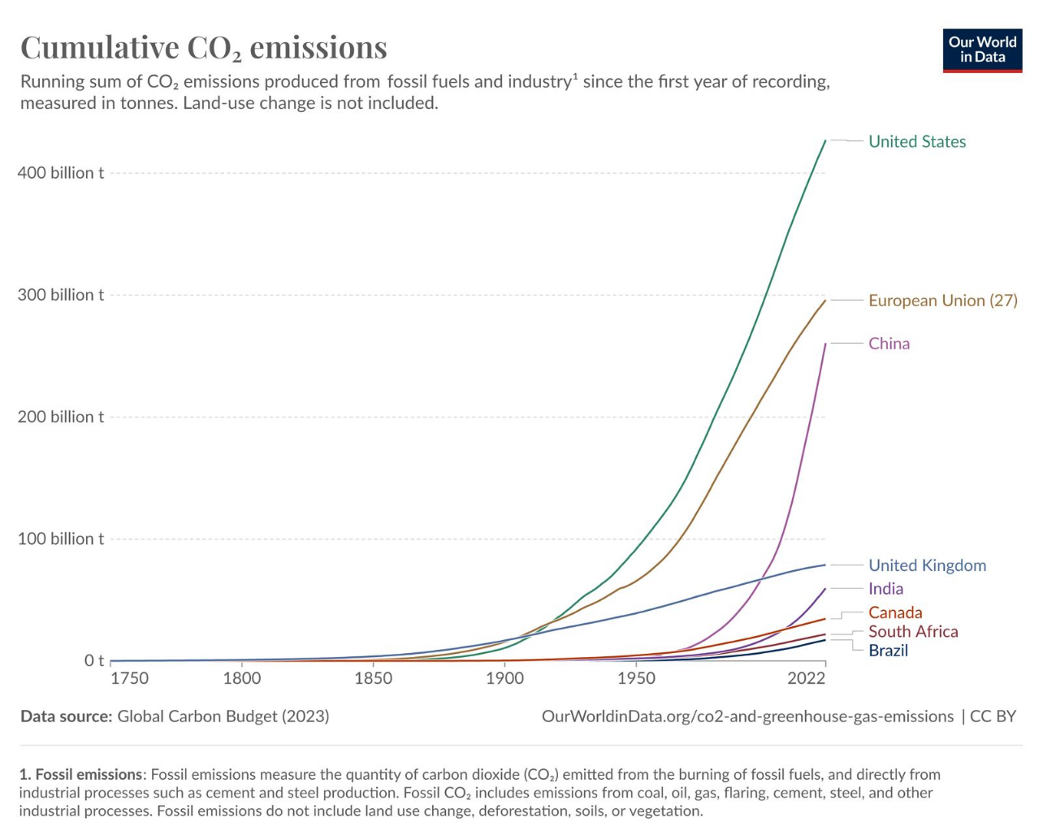
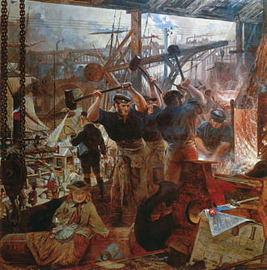
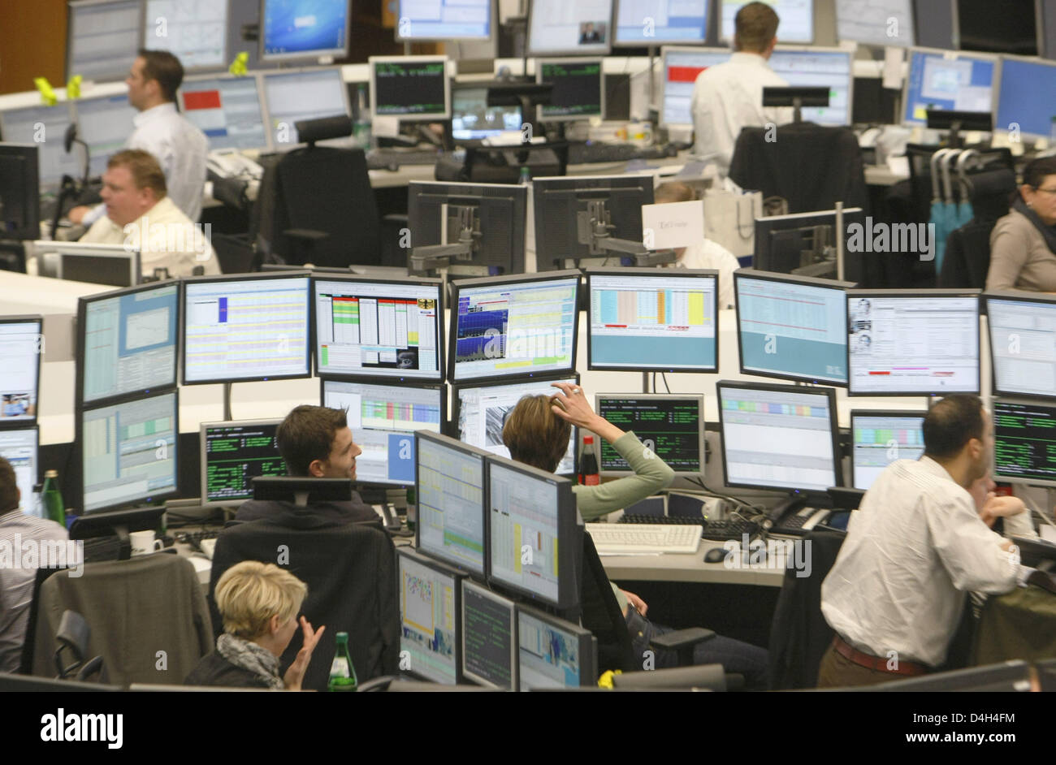
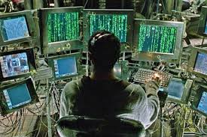
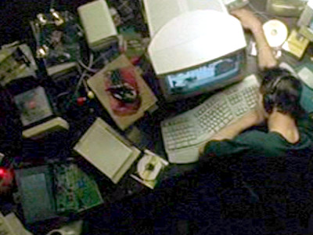
The Industrial Age: c. 1760 – c. 1989
The Information Age: c. 1947 -
Iron and Coal, 1855–60, by William Bell Scott illustrating the rise of coal and iron
The Matrix, 1999, depicts a dystopian future in which humanity is unknowingly trapped inside the Matrix, a simulated digital reality.

Slide 3
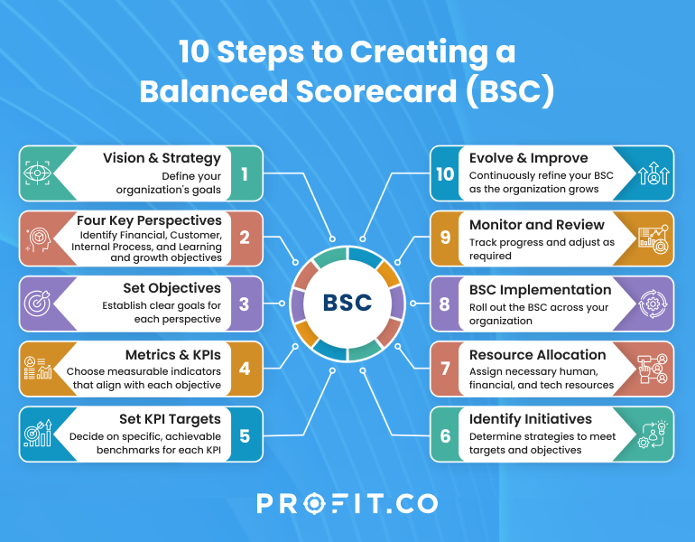
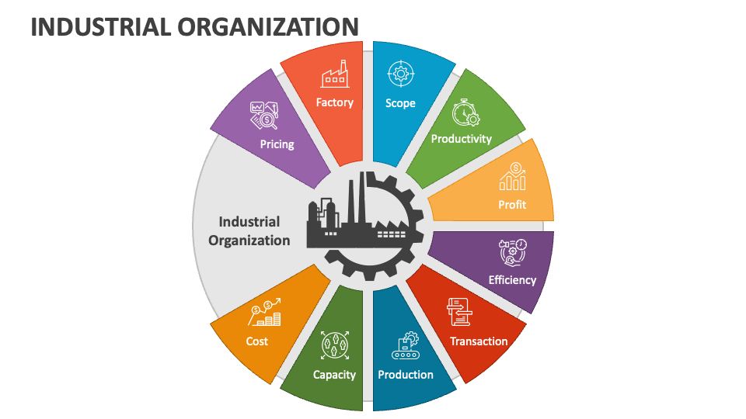
Our current dominant organisational model
Good financial outcomes = good long-term well-being

Slide 4
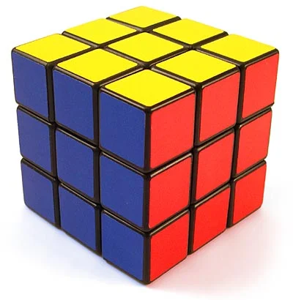
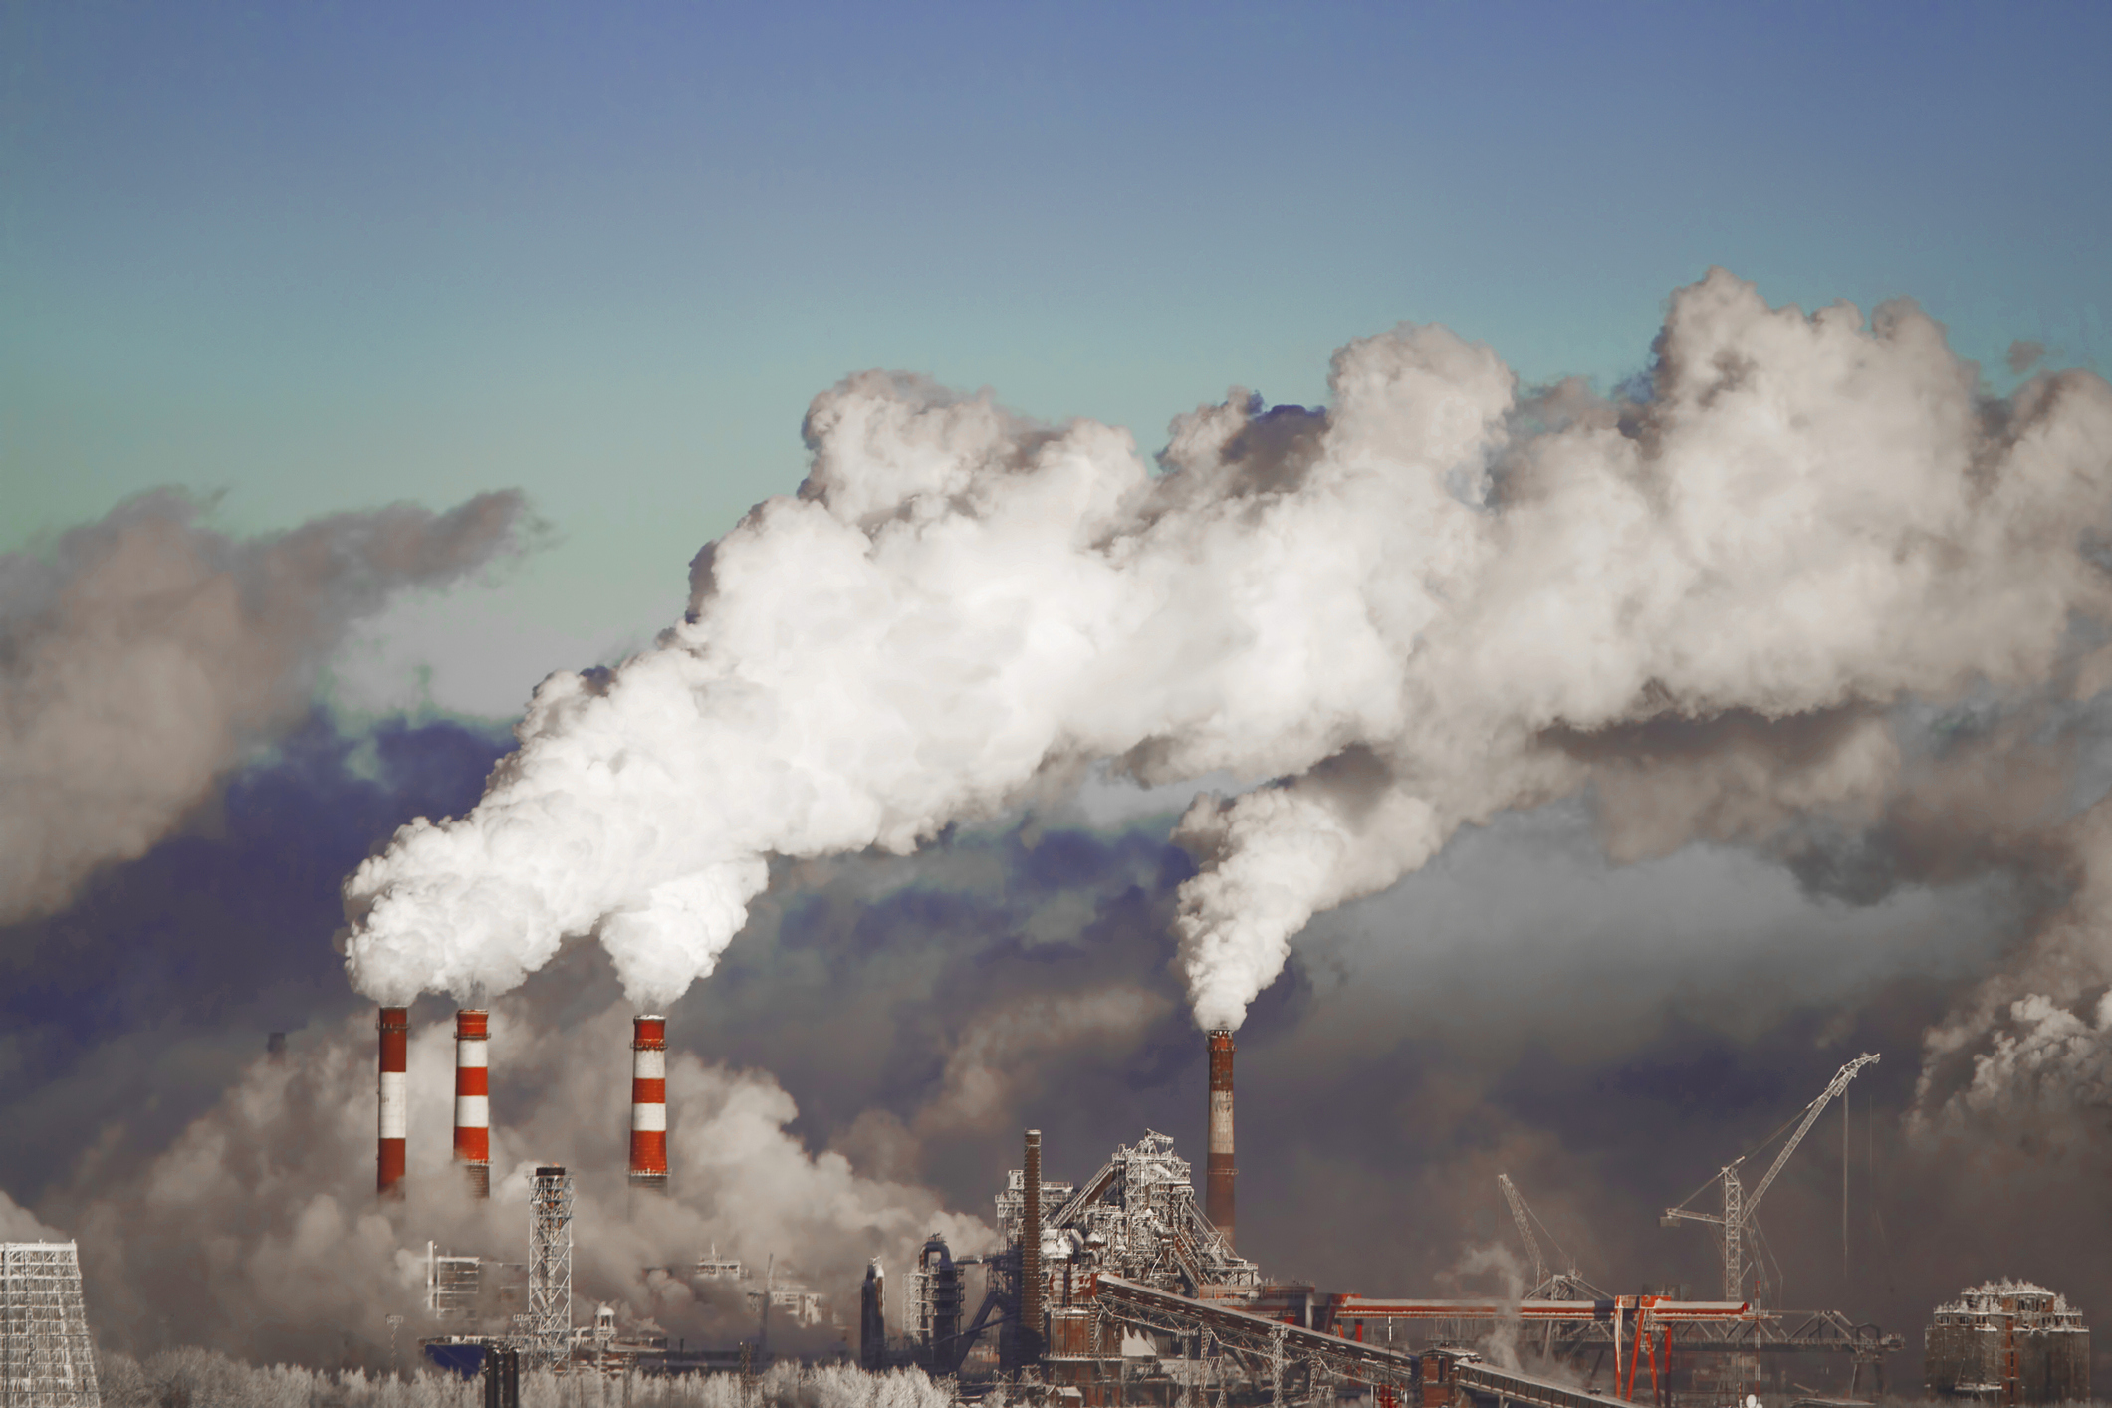
Two important negative vectors of the industrial organisation:
Reductionism (linear thinking):
The simplification of complex systems or problems by breaking them down into smaller, more manageable parts, although helpful in many contexts, overlooks the interconnectedness and holistic nature of the world and results in a range of negative outcomes for human beings and the environment.
Unsustainable Practices:
Rapid technological advancements and increased consumption have led to environmental degradation and the depletion of valuable resources. Short-term gains and prioritizing profit maximization have often overshadowed long-term sustainability and responsible resource management.

Slide 5
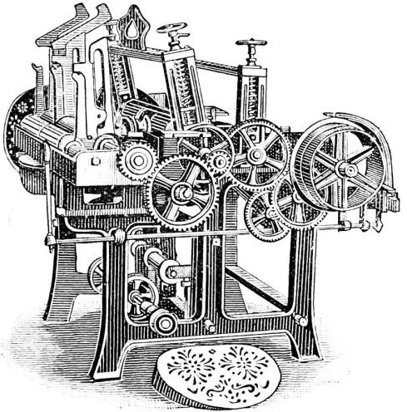
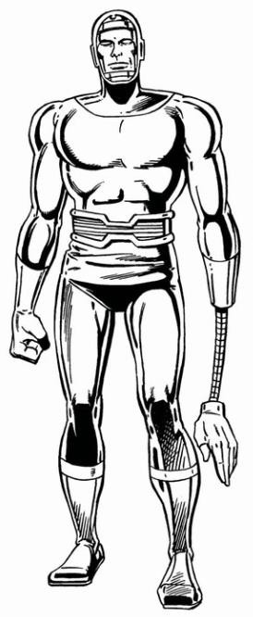
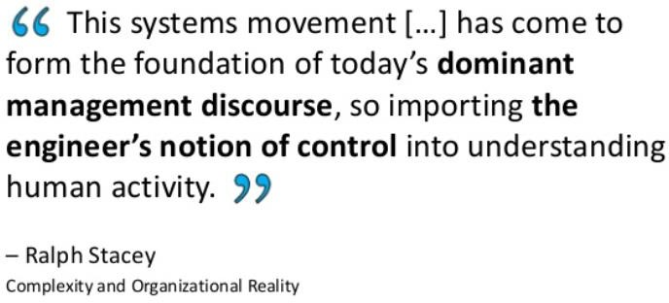
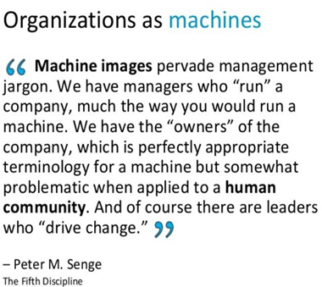
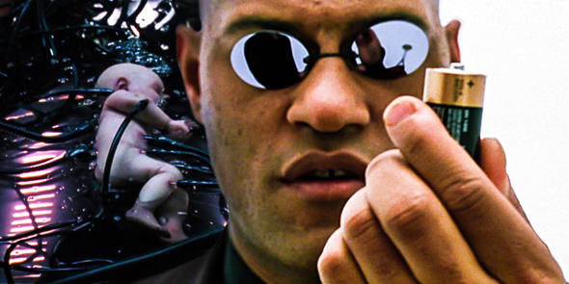
20th Century Leadership Thinking
"Organization [digital/machine] Man”
A cog or data program in a corporate machine
Ghoshal and Bartlett (2011) The Individualised Corporation. Harper

Slide 6
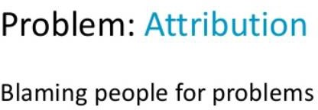
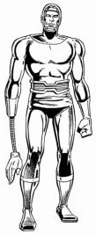
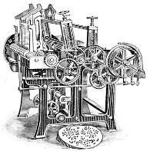
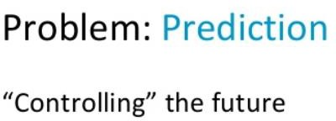
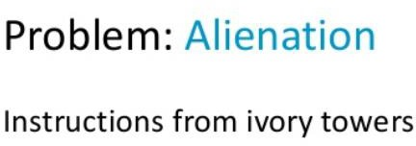
“Line manager’s challenge”
“Executive’s challenge”
“Consultant’s challenge”
“Project manager’s challenge”
“Architect’s challenge”
Reference: Jurgen Appelo, Complexity Theory

Slide 7
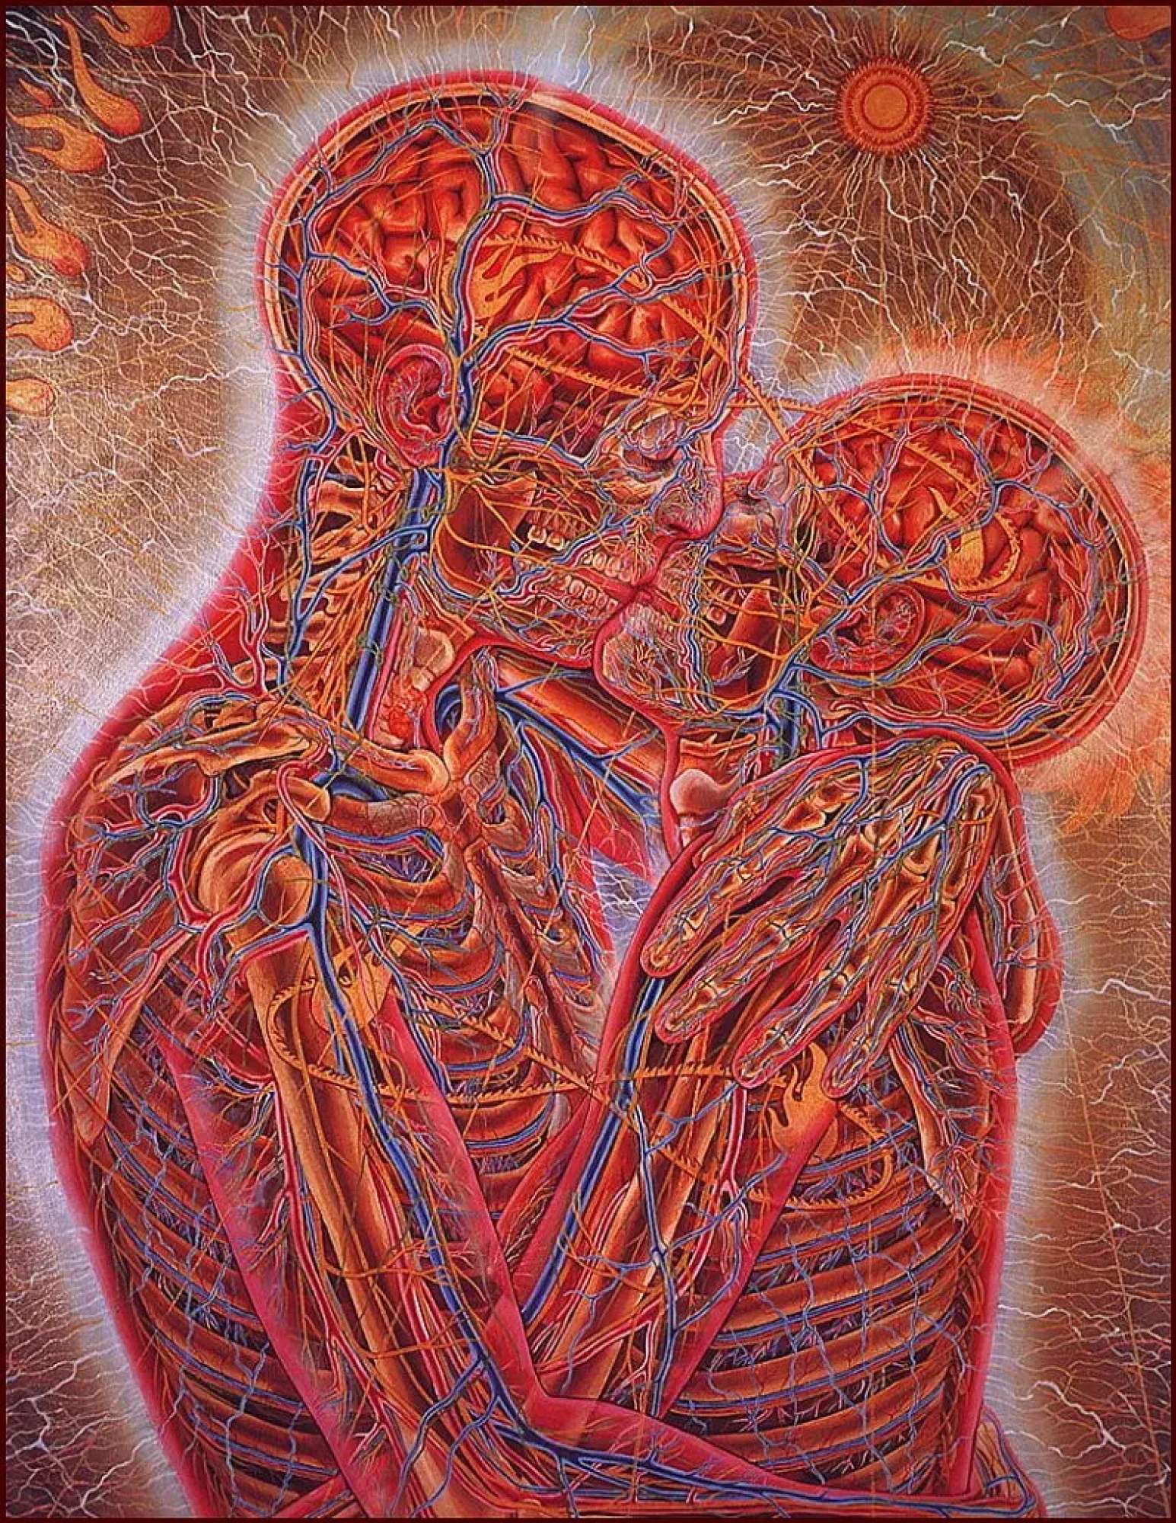
“The image in the painting could have us believe that what we are seeing here is only another illustration of the power of technology to make visible something that was previously merely hidden. Then the kiss is in danger of becoming a rush of neurochemical processes initiated by pressure contact between two pairs of mucous membranes of two people. There is no doubt, of course, that in one sense the kiss is such an event. But there is also no doubt that that kiss lies at an immeasurable distance from the experience and imagination of a kiss in human life.”
- Robert D. Romanyshyn, 1989, Technology as Dream and Symptom
‘A materialist attitude leaves no space for the human spirit… It is crucial that we see we are in an ethical dilemma about the way we treat the earth, the way we treat each other…We have to forge a new attitude… To do so will require of us the wisdom and intelligence to use the power of technology to open the surfaces of events into their invisible depths, and to avoid the use of that power to raise [reduce] all depths to a visible surface.’’
- Alex Gray, 1984, in an interview with Boston Visual Arts News
‘Kiss’ by Alex Gray, 1983

Slide 8
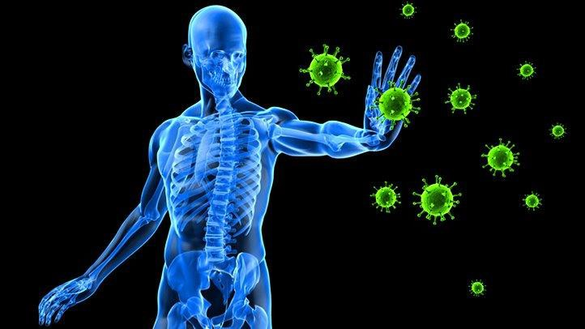
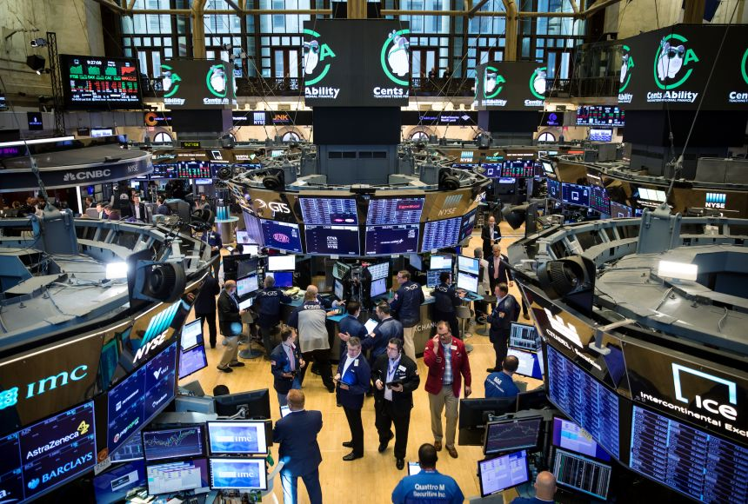
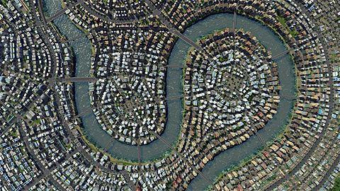
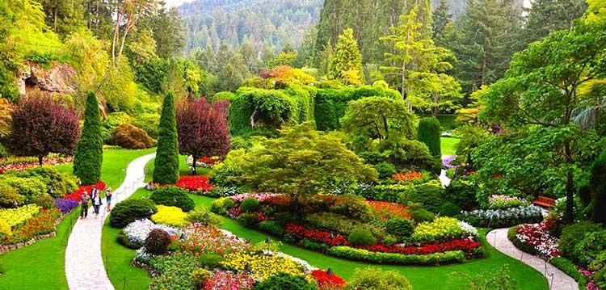
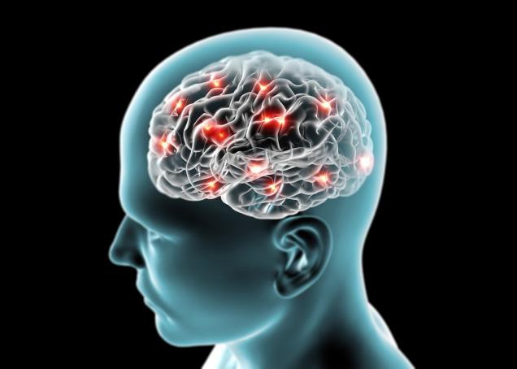
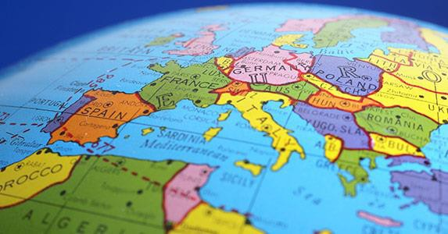
LIVING SYSTEMS
“Self-organization cannot be a best practice. It is the “default practice” of any system, including teams. No matter how you manage a team, there will be self-organization. People will discuss and agree on everything that management does not constrain (and much that it attempts to) and will self-organize. Humans have behaved this way for 200,000 years.”
Appelo, J. (2011). Management 3.0. Addison-Wesley

Slide 9
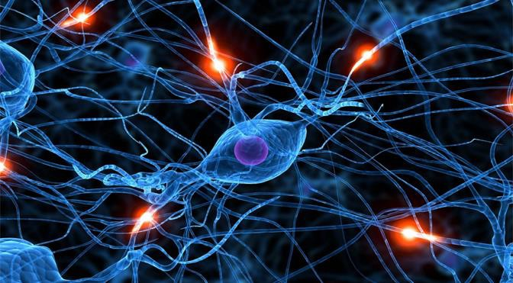
Complex Adaptive Systems (CAS) are open, evolutionary aggregates – neural-like networks – of interacting, interdependent agents cooperatively bonded by a common goal, purpose, or outlook.
(Ref: Cilliers, 1998; Holland, 1995; Langston, 1986; Marion, 1999; Uhl-Bien, Marion, & McKelvey, 2007).
They arise naturally in social systems, learn and adapt rapidly and are capable of creative problem solving.
(Ref: Carley & Hill, 2001; Carley & Lee, 1998; Goodwin, 1994; Levy, 1992; as cited in Uhl-Bien, et al., 2007).

Slide 10
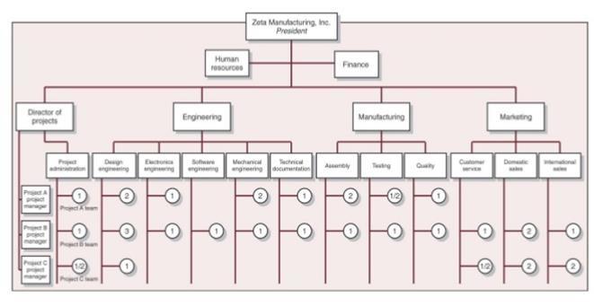

Slide 11
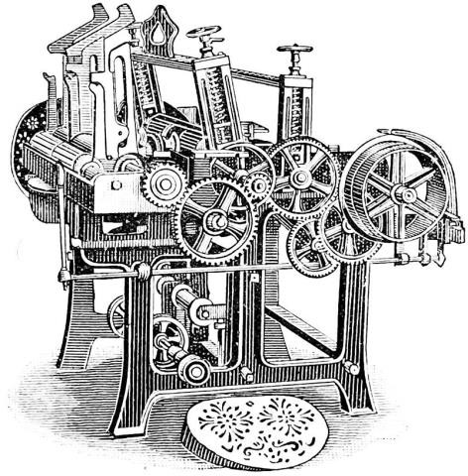
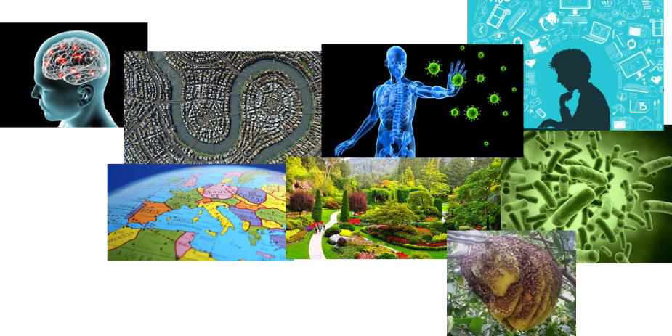
From 20th century industrial leadership to 21st century sustainability leadership

Slide 12
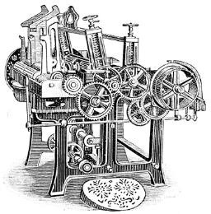
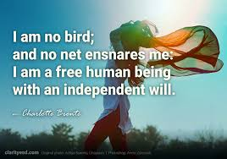
The control/freedom relationship
Consider how this law is false
for a machine.
Control
Freedom

Slide 13
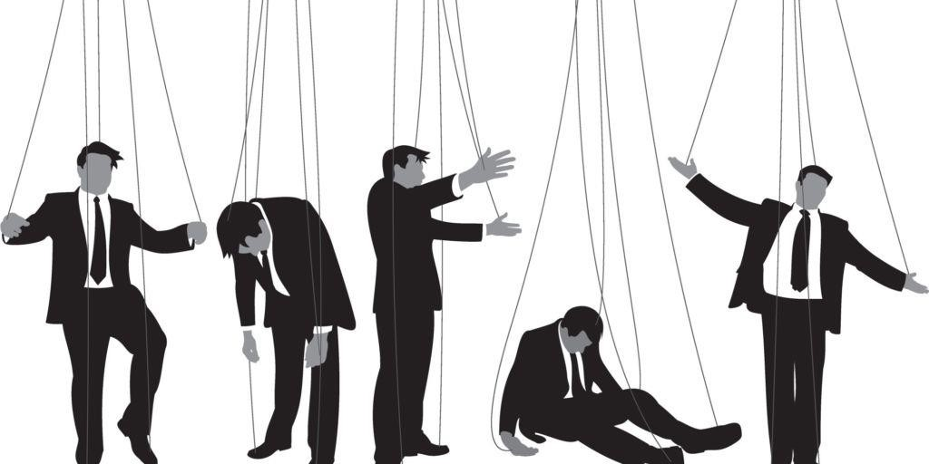
The leadership control illusion

Slide 14
Heroic leadership traps
I know the answer.
I am smarter than my team.
I know what to do.
I am not vulnerable.
I don’t need support.

Slide 15
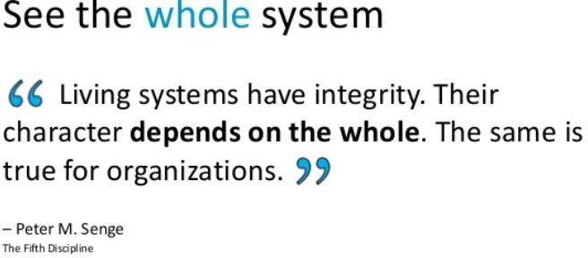
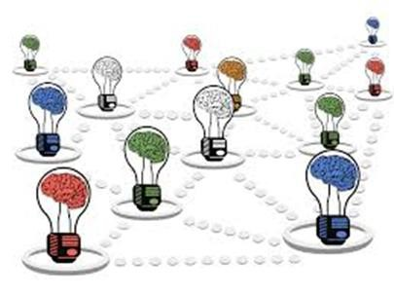
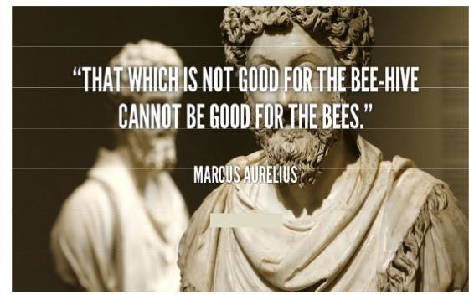
From individual (part) to collective (whole) intelligence

Slide 16
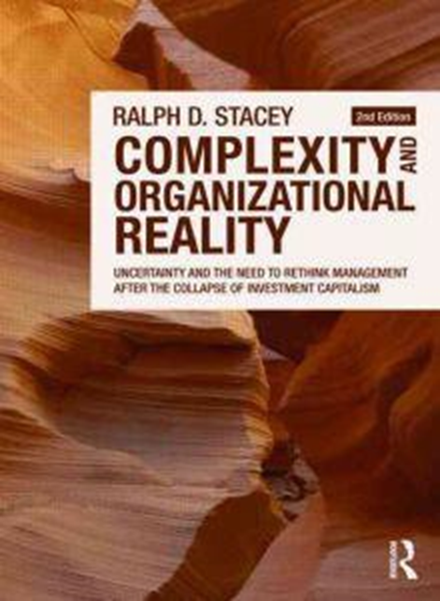
Leadership at the ‘Edge of Chaos’
Natural adaptation leads to increasing ‘closedness’ (order) in a human system
Leaders should lead toward, not away, from the edge of chaos.
The job of leadership is to create the conditions for self-regulation, rather than control.

Slide 17
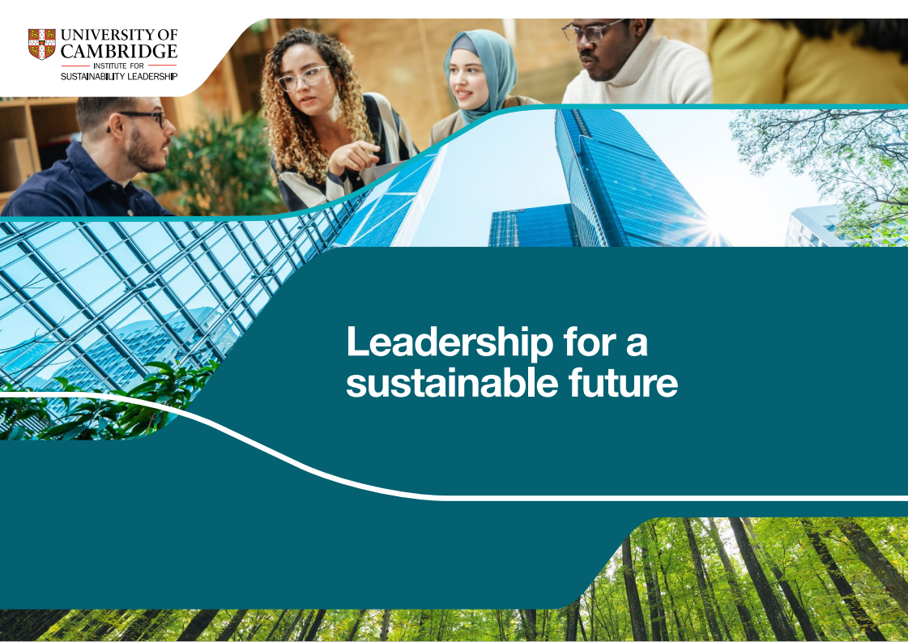
The Leadership we need for the 21st Century
www.cisl.cam.ac.uk/news-and-resources/publications/leadership-sustainable-future
Notes:
Delivering a sustainable future makes sound commercial sense
With the right conditions there is a significant growth market for the long-term
You can deliver business/organisational success in service of thriving societies- long term wellbeing for all
We want this to become the norm – a new business as usual

Slide 18
"Leadership as a dynamic social process within a specific place (context), which maximises the contribution of others towards the achievement of a meaningful purpose”
© CISL
Notes:
Leadership is not simply a set of capabilities possessed by an individual or a position held, but also:
A purpose – a clear meaningful goal that inspires leaders and followers to operate in service of specific ends
A process – a dynamic relational collective discursive and creative process of influence that shapes behaviour and organisational culture- generated in the interactions among people and emerging from the spaces between them – a relational, collective, discursive and creative process of influence. [Read more link]
Context-specific – is embedded in and shaped by culture and place and more widely by economies and societies

Slide 19
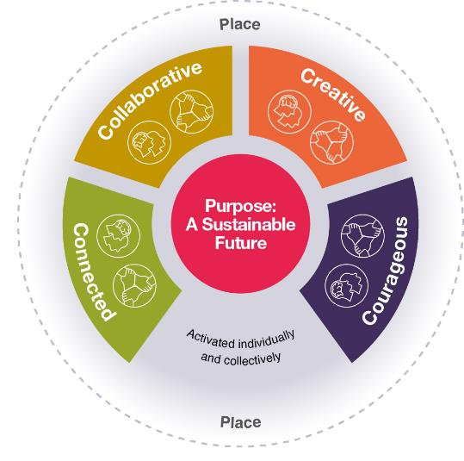
Leadership for a Sustainable Future
Collaborative
Leadership that is inclusive and works in alliance with others across boundaries to achieve collective change.
Creative
Leadership that experiments and innovates with curiosity, optimism and purpose.
Purpose
Leadership that is in service of and accountable for achieving a sustainable future.
Place
The various dimensions of context at both a broad and detailed level, over space and time, which shape how and why leadership is practised.
Connected
Leadership that navigates the complexity and connectedness of life and nurtures the relationships that underpin the systems on which we all depend.
Courageous
Leadership that knows the values that it stands for and nurtures the courage, integrity and resilience to pursue societal good.
© CISL

Slide 20
From Principles to Practice
Collaborative Leadership
Connected Leadership
The principle that characterises the way in which we work together collectively for a sustainable future
The principle that lays the core foundations for the pursuit of a sustainable future
Creative Leadership
Courageous Leadership
The principle that brings the energy and imagination for change towards a sustainable future
The principle that drives the agency and resilience to act for a sustainable future
Gabrielle Chanel
© Victoria and Albert Museum, 2023
ISBN: 978 1 83851 039 8 (Hardback)

Slide 21
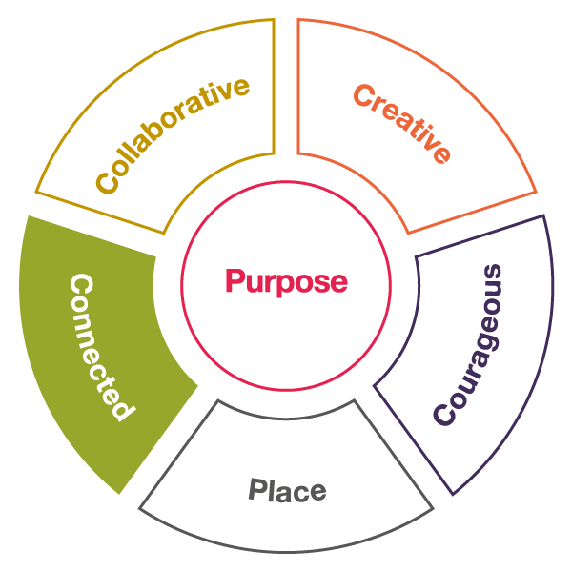
Connected leadership
Leadership that navigates the complexity and connectedness of life and nurtures the relationships that underpin the systems on which we all depend
Connected
© CISL
Connected leadership is the principle that lays the core foundations for the pursuit of a sustainable future

Slide 22
Connected mindset and practices
Connected mindset
Connected practices
Embraces a big-picture, systems view that appreciates the interconnections and relationships between the parts of the whole and seeks insights from multiple perspectives.
Sees patterns and underlying structures that help navigate and make sense of complexity.
Appreciates our critical dependency on each other, wider society and nature for thriving economies, lives and places.
Create stories that make sense of complexity, bringing meaning and direction for others.
Foster nurturing and empathetic relationships with both humans – through deep listening and authentic engagement, and with nature – learning from living systems.
Build key impacts and dependencies – human, societal and nature – into robust economic and organisational decision-making.

Slide 23
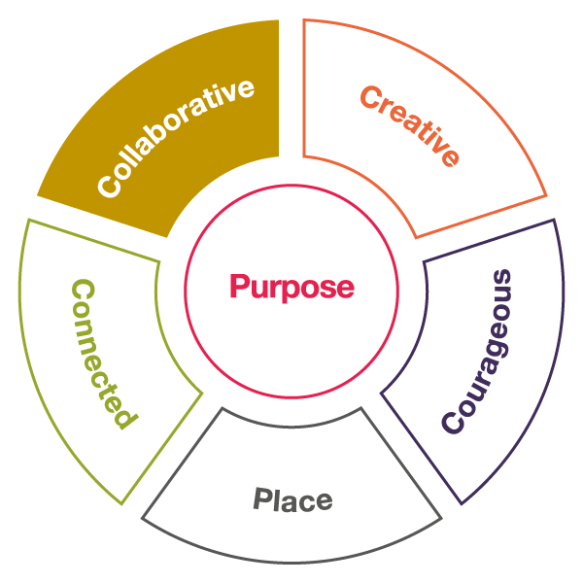
Collaborative leadership
Leadership that is inclusive and works in alliance with others across boundaries to achieve collective change
Collaborative leadership
Collaborative leadership is the principle that characterises the way in which we work together collectively for a sustainable future
© CISL

Slide 24
Collaborative mindset and practices
Collaborative mindset
Collaborative practices
Actively welcomes and values different people and perspectives, parks ego and self-regulates own contribution to ensure the inclusion of others.
Is committed to the power of collective agency and unlocking the potential of working towards a shared purpose and solutions.
Recognises the impact of power and privilege, opposing those dynamics that exclude or diminish certain people or groups.
Build the capacity to span boundaries, foster exchange and mobilise diverse actors to contribute to collective action.
Understand and leverage existing relationships of power in particular contexts and remove barriers to inclusion.
Encourage collective clarity on purpose, roles, responsibilities and decision rights, systems and processes, and accountability for results.

Slide 25
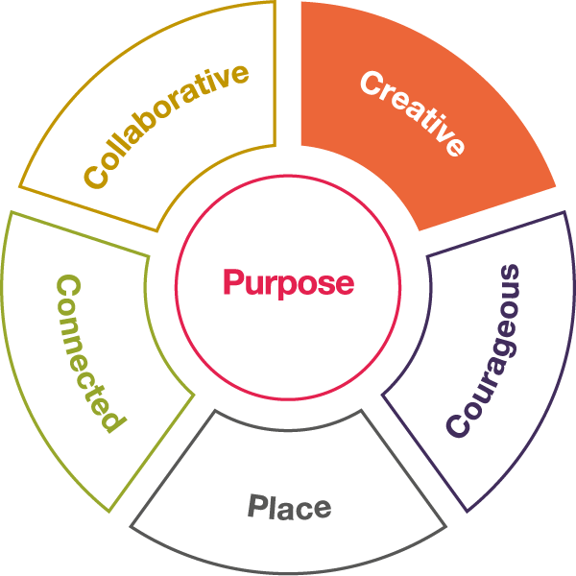
Creative leadership
Leadership that experiments and innovates with curiosity, optimism and purpose
Creative leadership
Creative leadership is the principle that brings the energy and imagination for change towards a sustainable future
© CISL

Slide 26
Creative mindset and practices
Creative mindset
Creative practices
Nurtures a humble, open curiosity and a willingness to disrupt and adapt.
Appreciates the emergent nature of creativity, and the importance of harnessing creative tension.
Understands experimentation and failure as an essential part of learning and growth, is willing to take thoughtful risks and is open to new possibilities.
Seek information, ask questions of the particular context, listen to feedback, and engage in reflective practice, learning and unlearning.
Enable generative conversations that use the creative value of tension to surface new ideas and innovative solutions.
Build psychologically safe learning cultures that support purposeful experimentation and risk-taking.

Slide 27
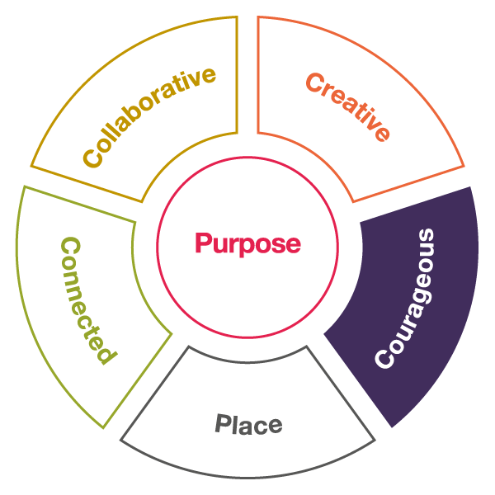
Courageous leadership
Leadership that knows the values that it stands for and nurtures the courage and resilience to pursue societal good
Courageous leadership
Courageous leadership is the principle that drives and agency and resilience to act for a sustainable future
© CISL

Slide 28
Courageous mindset and practices
Courageous mindset
Courageous practices
Has the moral courage and sense of accountability to pursue societal good wherever possible, and own the consequences of challenging decisions.
Withstands challenge, is comfortable with discomfort, and perseveres and grows in the face of setback, through a purpose and values based confidence.
Is vulnerable, authentic, open and humble, and able to self-evaluate and adapt accordingly.
Consider ethical and moral dimensions in a systematic, transparent and collective way, surfacing the implications for key decisions.
Practise brave acts in the smaller things to build moral courage and confidence.
Undertake regular self-reflection and examination, informed by feedback.

